Slide 1
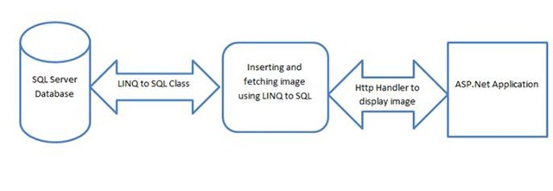
BIT 285: (Web) Application Programming
Lecture 14: Thursday, February 19, 2015
Bug Tracking

Slide 2
Bug Tracking

Slide 3
Why track bugs?
There’s too much stuff for you to track yourself
Deadlines, figuring out what the program should do, features you’re writing code for, the rest of the stuff in your life, etc
Makes it easier to report out to others
E.g., current project status, expected stability, etc
This will record the history of the bug someplace where you can find it again
Makes it easier to reassign bugs to other people
If you’re on vacation, or just got a high-priority bug that you need to jump on

Slide 4
Best Practices from Joel Spolsky
“Every good bug report needs exactly three things.
The MINIMAL Steps to reproduce,
What you expected to see, and
What you saw instead.”

Slide 5
Best Practices from Joel Spolsky
Someone creates it: it’s assigned to someone
“every bug needs to be assigned to exactly one person at all times, until it is closed.”
“A bug is like a hot potato: when it's assigned to you, you are responsible to resolve it, somehow, or assign it to someone else.”
Programmer resolves the bug
“When a bug is resolved, it gets assigned back to the person who opened it.”
“This is a crucial point. It does not go away just because a programmer thinks it should. The golden rule is that only the person who opened the bug can close the bug. ”

Slide 6
Best Practices from Joel Spolsky
Read this article when you get a chance.
It’s quick and has a very good story illustrating the stuff we just talked about.

Slide 7
Other ‘Best Practices’ Articles
From Axosoft
Good list of stuff to look at
Less prescriptive than Joel Spolsky’s stuff
From pipefy
Semi-generic list
Good visuals ☺
(Pipefy and axosoft sell bug-tracking software)
StackExchange posts / discussions:
Project Management SE
Good discussion
Redmine (an OSS web app for managing projects)
JIRA is another app in this same space

Slide 8
GitHub’s Issue Tracking

Slide 9
GitHub has issue tracking
https://guides.github.com/features/issues/
Let’s take a quick spin through it now
Game: Issue Volleyball / Pong: one person creates an issue, then assigns to the next person the team, who assigns it to the next person the team, until it ends up back with the creator
You may need to edit your profile

Slide 10
GitHub: close a bug from a commit
http://stackoverflow.com/questions/3547445/closing-multiple-issues-in-github-with-a-commit-message

Slide 11
Exercise: ‘Bug Bash’
Each person should find and log 1-3 bugs
[15-20 minutes]
The group then needs to triage each bug
How important?
Assign bugs to people
[15-20 minutes]
Each person should fix 1 bug
Check the code into GitHub
Label the issue ‘resolved’ in the issue tracker, close it and assign it back to the creator
Creator signs off on it and removes the ‘resolved’ label
(or else reactivates it ☺ )

