Slide 1
BIT 286: (Web) Application Programming
Lecture 07: Tuesday, January 27, 2015
Git

Slide 2
Adminis-trivia
Looks like 3 groups have finished the ‘Team Formation’ activity
4th and 5th need to be done by the time I grade it today
3:20pm+
The ‘Statement Of Needs’ was posted over the weekend
Please create accounts in StudentTracker and sign up for BIT 286
(this is how I’ll show you your grades)

Slide 3
Coding In A Group: Best Practices
What’s in the repository always works
Modulo bugs, of course
Do test while developing
So you’ll check in a completed feature and the tests for it
This might mean checking in a document with a checklist to manually verify
Do NOT develop the code and then go back for a 'QA' phase!!
These are required for this class!

Slide 4
Conflicting Changes (Review from last lecture)
Let’s walk through a merge conflict first
and then you can do this on your own to practice

Slide 5
Exercise: Conflicting additions to the repo
The following will cause a conflict:
You and your collaborator should:
Pull (fetch + merge) the most recent changes
Pick a file and both add a new first line to each copy of that same file
You should add and commit
Collaborator should commit + push to server
You should fetch, then merge
At this point git will warn you that there’s a conflict in that file
You can’t commit until you resolve that conflict
You should select the ‘conflicted’ file and click on ‘Add’
Dialog will appear asking you to fix the conflict
Edit the file in a separate editor (e.g., Visual Studio), then save it. DO NOT OPEN IN NOTEPAD
Click the ‘Add’ button (to close the dialog box), then commit. This will resolve the merge

Slide 6
Exercise: Conflicting additions to the repo
Look at the file that contains the conflict. It’ll look like:
<<<<<<< HEAD MY FIRST LINE ======= CONFLICTING ADDITION! >>>>>>> 672c79e8e9ef582edc24e23ce9619544fd9cface This is my distinctive first message!
MY FIRST LINE
This is my distinctive first message!
CONFLICTING ADDITION! This is my distinctive first message!
My change
Collaborator’s change

Slide 7
Exercise: Conflicting additions to the repo
In order to resolve the conflict:
Look at the changes, and decide what is the right thing to do
This means you need to understand what the code should do
Edit the file to do what you want
Then remove all the <<<,===, >>> stuff
Let’s keep both lines, but put the collaborator’s line first:
CONFLICTING ADDITION! MY FIRST LINE This is my distinctive first message!

Slide 8
Conflicting Changes (New Material)
Let’s practice this

Slide 9
Exercise: Semi-independent group coding
GOAL: Practice writing code at the same time, and merging your changes
One person should create a C# project in Visual Studio
Use a console application (it’s simple)
Create the project inside your repo’s directory (so that you can re-use your existing repo)
Commit and push that project to GitHub
All team members must now pull (fetch+merge) that VS project
Each person must add a new function, which must be called from main
Function ideas:
Print out the integer numbers from 1 to 100
Print out the integer numbers from 100 down to 1
Given an array, print it’s contents
Ask the user for an integer number, print a message telling them whether it’s even or not
Once everyone’s ready, merge them all together
Suggestion: merge the code person by person, with the active help of everyone else
NEXT ITERATION: Do this again, but see how little help you need from your peers

Slide 10
Branches

Slide 11
Branches
Easy, quick branches are one of git's strengths
You may (or may not) use it, but it's good to know about it.
I recommend that you not use it until you get more comfortable with git
Let's walk through http://git-scm.com/book/en/v2/Git-Branching-Branches-in-a-Nutshell
Visualizer to help you understand this: http://onlywei.github.io/explain-git-with-d3/#checkout

Slide 12
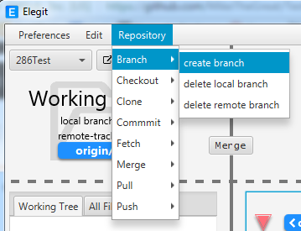
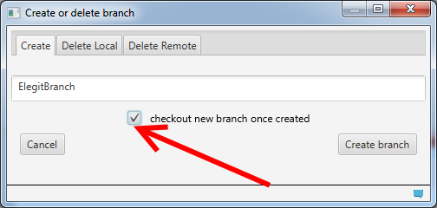
Create a new branch

Slide 13
Checkout: Copy files from <tree> to working dir
https://git-scm.com/docs/git-checkout: “Updates files in the working tree to match the version in the index or the specified tree. If no paths are given, git checkout will also update HEAD to set the specified branch as the current branch.”

Slide 14
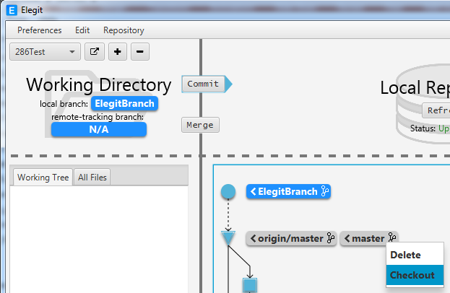
How to switch branches in Elegit
You must click on the branch label (the “<ElegitBranch>” box, or the “<master>” box) NOT on the circle/triangle/square next to the label
There’s also a ‘checkout different branch’ button at the bottom-left
“git checkout <branch>: To prepare for working on <branch>, switch to it by updating the index and the files in the working tree, and by pointing HEAD at the branch. Local modifications to the files in the working tree are kept, so that they can be committed to the <branch>.” (still from https://git-scm.com/docs/git-checkout)

Slide 15
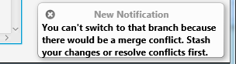
How to switch branches in Elegit
Once you’ve switched you can do work on the new branch
It’s completely independent of the other branches
This is particularly nice if you need to multitask: bug fixes, hot fixes, multiple features at once
What if you’ve staged work?
Notice that you can have merge conflicts between branches, just like you can have with changes from someone else

Slide 16
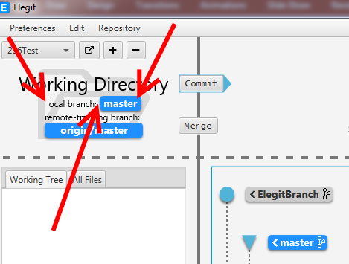
Merge two local branches
First, make sure that you’re working on the ‘destination’ branch
Normally the ‘master’ branch
This will let you merge your work from the side-branch into your master branch
Doesn’t have to be the master branch
You can even fetch/merge/push side-branches back up to the master branch on GitHub, if you wanted

Slide 17
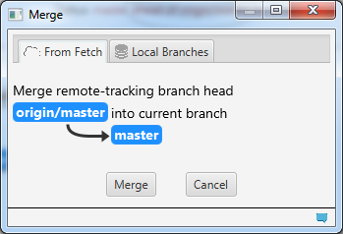
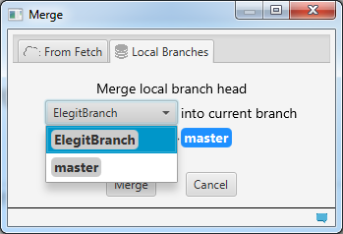
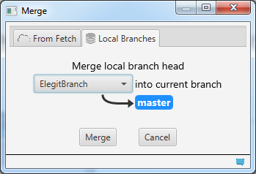
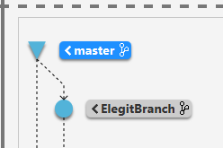
Merge two local branches Next, click ‘merge’ button

Slide 18
Exercise: Branch, change, merge
On your own:
Create a local branch + check it out (switch to it)
Modify a text file
“Added on branch BRANCHNAME by YOURNAME” is probably a good message ☺
Merge your changes back into the master branch
Make another change to your new branch
Merge that second back into the master branch
Do what you need to in order to push your changes on the master branch back to GitHub
Notice that your other branch is NOT pushed to GitHub – just the master

Slide 19
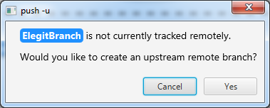
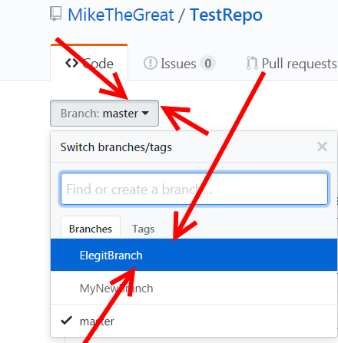
Pushing a side branch to GitHub
Make sure you’re on the branch you want to push
Click on ‘Push’, and you’ll see:
Click ‘Yes’
Elegit will push this branch to GitHub
You can then verify that it’s there
This can allow a couple of team members to work on a feature on the side / independent of the main work

Slide 20
Exercise: Working with someone else on a branch
Branch, change, and commit locally
Push THAT BRANCH to GitHub
Partner pulls and modifies their copy
Partner pushes their work to GitHub
You then download and merge that work into that same branch
Repeat several times, passing the work ‘back and forth’

Slide 21
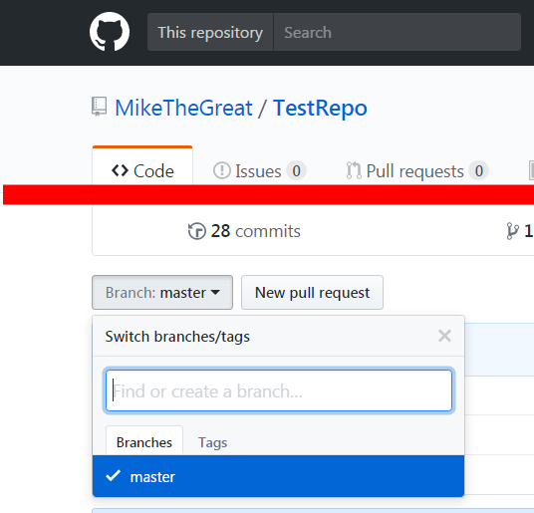
Create a new branch in GitHub
This will also switch you to the new branch (sorta like “checkout the new branch”)
B/c GitHub makes you commit after each change you don’t need to worry about staged changes.
This can be handy for creating new branches on your own, in order to practice with branches

Slide 22
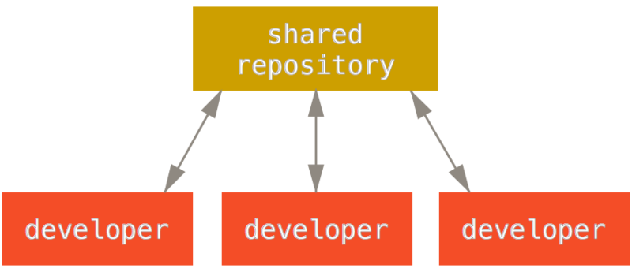
Working In A Group: Centralized Workflow
Single, shared, "master" repository
Pull the most recent changes from there, push your work back to it
CLASS REQUIREMENT: You must commit your work individually so that the instructor can see your work
Pro Git: Contributing (Private small team model)
(There's an example that may be helpful – ignore the command line options and instead )
Pro Git: Distributed Workflows

Slide 23
Developing the Project Concept Document

Slide 24
Project work
Read through the Statement of Needs (5 min)
Find a doc about Common Core that explains expectations of students finishing first grade (10 minutes)
Feel free to share with your group as you find stuff
Brainstorm ideas individually (10 minutes)
Brainstorm ideas as a group (15 minutes)
Ideas up that you thought up individually and/or thought up in a group
We’ll work on the Project Concept Document next class (As we learn Slack)

