Slide 1
BIT 286: Web Applications
ASP.Net MVC

Slide 2
Objectives
Applied
MVC overview
Controllers
Intro to Routing
Views
‘Convention over configuration’
Layout files
Passing info from controller to view: ViewBags
Models
Define a class that corresponds to a row in a DB table
Define a custom connection string
Start to grok the magic of Entity Framework (an ORM – Object-Relational Mapping layer)
Bringing it all together
Create a controller with full set of CRUD methods, including views. All ‘for free’ – VS does it for you!

Slide 3
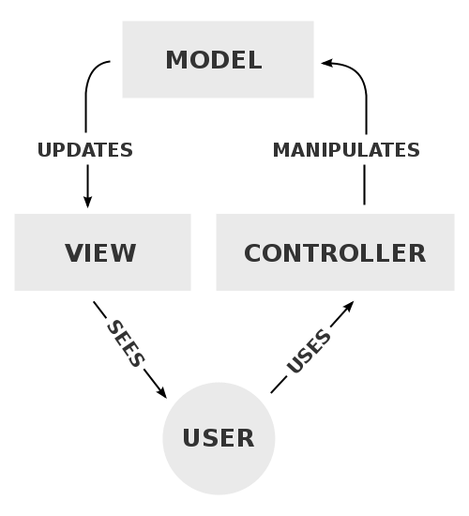
MVC: Model-View-Controller
(from Wikipedia)

Slide 4
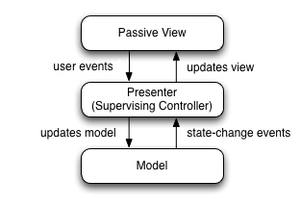
MVP (MVC in CakePHP, ASP.Net MVC)
From Wikipedia

Slide 5
MVC Overview
Model
DB interaction: SELECT, UPDATE, etc
Validation code
View
Renders web page
Controller
Receives input from prior page, decides what to do (including pulling stuff out of DB, storing stuff into DB, etc)
Selects which View to then render
Or redirect to another page, etc

Slide 6
First steps with a controller
Basic game plan: walk through the following tutorials, with Fun Bonus Commentary by your professor
https://docs.asp.net/en/latest/ tutorials/first-mvc-app/
Notes:
Previous version:
http://www.asp.net/mvc/overview/getting-started/introduction/getting-started
http://www.asp.net/mvc/overview/getting-started/introduction/adding-a-controller

Slide 7
Getting started: New project, new controller
New Project → Web → ASP.Net Web Application → Web Application
MVC by default
This will take a while
VS seems to now “install a copy of everything locally” (vs. DLL Hell)
Once that’s done then use the Debug → Start Debugging menu option
Add a controller:
Solution Explorer: right-click on ‘Controllers’ folder, select ‘Add’→New Item, then pick ‘MVC Controller Class’
Notice
The new controller (“HelloWorldController”)
The new view folder (“Views→HelloWorld”)

Slide 8
New Index, Welcome
// GET: /HelloWorld/ public string Index()
{
return "This is my <b>nifty</b> action..." + DateTime.Now;
// THIS IS BEING ESCAPED, INSTEAD OF FED TO THE BROWSER
}
//
// GET: /HelloWorld/Welcome/
public string Welcome()
{
return "This is the Welcome action method...";
}
Control+F5 to run the web app locally

Slide 9
Routing
/[Controller]/[ActionName]/[Parameters]
This is set up in the Startup.cs file:
public void Configure(…)
{
// <snip> …
app.UseMvc(routes =>
{
routes.MapRoute( name: "default",
template: "{controller=Home}/{action=Index}/{id?}"); });
}

Slide 10
URL-based Parameters to controller methods
In the controller:
public string Welcome(string name, int numTimes = 1) {
return HttpUtility.HtmlEncode("Hello " + name + ", NumTimes is: " + numTimes);
}
Run your application and browse to the example URL (http://localhost:xxxx/HelloWorld/Welcome?name=Scott&numtimes=4).

Slide 11
Using the default ‘id’ parameter
Try going to http://localhost:X/HelloWorld/Welcome/3?name=Rick
Notice that NumTimes is the default, 1
Change the controller code to
public string Welcome(string name, int ID = 1) { return Microsoft.Extensions.WebEncoders.HtmlEncoder.Default.HtmlEncode( "Hello " + name + ", NumTimes is: " + ID); }
Go back to Try going to http://localhost:X/HelloWorld/Welcome/3?name=Rick
Notice that ID is now three ☺

Slide 12
Nicer URL
We’re using a query string because the thing after ‘/Welcome’ didn’t match the {id} part of the format
Let’s fix that now!
routes.MapRoute(
name: "Hello",
url: "{controller}/{action}/{name}/{numTimes}"
);
Go to /localhost:XXX/HelloWorld/Welcome/Scott/3

Slide 13
First steps with Views
http://www.asp.net/mvc/overview/getting-started/introduction/adding-a-view
Generating web pages by concatenating HTML strings together is terrible
You want the web designer people to be able to create beautiful HTML in Dreamweaver (etc)…
….while the developers can focus on the application logic.

Slide 14
Change the controller’s Index method:
public ActionResult Index()
{
return View();
}
In the Views folder, right-click and ‘Add Folder’, named HelloWorld.
In Views→HelloWorld, right-click and select Add→New Item→MVC View Page, keep the default name (Index)

Slide 15
What to put in the View (Index.cshtml)
@{ ViewData["Title"] = "Index"; }
<h2>Index</h2>
<p>Hello from our View Template!</p>
Right click & “View In Browser”
http://localhost:xxxx/HelloWorld

Slide 16
Changing the layout affects ALL pages
Change the app’s title in Views→Shared→_Layout.cshtml
Layout == container
@RenderBody() is where the page-specific stuff is put
Change <title> to “Your App’s Name”
Notice how all the pages change

Slide 17
Views→_ViewStart.cshtml
Common ‘header’ for all views
Already defines the layout option
Can change in your view file
Or set to null to not have any layout

Slide 18
How to change this page’s individual title
@{ ViewData["Title"] = “MY AWESOME INDEX"; }
<h2> MY AWESOME INDEX </h2>
<p>Hello from our View Template!</p>

Slide 19
Passing data from controller to view
New file: Views→HelloWorld→Welcome.cshtml:
@{ ViewData["Title"] = "About"; } <h2>Welcome</h2> <ul> @for (int i = 0; i < (int)ViewData["NumTimes"]; i++) { <li>@ViewData["Message"]</li> } </ul>
In Controllers→HelloWorld.cs…
public IActionResult Welcome(string name, int numTimes = 1) { ViewData["Message"] = "Hello " + name; ViewData["NumTimes"] = numTimes; return View(); }
Go back to http://localhost:xxxx/HelloWorld/Welcome/Bob/2/

