Slide 1
Sit in front of a computer
Log in, go to course web page at
http://faculty.cascadia.edu/mpanitz/BIT286
Introduce yourself to folks around you
Buckle up and prepare for Mr. Toad's wild ride!

Slide 2
BIT 286: Web Application Programming 2
Instructor: Mike Panitz
Lesson 01
Course Orientation;
Team Formation

Slide 3
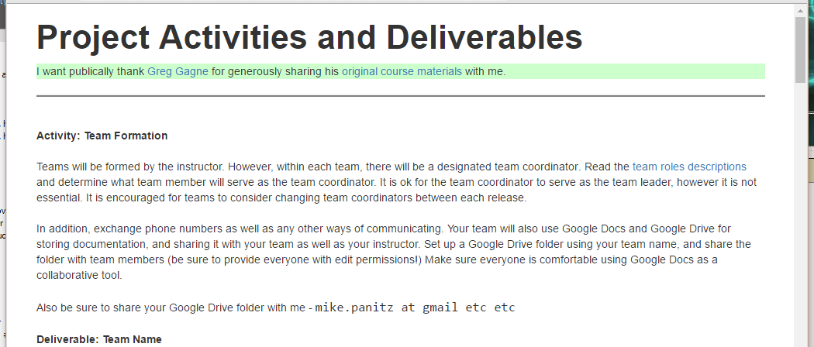
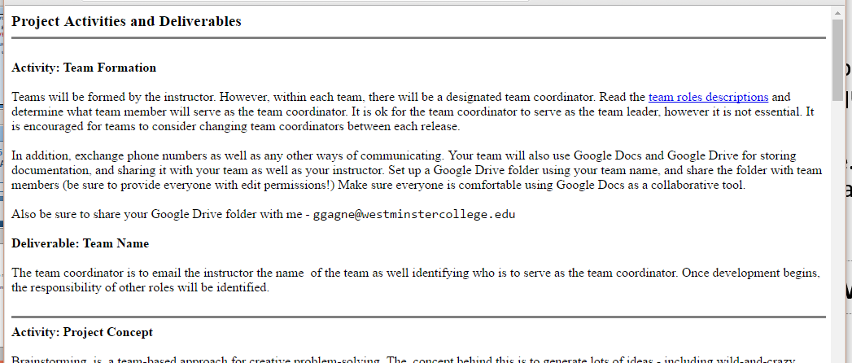
Website Warning
I’m borrowing another instructor’s course materials (with permission ☺ ) so there’s probably going to be lots of details that I didn’t quite fix up before I posted them.
Also – some of the links will go back to the original website. Feel free to read/skim these original website pages, but understand that only pages posted on my web site are ‘binding’ for this course.
I’ll put a ‘thanks to the original author’ band at the top, and style it with Bootstrap
YOUR WEBSITE Original Website

Slide 4
BIT286: Web Applications
Official Web Site: http://faculty.cascadia.edu/mpanitz/BIT286
Classroom: CC1-170
Class Times: Monday/Wednesday 11am - 1:15pm
Instructor: Mike Panitz
Instructor Email: MPanitz@cascadia.edu
Instructor Office: CC1-319 (top floor, hallway ‘behind’ the elevator)
Instructor Office Hours: < TBA >
or by appointment

Slide 5
Syllabus and Grading
Syllabus: Listed on the ‘Home’ tab for the course web page
Assessments | Points
Total of Agile.EDU assignments | 185
Technical Quizzes 5 points each, we will have from zero to ten of these throughout the quarter | 0 to 50 depending
 | 185 to 235

Slide 6
Required Software/Tools
Dreamspark https://www.dreamspark.com/
On the Hub: http://onthehub.com/download/free-software/
Windows
Visual Studio 2017 Community Edition
Microsoft SQL Server (for ICEs)
Cascadia VMWare Views (for remote access)
Microsoft Azure (6-Month Student account through invite)

Slide 7
The Big Idea
This course is being split down the middle:
1)Project management / software engineering (SE) lite
➔Using whatever you learned in BIT 285⬅
2) More MVC (make a REST API, maybe other stuff)
The plan is to alternate between SE and tech lessons
This way you’ll have some time to complete the SE work outside of class
Many of the SE lessons will have in-class work that you’ll need to finish outside of class for the points
The SE lessons will be mostly/all group work – each group can hand in a single copy of the work

Slide 8
The Big Idea
This course is being split down the middle:
1)Project management / software engineering (SE) lite
➔Using whatever you learned in BIT 285⬅
Notes:
I would like to emphasize this part ☺

Slide 9
Any Questions So Far?

Slide 10
Quarter overview
Let’s look at Greg Gagne’s presentation about his ‘Agile.EDU’ approach
(There’s a link on the website)

Slide 11
Divide up into groups
9 students registered ➔ 3 groups of 3
First cut: who can meet when?
Additional criteria:
Skill balance – someone who’s confident in programming, someone who’s good with people, etc
Gender balance – 4 women in the class, let’s aim for 2 women on 2 teams
(Research indicates that being the only woman/URM/etc in a group makes it harder for that one person)
Pre-existing interpersonal relationships
Then – ice breakers!

Slide 12
Ground Rules for Group Work
Come up with some ground rules for group work
Communication
How often you’ll meet, and when, and where
How you can contact each other outside of class meetings
Expectations for responsiveness (24 hours? Same working day? Different on weekends?)
How will work get done
Don’t leave it till the night before! Instead, how many days before the deadline should stuff get finished?
Talk about strategies for monitoring group progress, how to talk to each other when you’re concerned about a deadline, etc

Slide 13
Software Engineering / Project Management
It’s important to have some systematic approach
Even if it’s the wrong one for your project it can still serve as a starting point for discussing pros/cons & finding a better one
We’re going with an amalgamation of stuff ☺
It won’t write the software for you
It’s a process to make sure that you dot your i’s and cross your t’s
It’ll keep you organized while working through the project
But you still need to know which technologies to use, when, why, and how

Slide 14
Lecture 01: In-Class Exercise
From the menu bar, select Lectures and go to the Lectures 01 bar and select Lecture 01 ICE to begin working on today's in-class exercises.

