Slide 1
Lesson 10

Slide 2
Plan for today
NO QUIZ
Project Status document – estimation exercise
Project Work Day

Slide 3
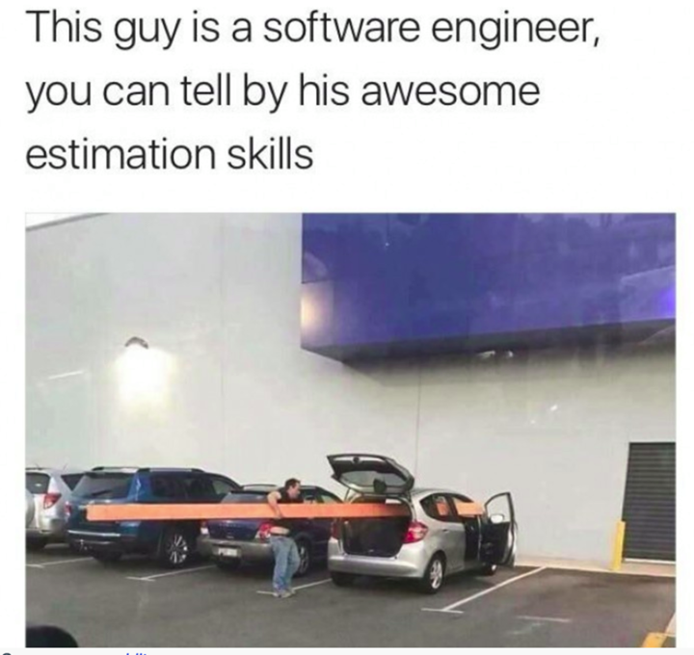

Slide 4
Feeback: Project REQUIREMENTS doc
Y’all need more detail on what you’re doing
Y’all mostly have a liste of features, not requirements (Ex: “Subtraction game”)
Ex: Who’s going to create the database?
Y’all are underestimating how much time it will take
Right now it’s ok - This is a natural stage of professional development
You’ll have a better handle on this after R1 is finished
We still need to work on this skill, though

Slide 5
Status document Estimation exercise
For TODAY:
Each person must pick a small task off your status document and then do it.
Track your time while doing the task.
In class we’ll have a discussion about how much time it took vs. how much time you thought it would take
Reflection: Did the amount of time that you actually took line up with your estimate?

Slide 6
Start work on your project!!
At this point you should start work on your project
Note: this is an ‘ongoing’ homework assignment, even though I’m not assigning due dates (other than the R1, R2 due dates)
Grant me (the instructor) permission to view each of your GitHub repos!
TeamFAM
Team Kismet
JASONS
÷ And Conquer

Slide 7
R1 Rubric Modified
I modified it so that “Actively communicates with Group” is now on there
You need to communicate with your group in ways that I can see
Y’all must use Slack
CC me on emails
If you’re using anything camtelse arrange with me to see that, too
Active Group Communication (this is per-person) | Instructor did not see the individual communicate with the rest of the group, or “just once or twice” | Instructor saw the individual communicate a very small number of times | Instructor saw the individual communicate with the rest of the group, but in a passive and / or minimal way | Instructor saw the individual communicate well with the rest of the group | Instructor saw the individual do an excellent job of both leading discussions and supporting teammates

