Slide 1
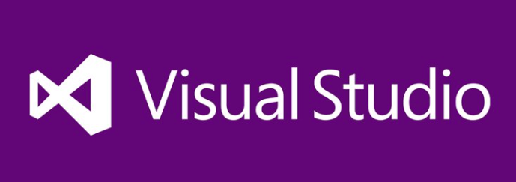
BIT 286: Web Applications
ASP.Net Core Web API - Basics

Slide 2
Agenda
Note: about requirements doc
Ignore the points for now - we will do ‘planning poker’ on the day that this is due
Email me so I can invite you to the BIT 286 Slack Team!
ASP.Net Core Web API
Brainstorming Quiz questions About 20 minutes before class ends:

Slide 3
Brainstorming Quiz questions
About 20 minutes before class ends:
Join the BIT286 class Slack team (invites will be sent out during class)
Y’all will brainstorm quiz questions for about 10 minutes
Anything you might want to see on a quiz you should post to #quiz-questions
I’ll be posting stuff, too
We’ll go over ‘likely’ candidate questions in the last 10 minutes of class
Quiz at the start of next lecture
Questions will be drawn primarily BUT NOT EXCLUSIVELY from our brainstorm

Slide 4
Objectives
Try creating a simple REST based web application, using ASP.Net
Use ASP.Net Core Web API
Use Postman to test the REST API
Instead of creating a full-on JS client

Slide 5
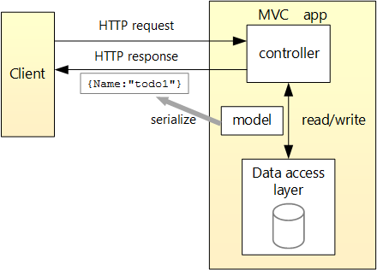
Review: REST API architecture
From https://docs.microsoft.com/en-us/aspnet/core/tutorials/first-web-api

Slide 6
.Net: Core vs. Framework
Tl;dr: .Net Framework is last-gen. It’s being replaced with .Net Core
VB → Web Forms → MVC
We’re going to be using .Net Core in this class

Slide 7
Installing the software

Slide 8
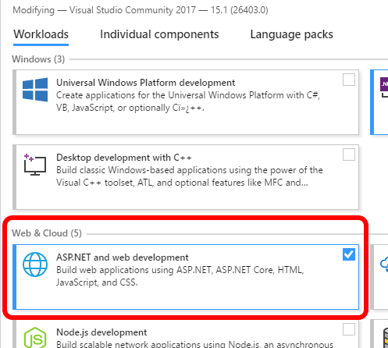
Install Visual Studio 2017
You’ll need to add the ‘NuGet package manager’, plus the “ASP.Net and web development” workload
Run the VS 2017 Installer, then click on the ‘Modify’ button
Note: this may take a long time
We’ll also use Postman
There’s a Chrome app for this
https://chrome.google.com/webstore/detail/postman/fhbjgbiflinjbdggehcddcbncdddomop

Slide 9
Basic Web API project
We’re going to follow along with https://docs.microsoft.com/ en-us/aspnet/core/ tutorials/first-web-api

Slide 10
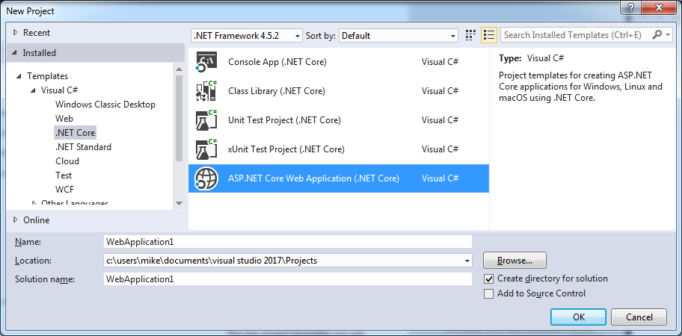
Create the Solution

Slide 11
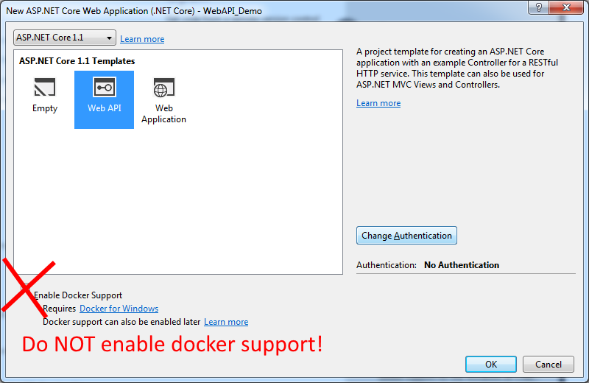
Use the Web API template

Slide 12
Install a test Database
InMemory DB
all records stored in memory
You’ll lose all data when you quit the program
Great for testing, terrible for real use ☺
https://docs.microsoft.com/en-us/ef/core/providers/in-memory/
We’ll do this using NuGet

Slide 13
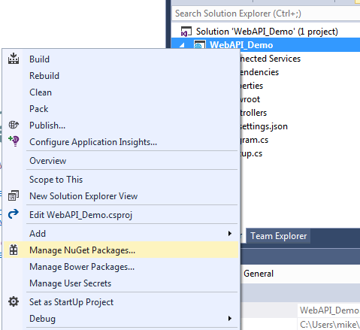
Install a test Database
We’ll install it using NuGet
NuGet is a package manager for Visual Studio
It’s included >= VS 2012
NuGet:
Right-click on the project
Select ‘Manage NuGet Packages’
More details at https://docs.microsoft.com/en-us/nuget/tools/package-manager-ui

Slide 14
Add the test DB
Click on ‘Browse’, then paste in Microsoft.EntityFrameworkCore.InMemory
When you mouse over it you’ll see the ‘install’ icon appear

Slide 15
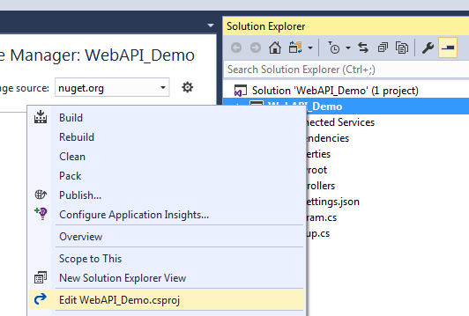
Add the test DB
At this point the software is installed
We just need to tell this particular project to use it

Slide 16
Modify the .csproj file
Make sure this line is present:
(for me it was already there when I went looking for it)
<Project Sdk="Microsoft.NET.Sdk.Web"> <PropertyGroup> <TargetFramework>netcoreapp1.1</TargetFramework> </PropertyGroup> <ItemGroup> <Folder Include="wwwroot\" /> </ItemGroup> <ItemGroup> <PackageReference Include="Microsoft.AspNetCore" Version="1.1.1" /> <PackageReference Include="Microsoft.AspNetCore.Mvc" Version="1.1.2" /> <PackageReference Include="Microsoft.Extensions.Logging.Debug" Version="1.1.1" /> <PackageReference Include="Microsoft.EntityFrameworkCore.InMemory" Version="1.1.1" /> </ItemGroup> <ItemGroup> <DotNetCliToolReference Include="Microsoft.VisualStudio.Web.CodeGeneration.Tools" Version="1.0.0" /> </ItemGroup> </Project>

Slide 17
Add Database support

Slide 18
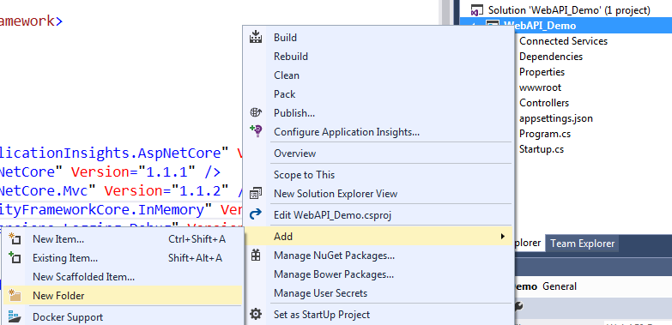
Create a Models folder
There’s no ‘Models’ folder, so let’s make one
Right click on the project, then Add→New Folder:

Slide 19
Add a Todo.cs to the Models folder
namespace WebAPI_Demo.Models // This will be specific to you
{ public class TodoItem
{ [Key] [DatabaseGenerated(DatabaseGeneratedOption.Identity)]
public long Key { get; set; }
public string Name { get; set; }
public bool IsComplete { get; set; {}
}
}

Slide 20
Examine code, Make sure it compiles
A Todo object represents a single row in the database
Looking at the code:
From https://docs.microsoft.com/en-us/aspnet/core/tutorials/first-web-api:
“The [Key] data annotation denotes the property, Key, is a unique identifier.”
“[DatabaseGenerated specifies the database will generate the key (rather than the application).”
“DatabaseGeneratedOption.Identity specifies the database should generate integer keys when a row is inserted.”
Build the program: Build → Build Solution

Slide 21
Add a DbContext
From http://www.entityframeworktutorial.net/EntityFramework4.3/dbcontext-vs-objectcontext.aspx :
Handles all the translation between your objects and the actual database
For example, given a LINQ-to-Entity it will generate the SQL to query/add/update/delete rows in the database
Add the file
Right click on the ‘Models’ folder
Add Class
Name it TodoContext.cs (so it’s easy to find ☺ )

Slide 22
Add a DB context
using Microsoft.EntityFrameworkCore; namespace WebAPI_Demo.Models
{
public class TodoContext : DbContext
{
public TodoContext(DbContextOptions<TodoContext> options)
: base(options)
{
}
public DbSet<TodoItem> TodoItems { get; set; }
}
}

Slide 23
How does TodoContext work?
It inherits from the DbContext, which does all the work
public class TodoContext : DbContext
{
DbContext must use magic reflection to inspect each object in order to be able to know how to map it to SQL and back
General description: Wikipedia
Warning: a bit dense – skim it to get the gist of it, but don’t worry about details
C#-specific docs

Slide 24
Next step: add a repository class
First, this is a terrible re-use of the word repository
Second, this is implemented via dependency injection
What is Dependency Injection?
Let’s say that you’ve got two classes, Car and Engine.
Normally each Car object will create an Engine for itself, usually in the constructor
We can say that the Car object depends on (it uses) the Engine object
Instead of having the Car create an Engine object, we will give it an Engine to use. AKA, we will inject the Engine object into the Car, which the Car then uses (the Car then depends on).

Slide 25
Next step: add a repository class
Key Benefit: We can now replace the Engine with other classes that also behave like Engines
Example: We could test our Car using a TestEngine which also logs the things it’s being told to do. We then check the log later to make sure the the Car was telling the Engine the correct things
Example: What if the Car object can save itself to a database? With DI, we could give it a different database object, and save itself into a different DB (for example, an Oracle DB instead of a MySQL)
Google for ‘dependency injection simple explanation’
‘Simple’ explanation #1
‘Simple’ explanation #2

Slide 26
Create the Repository class ( ITodoRepository.cs, in the Models folder)
using System.Collections.Generic; namespace WebAPI_Demo.Models { public interface ITodoRepository { void Add(TodoItem item); IEnumerable<TodoItem> GetAll(); TodoItem Find(long key); void Remove(long key); void Update(TodoItem item); } }

Slide 27
Should we review interfaces here? ☺

Slide 28
TodoRepository.cs (also in Models folder)
Entire code is right above https://docs.microsoft.com/en-us/aspnet/core/tutorials/first-web-api#register-the-repository
From the same link:
“By defining a repository interface, we can decouple the repository class from the MVC controller that uses it. Instead of instantiating a TodoRepository inside the controller we will inject an ITodoRepository using the built-in support in ASP.NET Core for dependency injection.”

Slide 29
Repository: Inheritance
using System.Collections.Generic;
using System.Linq;
namespace WebAPI_Demo.Models
{
public class TodoRepository : ITodoRepository
{
private readonly TodoContext _context;
public TodoRepository(TodoContext context)
{
_context = context;
if (_context.TodoItems.Count() == 0)
Add(new TodoItem { Name = "Item1" });
}

Slide 30
Implementing the ITodoRepository interface 1 / 2
public IEnumerable<TodoItem> GetAll()
{
return _context.TodoItems.ToList();
}
public void Add(TodoItem item)
{
_context.TodoItems.Add(item);
_context.SaveChanges();
}
public TodoItem Find(long key)
{
return _context.TodoItems.FirstOrDefault(t => t.Key == key);
}

Slide 31
Implementing the ITodoRepository interface 2 / 2
public void Remove(long key)
{
var entity = _context.TodoItems.First(t => t.Key == key);
_context.TodoItems.Remove(entity);
_context.SaveChanges();
}
public void Update(TodoItem item)
{
_context.TodoItems.Update(item);
_context.SaveChanges();
}

Slide 32
Register the repository
In Startup.cs, find the method named ConfigureServices()
Replace it with
public void ConfigureServices(IServiceCollection services)
{
services.AddDbContext<TodoContext>(opt => opt.UseInMemoryDatabase());
services.AddMvc(); // already present
services.AddScoped<ITodoRepository, TodoRepository>();
}

Slide 33
Register the repository
In Startup.cs, add the following to the top of the file:
using WebAPI_Demo.Models;
using Microsoft.EntityFrameworkCore;

Slide 34
Dependency Injection
https://davidzych.com/dependency-injection-in-asp-net-vnext/

Slide 35
Adding a controller

Slide 36
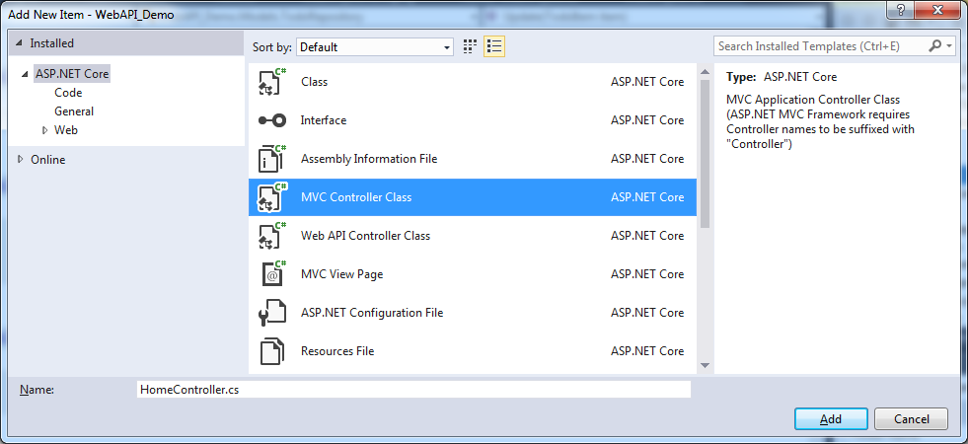
Add the controller file
Right click on the Controllers folder, Add → New Item
You want MVC Controller class.
Make sure it’s for .Net Core
Name it TodoController.cs

Slide 37
I’m going to switch it up from here
Creating the slides takes a lot of time
And it’s all being copied from that tutorial page anyways
So instead of showing you everything, we’re going to try something new:
➔ Slides will be used as notes

Slide 38
Copy from tutorial
From https://docs.microsoft.com/en-us/aspnet/core/tutorials/first-web-api#getting-to-do-items

Slide 39
Controller - Routing
Routing can be done with attributes:
[Route("api/[controller]")]
public class TodoController : Controller
[controller] placeholder:
The class name without the ‘Controller’ part
“TodoController” – “Controller” = “Todo”
URLs will start with <server info>/api/todo
NOTE: Routes are case INsensitive in ASP.Net Core – Todo, todo, ToDo, tOdO all work
Example:
http://localhost:51070/api/todo <server info>/api/[controller]

Slide 40
Controller - Routing
More Details:
Attribute Routing Overall
Placeholders: The [controller] thing

Slide 41
Routing details
[HttpGet] // matches /api/[controller]
public IEnumerable<TodoItem> GetAll()
{ return _todoRepository.GetAll(); }
Example: http://localhost:51070/api/todo - goes to GetAll
Example: http://localhost:51070/api/todo/3 - goes to GetById
[HttpGet("{id}", Name = "GetTodo")]
public IActionResult GetById(long id)
{ // ‘Name’ in HttpGet is for internal (code) purposes

Slide 42
Run it
Control + F5, then wait for the browser to appear
Let’s play experiment with the browser results a bit
WARNING: when your browser window closes, the web server shuts down
Then let’s experiment with Postman for a bit
With the browser window still open ☺

Slide 43
Create
‘CreatedAtRoute’ is a method that returns an object that will eventually become an HTTP 201 response
This includes a ‘Location’ field
Postman – POST
{ "name":"walk dog", "isComplete":true }

Slide 44
Update
Note – must send the entire object
Can use HTTP PATCH for just sending the delta
We’re not handling PATCH requests here
Postman
PUT request
http://localhost:51071/api/todo/2 ⬅ 2 is the id of the thing to update
Must include the entire object (including ‘key’, which is weird ☺ )
{ "key": "2", "name":"walk dog woooo it’s chaaaaaaanged!“, "isComplete":false }
204 (No Content) is the ‘success’ response

Slide 45
Delete
Postman – DELETE verb

Slide 46
Debugging
Set a break point in Visual Studio
Launch the ASP.Net Core web app via Debug → Start Debugging
Have the browser (or Postman) make a request that will execute the breakpointed code
Visual Studio auto-magically stops where your breakpoint is!

Slide 47
Where to go next?
Logging
Get information from your web app about what’s happening on the server
Critical for debugging
Can be set up to be viewed in Visual Studio
Client – JavaScipt
jQuery?
Angular?
React?
Vue?
Note: Frameworks are arranged in descending order of instructor familiarity ☺

