Slide 1
Log in to the computer in front of you
Temp account: 235class / Win@2020
Update your email in Cascadia's system
If I need to email you I'll use this address
Google for "Cascadia Student Toolbox"
You are required to read your email at least once every 24 hours
Set up Canvas notifications for discussions
There’s info in the 'Orientation' page
You are required to read all announcements and discussion board messages at least once every 24 hours.
Introduce yourself to the people around you
Notes:
Note that posting 1 question & 1 answer to the Google Group will be part of Lesson 02's Post Class Exercises!

Slide 2
BIT 143: Programming –Data Structures
Instructor: Mike Panitz
(mpanitz@cascadia.edu)
Weds, 11am till 1:05pm, On Zoom

Slide 3
tl;dr
Get Visual Studio
Visual Studio 201x Community Edition is great
If not, you can use Cascadia’s computers, on-site or remotely (https://desktop.cascadia.edu)
The lesson 01 exercises (both coding and video-watching) are due at midnight of the same class day as this one, next week
As long as you get the work done on time then any hand-in errors will be forgiven ☺

Slide 4
Exams happen on Canvas, at a specific time
For Lesson 01 you must either:
Confirm that you can make the exams
-OR-
Make alternate arrangements for the exam
If you fail to make alternate arrangements then you must take the exam during the day & time listed on the course web page.

Slide 5
REALLY IMPORTANT: ‘NUnit’ material in Lesson 01
I added several short videos and an exercise to Lesson 01
They’re at the bottom of the list of topics
MAKE SURE YOU CAN GET THIS TO WORK!!
(Or show up in class next week with questions and I’ll help you get this to work)

Slide 6
Vision for NUnit material
This week learn what NUnit is and verify you can get it to work
Next week actually get some unit tests to pass. The tests aren’t related to the rest of the lesson
Starting the week after that: the work you do for each lesson will have tests for that lesson’s work

Slide 7
StudentTracker is gone
We’ll use Canvas for the first couple of weeks, then switch to GitHub
We’ll use Canvas for me to send you grades and feedback

Slide 8
Canvas is the new new thing
I’m still learning Canvas. If something seems weird and/or you saw another teacher do something awesome and would like me to do that too, please talk to me about it!
I may make changes to the hand-in procedure after I get feedback from BIT 115 trying it out later today

Slide 9
Vision for Git / GitHub material
This week learn what git and GitHub is and verify you can get it to work
Next week actually do some work via git/GitHub. These exercise(s) aren’t related to the rest of the lesson
Starting the week after that: you will download the starter project from GitHub, do your work, and upload (submit) your work there too

Slide 10
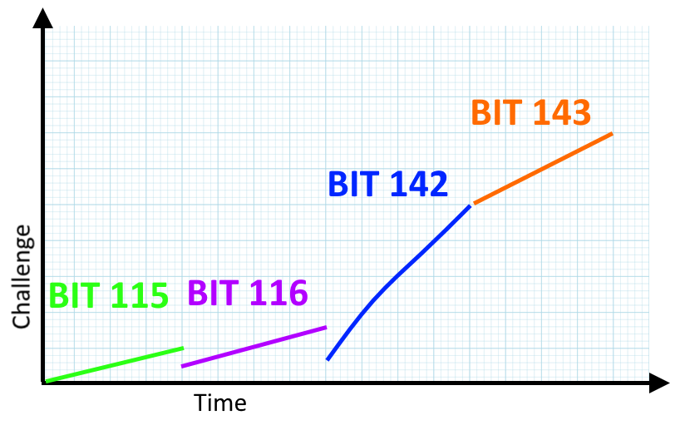
Rising Expectations for 142/143
.
‘Graph Paper’ image from https://openclipart.org/detail/184567/plain-graph-paper, image is in the public domain.

Slide 11
Hybrid (Sync) vs. “Online” (Async)
Online students:
No points for in-class work
Attendance is therefore optional
Class is valuable preparation for the week’s work
OL students CAN attend class
Except for the exams – you MUST show up on time for exams
Dates are listed on the course website

Slide 12
Hybrid vs. “Online”
Hybrid students:
10 points for each class meeting
2 point quiz on prior Lesson
10 points for participation
The exams are still given during class
You can switch between them by emailing me during the first or second week of the quarter

Slide 13
Hybrid vs. online
Think of hybrid as “online, plus guided help sessions before each week’s work starts”
Each hybrid class will be a 'real class'.
There will be structure activities for you to do
You will be encouraged to work together in pairs / small groups
Which one should you sign up for?
There's an ungraded quiz in Lesson 01 to help you think about this decision

Slide 14
Syllabus
YOU are responsible for knowing the syllabus!
If info isn’t on here, you should ask before it’s an issue.
We won’t be talking about grading, etc, here in class.
Instead, there’s an online quiz (in Canvas) that you’re required to get 100% right (or else lose points)
Notes:
This includes the plagiarism (cheating) policy

Slide 15
Exams happen during sync class time
There are NO ONLY ONLINE EXAMS
If you're an online student start planning for this now!!!!
Exams happen in class on Canvas
You must bring photo ID, which will be checked!
Exam occurs during class time on the date specified
Exam dates are listed on the respective course home page

Slide 16
Syllabus : Book info
BIT 143 uses the book pretty lightly
I would recommend getting it only if you can get it cheaply, or if you’ve got it left over from BIT 142
The edition does not matter
"C# How To Program" is the same as "C# For Programmers"
Section numbers may be slightly off. Please first try to locate the material on your own, then email the Discussion Forum if you can't find it.

Slide 17
Website: Orientation Page
Clearly indicated on the front page / main page of the course
Read this first
Follow all the directions on this page

Slide 18
Website: Main Page
Each Lesson looks like the image on the right
Each has a list of stuff that is due
Each of the Lesson 0x links go to the lesson 0x page, which describes everything in more detail

Slide 19
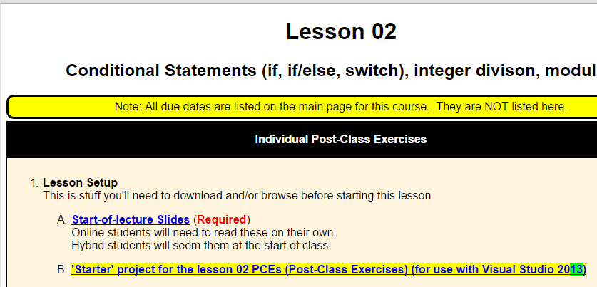
Website: Lesson Page
Each Lesson is about a week of time
EVERYONE is required to read through the ‘start of class’ PowerPoint slides
(In-class or afterwards)

Slide 20
Website: Post Class Exercises (PCEs)
Done INDIVIDUALLY, although you’re welcome to get help from other people, if you need it.
This means that each person must submit their own, unique solution to all the problems.
You are REQUIRED to know all the material, for all the exercises
(i.e., if any of these showed up on an exam, or must be used in a HW assignment, then you need to know it)
You’re only required to HAND IN those items labeled ‘Hand-In’
It’s highly recommended, but not required, that you do all the exercises – do as many as your schedule allows, and as you need to, in order to learn this material!

Slide 21
Occasional Revisions for autograded PCEs
Starting with lesson 03 your code will be autograded.
So it’s easy for me to grade, and regrade
But if I say “No deadlines – hand it in whenever”, nobody will do the work until week 10, then they’ll be overwhelmed

Slide 22
Revisions for autograded PCEs
For the autograded PCEs, you will have a second chance to revise and hand in your work
On the day of the midterm exam you may upload any fully autograded PCEs (and/or Viewing Quizzes) that were due prior to the midterm exam.
On the day of the final exam you are allowed to upload any fully autograded PCEs (and/or Viewing Quizzes) that were due after the midterm exam and prior to the final exam
This replaces the ‘Missing File Extension’ policy

Slide 23
Do NOT plagiarize other people’s work
Examples of code and exam plagiarism include:
Taking the work of someone else (including other students) and turning it in as your own.
Giving your work to another student to turn in as their own.
Getting information about an exam from another student.
Giving information about an exam to another student.
Copying code off the Internet and turning it in as your own.

Slide 24
Do NOT plagiarize other people’s work
If two or more homeworks or exams are found to be suspiciously similar, the burden of proof rests upon the students who submitted the work.

Slide 25
Late Policy, Extension Policy
Goal:
Allow you to hand in something again if you made a mistake packaging up your homework

Slide 26
Late policy for work
Work is due on a day and time
“Work” = PCEs, and homework projects, etc
I will grade the work at or after that time
You’ll get email once the grading is finished
You are encouraged to keep uploading your work until I finish grading it
Once it’s graded then no further uploads will be accepted
EXCEPTION: See next slide

Slide 27
PCE & Homework Extensions
After instructor finishes grading your work you can use an extension to hand in something late
To use your extension: upload the work to StudentTracker and then email me and say that you want to use an extension
Do this even if you’re not sure how many extensions you’ve got
If you haven’t got any left then it will have no effect
No penalty either – you think you might have an extension, then you may as well try

Slide 28
PCE & Homework Extensions
Each person has two (2) extensions
Each extension must be used within 24 hours of when the instructor grades your work & emails you
Each extension can be used once
You can track these on StudentTracker
You can use an extension if:
You didn’t hand in anything
You forgot to include an entire file or files
You cannot use an extension to revise a file that you’ve already handed in

Slide 29
PCE & Homework Extensions tl;dr:
You can hand in missing work as late as 24 hours after you get my email with your grade
You can use an extension if the whole thing is missing
You can use an extension if one or more file(s) are missing
Extensions are NOT revisions

Slide 30
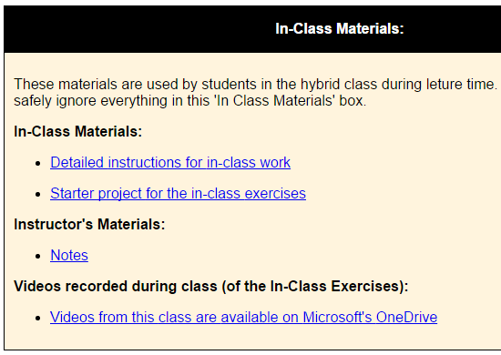
Website: In Class Materials
These are listed at the bottom of each Lesson page
In class materials may be used in class (or not)
Any videos (of the instructor) recorded during class may be posted for later viewing

Slide 31
Visual Studio here at Cascadia
If nothing else you can use VS here at school.
You will need to sign in (to Microsoft's servers) for this to work!
The account is free.
I think of it as being like the Google account sort of thing

Slide 32
BIT 143 Topics for tonight
Getting started with Unit Testing & NUnit
Review OOP
Review the memory model

Slide 33
REMINDER: Lesson 01 work due at midnight, a week from today!
Hybrid Students: Next class will start with a quiz that covers the Lesson 01 material!

