Slide 1
Don’t hack / crack the system!

Slide 2
What you *should* do in this class
Learn a topic
Write a program that demonstrates your knowledge and mastery of that topic
The autograder then verifies that the program appears to function correctly

Slide 3
You are *NOT* allowed to work around the autograder
Example: WRITING CODE TO PASS A TEST, DESPITE NOT DEMONSTRATING KNOWLEDGE
Let’s that that you’re told to write a ‘FindInArray’ method.
Let’s say you notice that one of the tests asks ‘FindInArray’ if the value 8 is present in a specific array. Let’s say that array does contain 8
Thus, the correct answer is for ‘FindInArray’ to return true
Writing a version of ‘FindInArray’ that returns true when asked to find 8 WITHOUT searching the array is NOT OK

Slide 4
Don’t crack / hack the system!
Compromising the system in any way will get you a zero
If I catch you doing this you get a zero AND I go back and re-check everything else you’ve handed in this quarter

Slide 5
What is Unit Testing?

Slide 6
Unit Testing (Definition)
“To write test cases for every non-trivial function or method in the module so that each test case is [as] separate from the others [as] possible.” www.discovercomputers.info/ComputerSecurity/glossary.html
In other words – call every single method/function and manually check that you got the right answer until you’re convinced that it works

Slide 7
Example Function To Test
public bool isPrime( int num) { /*implementation omitted*/ }
Definition of a prime number:
“A prime number (or a prime) is a natural number which has exactly two distinct natural number divisors: 1 and itself.” (Wikipedia)
“The number 1 is by definition not a prime number”

Slide 8
Prime / Non-Prime Examples
5 is prime
5/5 = 1
5/1 = 5
nothing else divides evenly ➔ 5 is prime
6 is not prime
6/6 = 1
6/1 = 6
6/3 = 2 ➔ 6 is not prime
6/2 = 3 ➔ 6 is not prime, definitely ☺

Slide 9
Example Test Cases
public bool isPrime( int num) { /*implementation omitted*/ }
Test with:
small primes (2, 3, 5, 7, 11)
large primes
non-primes (1, 4, 9, 12, 11*17)
zero
negative numbers
Note that we’ve figured out what the right answer is ahead of time
Our unit tests simply ask “Did isPrime(3) produce true, like it should?”

Slide 10
Overview of NUnit

Slide 11
What is NUnit?
A free, open-source framework to help people create their own unit tests for any .Net language
We’ll use it for C#
Related to (“inspired by”) JUnit
JUnit is for Java testing

Slide 12
NUnit’s Goal(s):
Make it quick and easy to create unit tests, and to run those tests, and to get a list of which tests passed/failed.

Slide 13
My expectations of you
For this class, you are NOT required to create your own Unit Tests.
You ARE required to write software that passes tests.
The tests are provided to you, by the teacher
This means that you need to understand how unit tests work

Slide 14
How do I Use NUnit?
The starter project should include all the NUnit materials that you need
This should work on your personal computer
On Cascadia’s computers, you may need to install the “NUnit3 Test Adapter” extension into Visual Studio
You may need to do this *every* time (sorry!)

Slide 15
How to get the NUnit3 Test Adapter working in Visual Studio on Mac
These instructions are for:
Your personal computer

Slide 16
How to get NUnit working in Visual Studio
These instructions are for:
Your personal computer
(Windows or Mac)
The computers at Cascadia

Slide 17
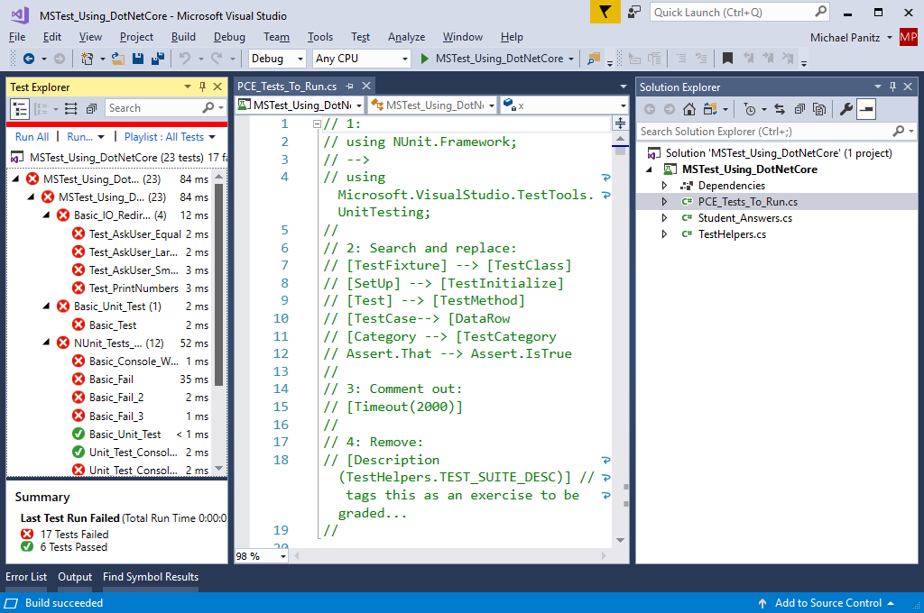
Goal: Visual Studio shows you a list of tests that passed (green) or failed (red) (Image: VS on Windows)

Slide 18
Goal: Visual Studio shows you a list of tests that passed (green) or failed (red) (Image: VS on Mac)

Slide 19
Warning: You will need to fiddle with things
This *may* go smoothly on the first try
But it probably won’t
You should be prepared to fiddle with things a bit
If you can’t get it to work after following these instructions definitely ask questions!

Slide 20
Get The NUnit starter project
Download the starter project, extract it, open it in Visual Studio
Make sure that you’re downloading the correct project!
There’s a separate project for just the NUnit stuff, separate from the starter project for the rest of this lesson!

Slide 21
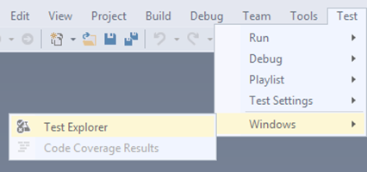
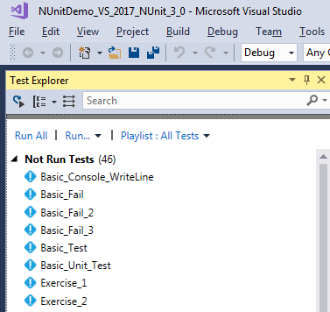
Open Test Explorer
Open the Test Explorer
Windows: Test → Text Explorer
VS on Mac: View → Pads → Unit Tests
You should see the Test Explorer window

Slide 22
Do you see a list of tests?
A list of tests with blue icons is good – next you need to run the tests
(Try clicking ‘run all’ – if you see red/green dots next to the tests then you’re done!)
If you see blank space (or can’t run the tests) then keep going with these
instructions

Slide 23
Easy thing to try #0: Make sure you’ve got the right project

Slide 24
Easy thing to try #1: Compile it
Compile and run the program
Test Explorer can’t find any tests until you compile the program
Debug → Start Without Debugging
Remove all compiled temporary files (using Build → Clean Solution) and Debug → Start Without Debugging again
(The program won’t do anything interesting, but if it runs then you know it compiled)

Slide 25
Easy thing to try #2: ‘Run All’
Once your program has compiled + run, then try:
Within the Test Explorer clicking on ‘Run All’ may cause it to discover the tests

Slide 26
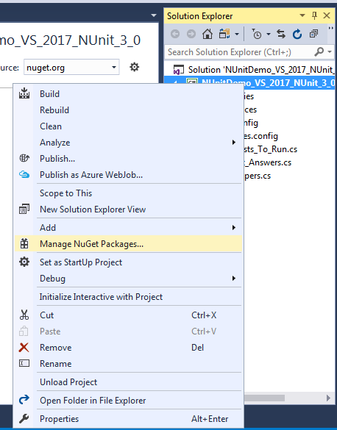
Easy thing to try #3: Update NUnit
Show the Solution Explorer
(View → Solution Explorer)
Right click on the project
Select ‘Manage NuGet Packages’

Slide 27
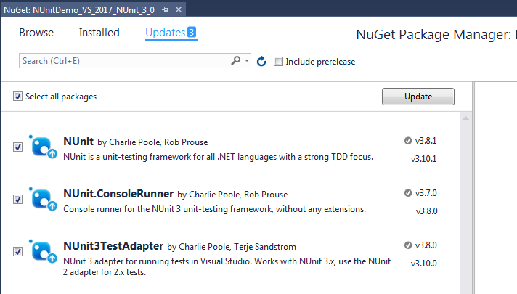
Easy thing to try #3: Step 2
Click on ‘Updates’
Click on ‘Select all packages’
Click ‘Update’ button

Slide 28
Easy thing #3: Step 3
Redo the first two easy things ☺
Re-compile your program
Click on ‘Run All’ in the Test Explorer window

Slide 29
Less easy: Install Nunit Test Adapter Extension
The starter project includes NuGet packages for NUnit and to enable Test Explorer to find the tests
Key point: NUnit is installed into the starter project
If that doesn’t work then we can install NUnit into Visual Studio (instead of the project)
It’s not difficult to do, but it does require several steps, so I’m going to put those steps on separate slides

Slide 30
Windows instructions
How to install the Visual Studio Extension into Visual Studio For Windows

Slide 31
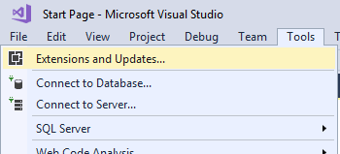
Tools → Extensions and Updates
Within Visual Studio
Click on Tools → Extensions and Updates

Slide 32
Search for NUnit3 online
Click on ‘Online’
Click in the search box at the top-right
Type in “NUnit3”

Slide 33
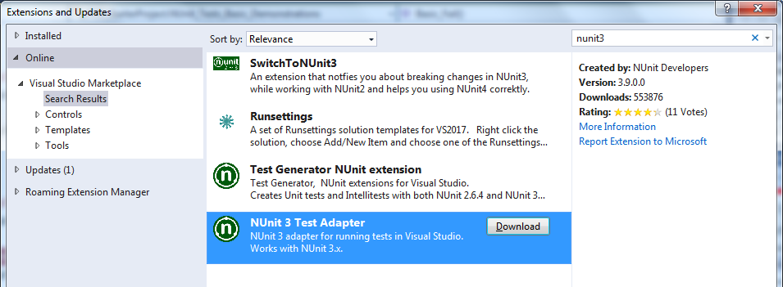
Download NUnit3 Test Adapter
Look for “NUnit3 Test Adapter”
Click on it
It will look like the picture below after you click on it
Click on ‘Download’

Slide 34
Mac instructions
How to install the Visual Studio Extension into Visual Studio For Mac
Much thanks to Mary C. for sending me these screenshots! ☺

Slide 35
Search for NUnit3 online
Click in the search box (at the top-right)
Type in “NUnit3”
Select ‘Search Packages’

Slide 36
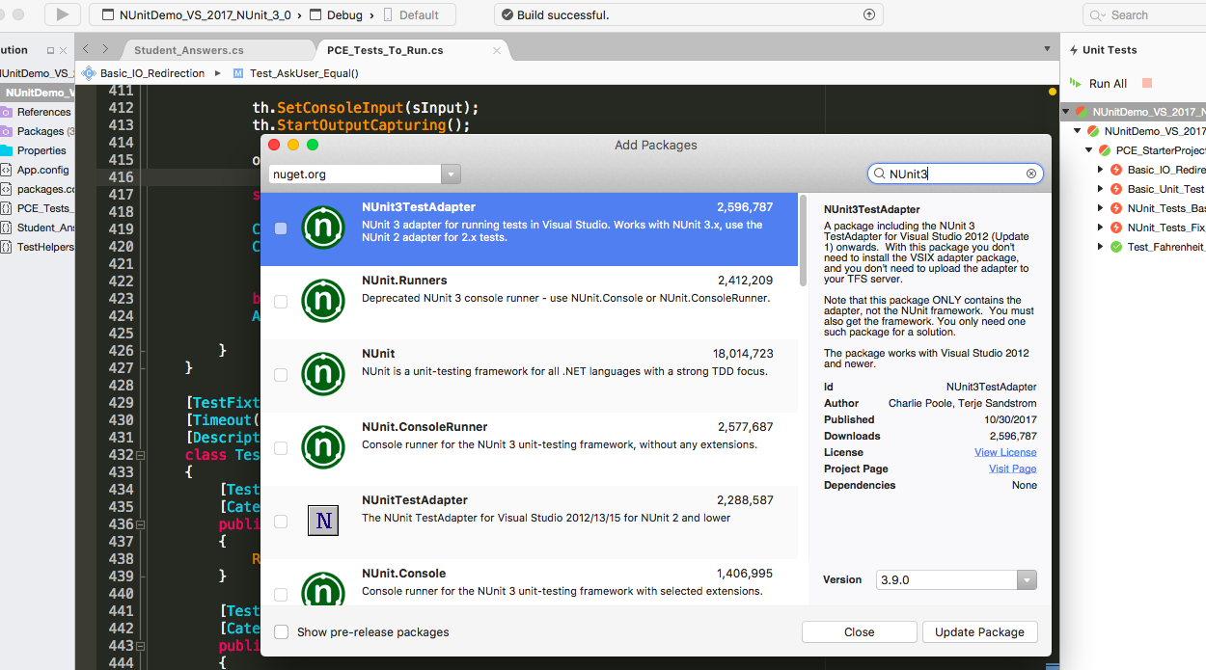
Search for “NUnit3 Test Adapter”
Click on it
It will look like the picture below after you click on it
Click on ‘Update Package’

Slide 37
Retry the earlier actions
Once you’ve installed the extension into Visual Studio go back and retry the earlier actions
Make sure the program compiles
Try running the program
Click ‘Run All’ in the Test Explorer panel

Slide 38
Mac-specific error: ‘32 bit process’
FOR MAC ONLY:
If you can see the tests in Test Explorer but you can’t get them to run, and you receive an internal error that mentions a “32 bit process” try the following steps:
In the solution explorer find the project (not the overall solution, but the specific project), and right click (using two fingers at once) on it
Find the Options menu item and click on that
Go to Compiler then change the Platform Target to X64
Clean all and rebuild

Slide 39
How to run the tests
Using Visual Studio’s Test Explorer

Slide 40
Open the Test Explorer
Test → Windows → Test Explorer

Slide 41
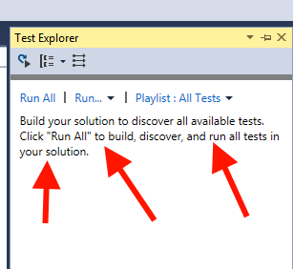
Build the project first
Build → Build Solution

Slide 42
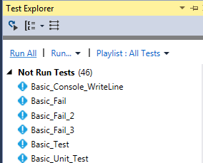
Click ‘Run All’
Before being run, tests are blue (for ‘unknown result’)

Slide 43
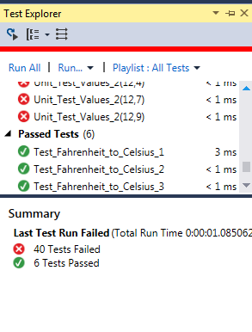
VS Shows you the results
Red means ‘test failed’
Green means ‘test passed’
There’s a summary in the bottom panel

Slide 44
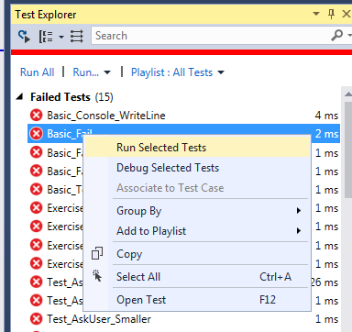
How To Run One Test
Right click on the test you’re interested in
Select “Run Selected Tests”

Slide 45
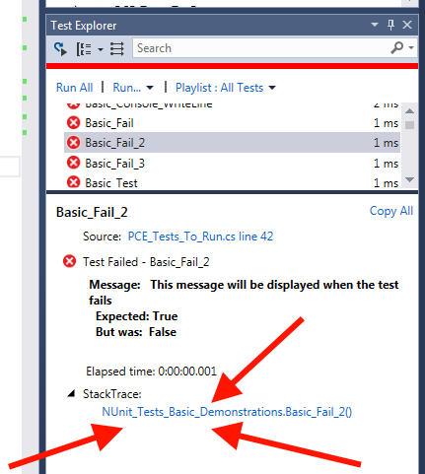
Click on a failing test for more info
Click on the ‘StackTrace’ (arrows at the bottom) & V.S. will show you the line that failed.
Make sure to read the message
Make sure to read the test method!!!

Slide 46
How to find a failing test
Run the test(s) in the Test Window
Get the name of a test that is failing Ex: “Basic_Fail_2”
Edit→ Find And Replace →Quick Find
This will find inside the current file
Edit→ Find And Replace →Find In Files
This will search all the files in your project

Slide 47
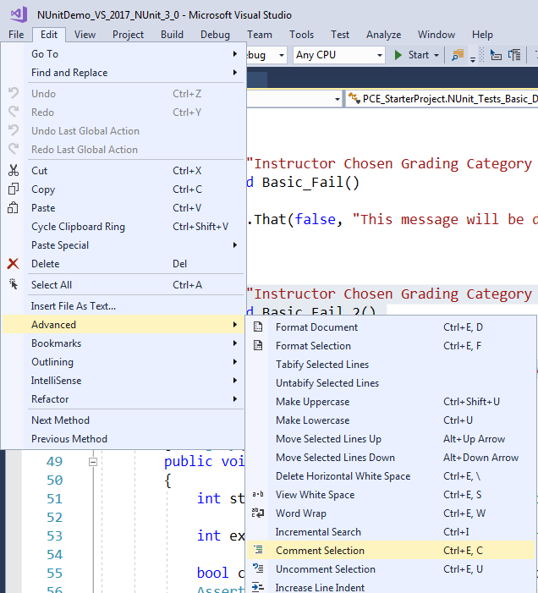
How to disable tests
If you want to disable a test without just deleting it, you can comment it out
VS can comment/uncomment lines for you
Edit → Advanced → Comment Selection
(or Uncomment Selection)
MAKE SURE ALL THE TESTS PASS BEFORE YOU HAND IN YOUR WORK!!!

Slide 48
How To Debug a test
Using Visual Studio’s Test Explorer

Slide 49
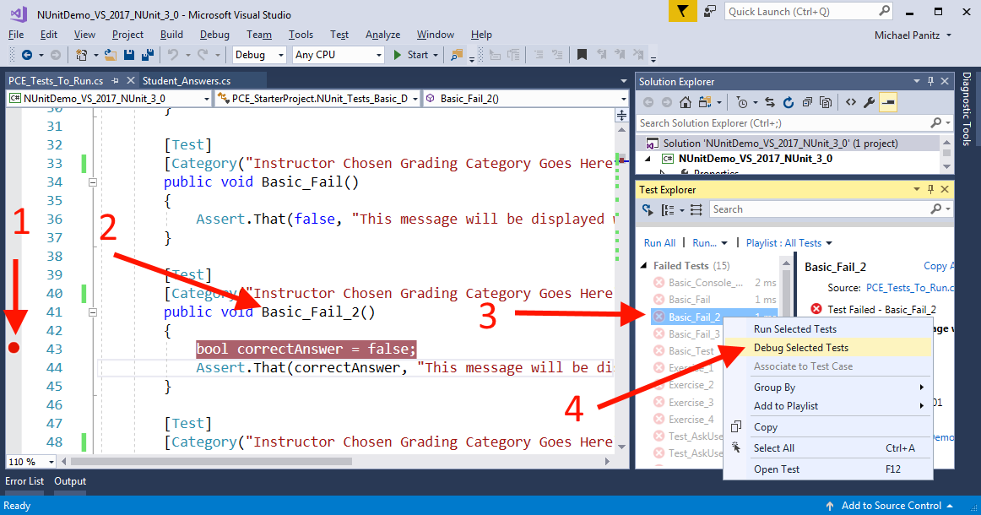
Click to set breakpoint
Remember the name of the test
Find the test in the list
RIGHT-click on the test, select ‘Debug Selected Tests'

Slide 50
Warning: You Must Disable Test Time Limits
The [Timeout(2000)] attribute says that each test has 2 seconds to finish
This prevents tests that are stuck in infinite loops from causing problems ☺
You will need to comment this out
This is located on the class containing the test method
Otherwise, the test will fail after you’ve stopped it in the debugger for 2 seconds ☹

Slide 51
What’s My Grade?
How to figure this out
manually

Slide 52
Calculating your raw grade
Calculate your total grade by adding up the penalties, and adding that to the maximum score
Example: weekly PCE is worth 10 points
Your code’s penalties are -4 points (total)
10 + (-4) = 6 points as the ‘raw’ grade

Slide 53
Calculating your final grade
For homework assignments, your raw grade is your final grade
For weekly PCEs:
If your ‘raw’ grade is 6 points or higher you get an additional 2 points, up to the maximum
Sometimes you’ve learned the topic well, but actually getting the tests to pass 100% is an extra N hours of work

Slide 54
Two approaches
‘Category-based grading’
If any test in a ‘Grading Category’ fails then the category fails and the point penalty for that category is applied to the final score
Penalty is applied ONCE for the entire category
Individually graded tests
Some tests have individual point penalties
If that test fails, the point penalty is applied
Every test will be graded using only ONE of these approaches
Let me know if a test appears to be graded both ways

Slide 55
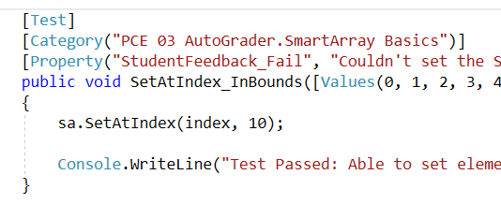
Category-based grading
Look for ‘Category’ attribute
The dot ( . ) separates the display category from the grading category
"PCE 03 AutoGrader.SmartArray Basics” ➔
Grading category is “SmartArray Basics”
Display this test under “PCE 03 AutoGrader”

Slide 56
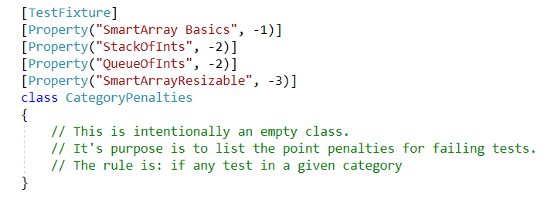
Find category penalty
Find the ‘CategoryPenalties’ class
Next, find the category name and it’s penalty
“SmartArray Basics” has a penalty of -1 points
Sum up your penalties, add that to the max score

Slide 57
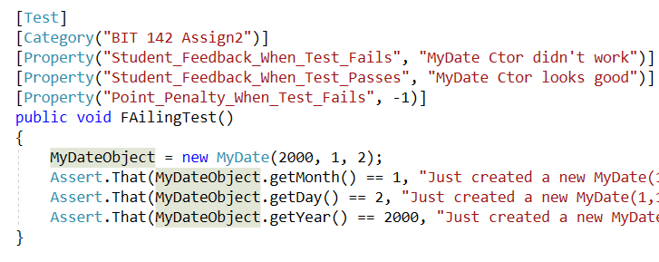
Individually graded tests
If the test as a ‘Point_Penalty_When_Test_Fails’ attribute…
…then it is individually graded

Slide 58
Details of individually graded tests
If the test fails, then the point penalty is applied
In this case, the penalty is -1
Notice that the ‘Category’ attribute only has a display category (“BIT 142 Assign2”) and no grading category
Therefore ONLY the individual penalty applies

Slide 59
Workflow
How will I use NUnit as part of my work in this particular course?

Slide 60
Student Workflow: Work
Download starter project
Examine first exercise, in Word .DOC
Figure out which tests are used in the exercise
Run tests, figure out which ones have failed
Write code to make one (or more) tests pass
Repeat until all tests pass
Repeat until all exercises done

Slide 61
Student Workflow: Hand-In
Check that you did NOT modify the instructor’s code
Let’s say that you’ve named a method “DoWork()”
This compiles just fine by itself
Let’s say that the test uses a method named doWork()
Note the lowercase ‘d’
This test does NOT compile with your code, because your code has no doWork() with a lowercase ‘d’
It may be tempting to ‘fix’ this by changing the test
YOU CANNOT CHANGE THE TESTS!!
Your code will be run using a fresh, original copy of the test

Slide 62
Student Workflow: Hand-In
Check that you did NOT modify the instructor’s code
Download a fresh copy of the starter project
Copy and paste your Student_Answers.cs into it
Make sure it compiles without error
If there are errors, modify YOUR Student_Answers.cs file until the errors are fixed
Then re-do this step (download a new copy and verify that your work does compile cleanly)
Hand in Student_Answers.cs, etc

Slide 63
Instructor Workflow
Run tests to get basic grade
Double-check code
Grade feedback/ other stuff that’s not auto-graded
Finalize grade & email gradesheets

Slide 64
Explanation Of Files
A quick guide to the files you’ll see

Slide 65
Student Work File
For the PCEs, this is typically named Student_Answers.cs
It may be called something else, like Program.cs
This is where YOUR CODE will be put.
You should ONLY MODIFY the files that you’re told to put your work into

Slide 66
File Containing The Tests
For the PCEs, this is typically named PCE_Tests_To_Run.cs
This file contains the actual tests – you’ll want to look in here for the details of a particular test.

Slide 67
TestHelpers.cs
TestHelpers.cs contains stuff that multiple tests, across multiple assignments, make use of
Input/output capturing code
‘Fuzzy’ comparisons

Slide 68
NUnit Details

Slide 69
Code Details: NUnit Tests
You should never need to change or modify these
We’ll look at how the NUnit tests work
If you need to disable a test, you can just comment the whole method out, and the rest of the system *should* just work ☺

Slide 70
[Test] Attribute
Specifies that test will be automatically run (the method will called) by NUnit.
The Test Adapter automatically finds this test and lists the test in the Test Window in VS

Slide 71
Attributes to ignore:
[TestFixture], [TimeOut], [Description]
These are used to tell Nunit about tests

Slide 72
Execution of a test
NUnit ‘magically’ finds the tests to run
(By looking for the [Test] attributes)
Once the test starts, the method runs just like normal code
We can tell NUnit to check that certain things are true at certain points, and fail the test if they’re not true
This is done using the Assert.That command
If the function crashes (or throws exception), then the exception / crash will be caught and the test will fail

Slide 73
Basic (Failing) Test
Assert.That(false, “msg” );
What this does:
Since the first parameter (‘false’) is false, then the test will fail, with the message “msg”
If the first parameter had been true, then the test could continue to execute
What this test does:
It will fail with the message “This message will be displayed when the test fails”

Slide 74
Using Assert.That to check a parameter
bool correctAnswer = false;
Assert.That(correctAnswer, “msg” );
What this does:
If the first parameter (‘correctAnswer’) is false, then the test will fail, with the message “msg”
What this test does:
It will fail with the message “This message will be displayed when the test fails”

Slide 75
More typical pattern
What this test does:
Checks if the student’s answer is the same as the expected answer (studentAnswer == expectedAnswer)
Since the expected answer is 3, but the student’s answer is 1, they are not the same and the test fails
This separates out the ‘is it correct?’ logic from the Assert statement

Slide 76
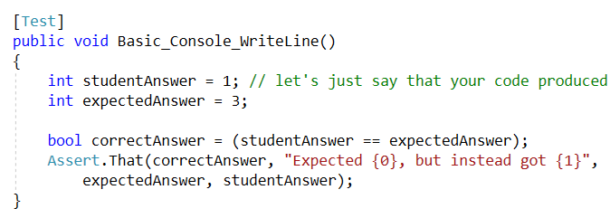
Using Assert Like Console.Write*
Assert.That can use placeholders, just like Console.WriteLine:
What this test does:
Since correctAnswer is false the test will fail with the message "Expected 3, but instead got 1"

Slide 77
NUnit Calls Your Code
Typically, a test will call a method in your code, check the result, and then Assert that your answer is the same as the expected answer
Because the test code is in another project, you MUST make your classes PUBLIC in the Student_Answers.cs file
This will either have been done for you, or else we’ll cover how to create your own classes in C#

Slide 78
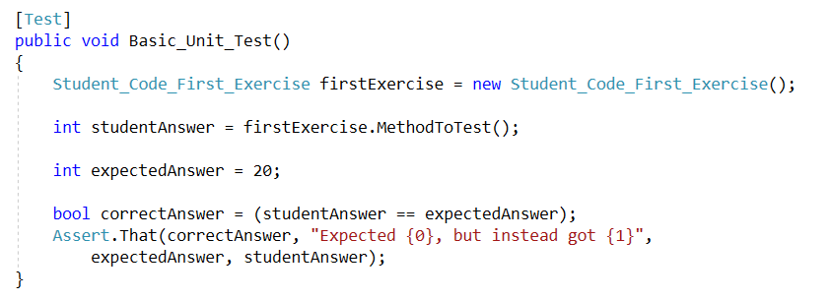
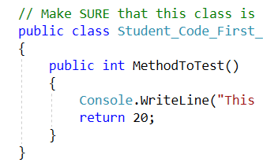
Example of Calling Your Code
This is the first ‘real’ unit test ☺
Call into your code
Check the answer
Pass (or fail) the test

Slide 79
How To Find Code Quickly In Visual Studio

Slide 80
How to find code throughout your project
NUnit tends to spread code through several files
Test code typically goes into a file named something like PCE_Tests_To_Run.cs
Your code (your work) typically goes into a file named something like Student_Answers.cs
It would be nice to be able to find classes, methods, etc quickly
Visual Studio (often) can do this for you
Any other IDE should have similar features

Slide 81
The ‘Find And Replace’ Menu
There’s a lot of options in the ‘Find And Replace’ menu
Get there via: Edit → “Find And Replace”

Slide 82
Quick Find
Edit → “Find And Replace” → “Quick Find”
Then type in what you want it to find
Visual Studio will look for an EXACT match
If you don’t remember the entire thing you can type in just the part that you remember
Visual Studio will ONLY look in the file that’s open and in the foreground

Slide 83
Find In Files
Edit → “Find And Replace” → “Find In Files”
Then type in what you want it to find
Visual Studio will give you a bunch of options. The defaults are fine but you might want to look up the others later when you’ve got time
Visual Studio will (by default) look in ALL the files in the solution.

Slide 84
Quick Find vs. Find In Files
Quick Find is good if want to find something in the same file
Find In Files is good if you don’t know where something is.
It can be a bit slow
It can be a bit harder to use (because it puts the results into a list in a new window/panel)

Slide 85
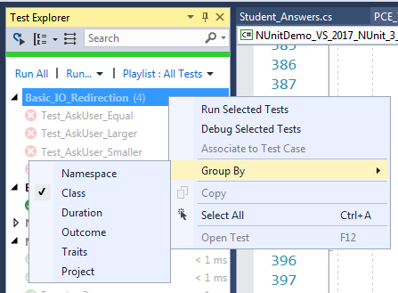
Grouping Tests in Test Explorer
Within Test Explorer you can right-click anywhere in that window
Then select “Group By” and see your options
“Group By” → Class is a good option
The exercises tend to tell you which class contains the tests that you need to work on

Slide 86
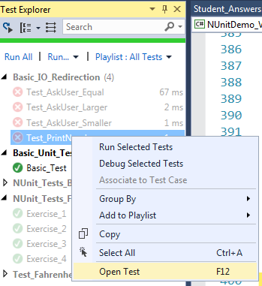
“Open Test” in Test Explorer
Within Test Explorer you can right-click on a specific test
Select “Open Test” and Visual Studio will open the right file and show you that test
+

Slide 87
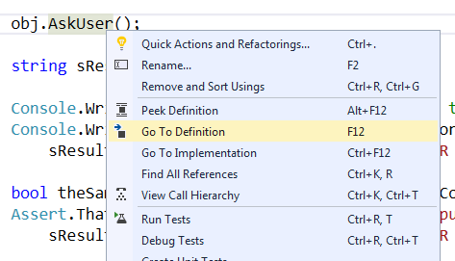
“Go To Definition”
When you’re looking at C# source code you can right-click on a variable / method call / class name / etc
The select “Go To Definition”
+

Slide 88
“Go To Definition” - Usage
Go to Definition is great to find the code for a method that a test is calling
If you’re looking at a [Test] method and you see that it calls another method (maybe it calls your method) you can right-click on it and Visual Studio can jump to that other method

Slide 89
Making your tests pass Example #1

Slide 90
Basic Approach
Read exercise to know:
What your code is supposed to do
What tests should pass
Write your code based on the exercise description
Run the tests – do they all pass?
Pick a failing test (from this exercise)
Read the test in detail to figure out what it’s trying to do
Try to fix your code then see if the test passes
Repeat prior 2-3 steps until all these tests pass
Other tests, unrelated to this exercise are still failing, and that’s ok

Slide 91
#1: Read exercise
What your code is supposed to do
What tests should pass

Slide 92
#2: Write your code
class MakingTestsPass
{
public bool IsInRange(int num)
{
throw new Exception("YOU NEED TO IMPLEMENT THIS!");
}
Note that the Exception guarantees that all the tests will fail

Slide 93
#2: Write your code (first attempt)
class MakingTestsPass
{
public bool IsInRange(int num)
{
if (num < 4)
return true;
else
return false;
}
This is close, but not quite – it’ll miss negative numbers!

Slide 94
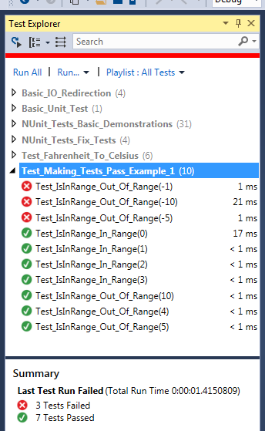
#3: Run the tests
Do they pass? Mostly, but there’s a couple that don’t

Slide 95
#4: Pick a failing test
Let’s go with Test_IsInRange_Out_Of_Range(-1)

Slide 96
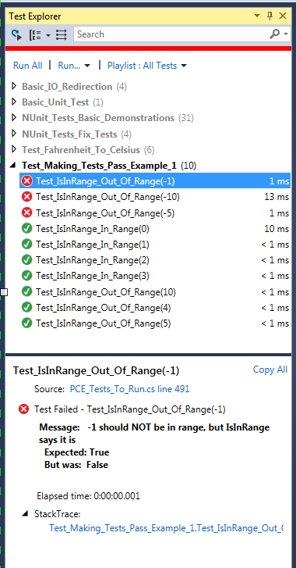
#4: Get more info
Click once on the test
Then read the information down below
Next: Double-click on it to see the code

Slide 97
#5 Figure out what the test is trying to do (which test?)
[Test]
[Category("Making Tests Pass No1")]
public void Test_IsInRange_Out_Of_Range( [Values(-10, -5, -1, 4, 5, 10)]int num)
{
Assert.That(mtpObj.IsInRange(num) == false,
"{0} should NOT be in range, but IsInRange says it is", num);
}
First – the test fails when num is -1

Slide 98
#5 Figure out what the test is trying to do (mtpObj?)
[Test]
[Category("Making Tests Pass No1")]
public void Test_IsInRange_Out_Of_Range( [Values(-10, -5, -1, 4, 5, 10)]int num)
{
Assert.That(mtpObj.IsInRange(num) == false,
"{0} should NOT be in range, but IsInRange says it is", num);
}
Second – figure out what ‘mtpObj’ is by right-click →“Go To Definition” (F12)
class Test_Making_Tests_Pass_Example_1
{
MakingTestsPass mtpObj = new MakingTestsPass();

Slide 99
#5 Figure out what the test is trying to do (mtpObj?)
[Test]
[Category("Making Tests Pass No1")]
public void Test_IsInRange_Out_Of_Range( [Values(-10, -5, -1, 4, 5, 10)]int num)
{
Assert.That(mtpObj.IsInRange(num) == false,
"{0} should NOT be in range, but IsInRange says it is", num);
}
Test calls ‘IsInRange(-1)’ on mtpObj
Test expects return value to be false
Let’s see if our code is doing that

Slide 100
#6: Try to fix your code then see if the test passes
class MakingTestsPass
{
public bool IsInRange(int num)
{
if (num < 4)
return true;
else
return false;
}
Let’s imagine what’ll happen if we call IsInRange(-1)
The ‘if statement’ line will be true
So we’ll return true
But we wanted to return false!

Slide 101
#6: Try to fix your code then see if the test passes: will this work?
class MakingTestsPass
{
public bool IsInRange(int num)
{
if (num >= 0 && num < 4)
return true;
else
return false;
}
Let’s change the if statement to be
if (num >= 0 && num < 4)

Slide 102
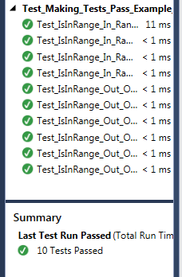
Success!

Slide 103
Don’t forget
Re-read the instructions to make sure you haven’t left anything out
Try it out again with a separate, fresh copy of the project
Download a fresh copy
SAVE YOUR ORIGINAL WORK!!!!
Copy your work into the fresh copy
Make sure the tests still pass!

Slide 104
Redirecting Input & Output in NUnit Tests

Slide 105
Redirecting I/O
Certain tests may redirect input, output
This means that they can ‘feed’ input to your code, and ‘capture’ the output that you produce

Slide 106
Output (captured by the test)
Using the TestHelpers software, the tests can capture output.
This is in the TestHelpers.cs file ; you’re welcome to look at it, if you’re curious about how it works
Anything that you print (using Console.Write) can be captured
Test: Unit_Test_Console_WriteLine

Slide 107
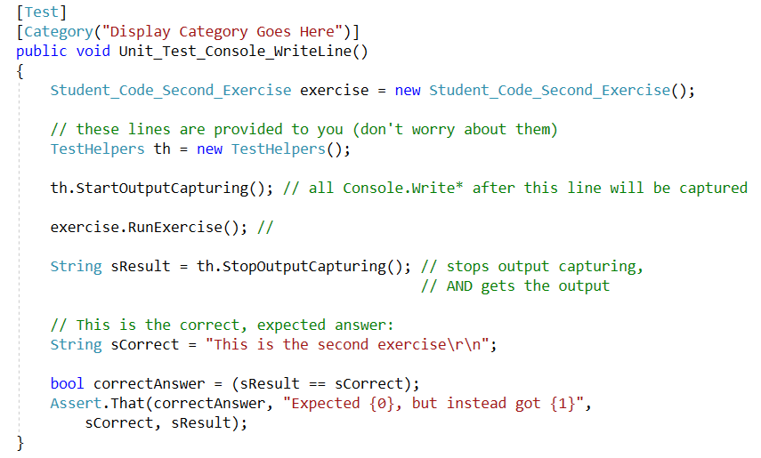
Example of Directing I/O in a test
Capture the output
Ask if the output is identical to “This is the second exercise\n”
1
2

Slide 108
Fuzzy String Comparisons
The TestHelpers software also provides for a number of helpful routines, including ‘fuzzy’ comparisons
‘Fuzzy’ for strings means case-insensitive, and without (too much) regard for blank spaces
Test: Unit_Test_Console_WriteLine_Fuzzy

Slide 109
Test-Supplied Input
The test can also assemble a string, which will be used as the input to your code.
Whenever you call Console.Readline, you will read everything up to the next newline
Newline in C#: \n
Example of input:
“2\n3\nquit\n” is the same as typing 2<enter>3<enter>quit<enter>
Test: Unit_Test_Console_IO_Fuzzy

Slide 110
[Values], [TestCase], [SetUp] Attributes

Slide 111
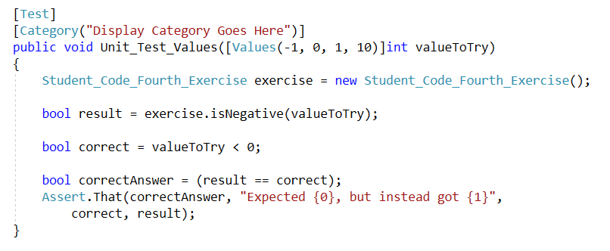
[Values] Attribute
public void Unit_Test_Values( [Values(-1, 0, 1, 10)]int valueToTry)
Tells NUnit to call this function with valueToTry set to -1, then call the function again with valueToTry set to 0, then call the function again with valueToTry set to 1 then call the function again with valueToTry set to 10

Slide 112
[Values] Attribute - Combo
public void Unit_Test_Values_2( [Values(1, 10)]int a, [Values(2, 4)]int b)
Tells NUnit to call this function with ALL POSSIBLE COMBINATIONS OF a and b:
a = 1, b = 2
a = 1, b = 4
a = 10, b = 2
a = 10, b = 4

Slide 113
[TestCase] Attribute
[TestCase( 1, 2)]
[TestCase( 10, 4)]
public void Unit_Test_TestCase(int a, int b)
Tells NUnit to call this function with EACH TestCase:
a = 1, b = 2
a = 10, b = 4

Slide 114
Tests that use the [Setup] Attribute
Notice that before each test, the method marked with [Setup] will be run
In the example test (next slide), we’ll use this to initialize x to be 10 and ex5 to refer to an object

Slide 115
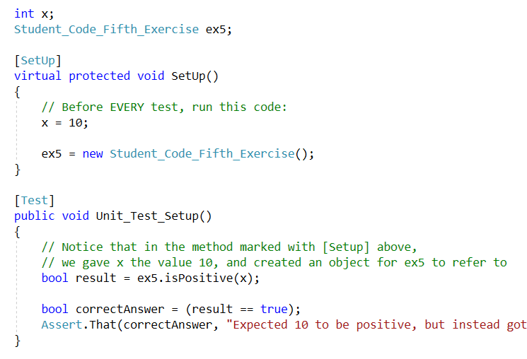
This methods is run FIRST
THEN this test is run

Slide 116
IGNORE THE FOLLOWING SLIDES
I haven’t finished example #2 yet, and will not do so this quarter.
Please ignore all the slides from here all the way to the end of this slide deck. Thanks!

Slide 117
Making your tests pass Example #2 (Using the debugger)

Slide 118
Basic Approach
Read exercise to know:
What your code is supposed to do
What tests should pass
Write your code based on the exercise description
Run the tests – do they all pass?
Pick a failing test (from this exercise)
Read the test in detail to figure out what it’s trying to do
Try to fix your code then see if the test passes
Repeat prior 2-3 steps until all these tests pass
Other tests, unrelated to this exercise are still failing, and that’s ok

Slide 119
Nutshell
If a test fails, it’s because your code didn’t provide the expected response
Your job is to figure out:
Which of your function(s) the test called
What the parameters were when the test called your code
What return value the test was expecting

Slide 120
The Test
Your Code
Parameters
Result
Your job: figure out what result the test was expecting, given the input (parameters)

Slide 121
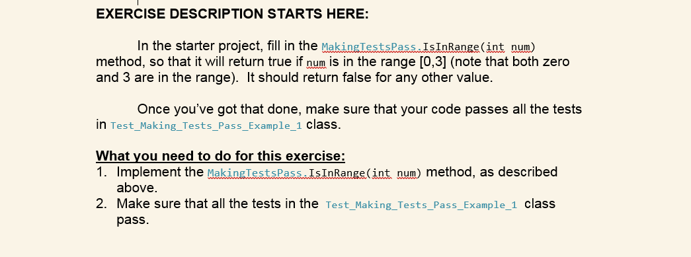
#1: Read exercise
What your code is supposed to do
What tests should pass

Slide 122
#2: Write your code (first attempt)
class MakingTestsPass
{
public bool IsOutsideRange(int num)
{
if (num < 4)
return true;
else
return false;
}
This is close, but not quite – it’ll miss negative numbers!

Slide 123
#3: Run the tests
Do they pass? Mostly, but there’s a couple that don’t

Slide 124
#4: Pick a failing test
Let’s go with Test_IsInRange_Out_Of_Range(-1)

Slide 125
#4: Get more info
Click once on the test
Then read the information down below
Next: Double-click on it to see the code

Slide 126
#5 Figure out what the test is trying to do (which test?)
[Test]
[Category("Making Tests Pass No1")]
public void Test_IsInRange_Out_Of_Range( [Values(-10, -5, -1, 4, 5, 10)]int num)
{
Assert.That(mtpObj.IsInRange(num) == false,
"{0} should NOT be in range, but IsInRange says it is", num);
}
First – the test fails when num is -1

Slide 127
#5 Figure out what the test is trying to do (mtpObj?)
[Test]
[Category("Making Tests Pass No1")]
public void Test_IsInRange_Out_Of_Range( [Values(-10, -5, -1, 4, 5, 10)]int num)
{
Assert.That(mtpObj.IsInRange(num) == false,
"{0} should NOT be in range, but IsInRange says it is", num);
}
Second – figure out what ‘mtpObj’ is by right-click →“Go To Definition” (F12)
class Test_Making_Tests_Pass_Example_1
{
MakingTestsPass mtpObj = new MakingTestsPass();

Slide 128
#5 Figure out what the test is trying to do (mtpObj?)
[Test]
[Category("Making Tests Pass No1")]
public void Test_IsInRange_Out_Of_Range( [Values(-10, -5, -1, 4, 5, 10)]int num)
{
Assert.That(mtpObj.IsInRange(num) == false,
"{0} should NOT be in range, but IsInRange says it is", num);
}
Test calls ‘IsInRange(-1)’ on mtpObj
Test expects return value to be false
Let’s see if our code is doing that

Slide 129
#6: Try to fix your code then see if the test passes
class MakingTestsPass
{
public bool IsInRange(int num)
{
if (num < 4)
return true;
else
return false;
}
Let’s imagine what’ll happen if we call IsInRange(-1)
The ‘if statement’ line will be true
So we’ll return true
But we wanted to return false!

Slide 130
#6: Try to fix your code then see if the test passes: will this work?
class MakingTestsPass
{
public bool IsInRange(int num)
{
if (num >= 0 && num < 4)
return true;
else
return false;
}
Let’s change the if statement to be
if (num >= 0 && num < 4)

Slide 131
Success!

Slide 132
Don’t forget
Re-read the instructions to make sure you haven’t left anything out
Try it out again with a separate, fresh copy of the project
Download a fresh copy
SAVE YOUR ORIGINAL WORK!!!!
Copy your work into the fresh copy
Make sure the tests still pass!

