Slide 1
Stacks
The content for these slides was originally created by Gerard Harrison.
Ported to C# by Mike Panitz

Slide 3
Overview
Definition of Abstract Data Type
Stack Introduction
Example: Reverse Polish Notation
Stack Specification
Implementation Of Stacks

Slide 4
C# Data Types
C# provides simple types such as int, float, bool
C# also provides classes (and structs) which we use to build new types

Slide 5
Abstract Data Types (ADTs)
An Abstract Data Type is a language-independent view of a more complicated data type ‘pattern’
Consists of data, and a set of actions that can be done on the type
We’ll use the idea of a Stack in many languages, and contexts

Slide 6
Goals of ADTs
Clarification
Reusability
Decoupling
Encapsulation & Information Hiding

Slide 7
Stack Introduction
A stack is an abstract data type in which all the insertions and deletions of entries are made at one end, called the top of the stack.
The most recently added entry is the first entry that will be removed
Sometimes referred to as Last-In First Out (LIFO)

Slide 8
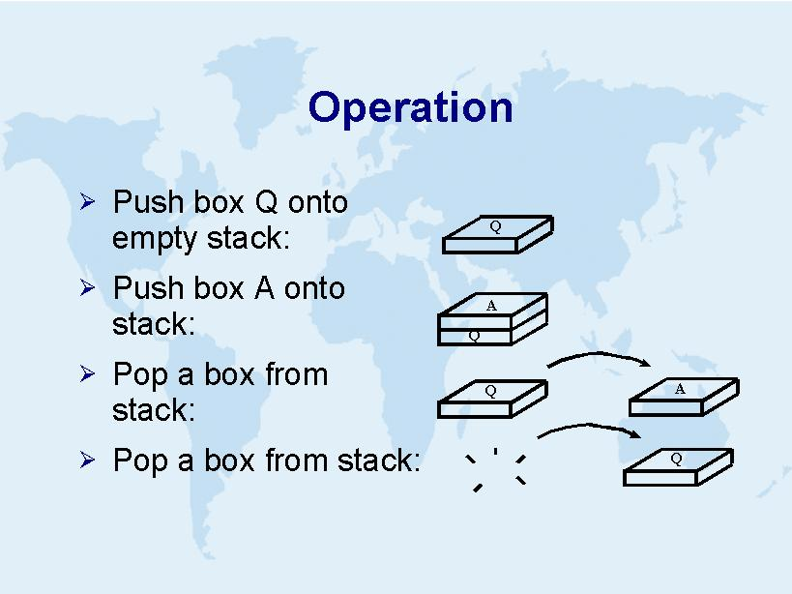

Slide 10
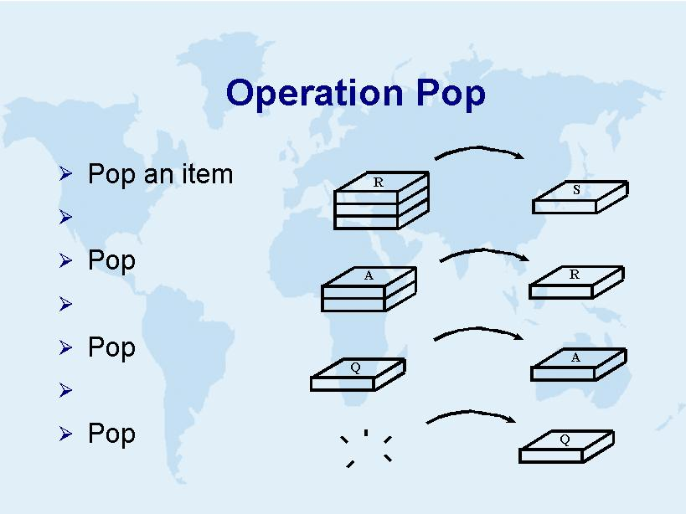

Slide 11
Examples
Back button on a web browser
Call stack (of function/method calls)
“Undo”/ “Redo” feature of Word, etc
Finding one’s way through a maze
Depth-First Search of a tree structure (ex: BinarySearchTree.Print)
We’ll see these later in the term
Also: Reverse Polish Notation

Slide 20
Detecting Palindromes
This is a good place for the ‘detecting palindromes’ exercise

Slide 21
Stack Class Specification (API)
API: Application Programming Interface
Methods, properties, fields, events, etc, that can be called from a C# program that you write
The API used here is loosely based on the .Net FCL Stack class.

Slide 22
Stack.Push
If the stack is not full, add item to the top of the stack.
If the stack is full, an overflow error has occurred, and throw an OverflowException
void Push(int item); // throws OverflowException

Slide 23
Stack.Pop
If the stack is not empty, then the top item is removed & returned via the return value.
If the stack is empty, then an underflow error has occurred, and an UnderflowException is thrown.
int Pop(); // throws UnderflowException

Slide 24
Stack.Peek
If the stack is not empty, then the top item is returned via the return value. The stack itself is unchanged
If the stack is empty, then an UnderflowException is thrown.
int Peek(); // throws UnderflowException

Slide 25
Stack.IsEmpty
If the stack is empty, then true is returned. Otherwise, returns false.
bool Stack.IsEmpty();

Slide 27
Stack: Implementation
Each instance of the class will use per-instance variables to keep track of
An array of integers
These represent the contents of the stack
An integer to keep track of the index of the ‘top’ of the stack
If there are no items in the stack, we’ll set this to -1.

Slide 28
Stack: Implementation: Ctor
public class Stack {
private int []items; private int iTop = -1; public Stack() { items = new int[10]; iTop = -1; }
Note: We should also provide at least one other constructor, so that a person could choose a different size for the stack.
Question: From a testing perspective, why would a small stack be advantageous?

Slide 29
Summary
Used where reversal of data is needed
Simple to use, and simple to implement

