Slide 1
Queues
The content for these slides was originally created by Gerard Harrison.
Ported to C# by Mike Panitz

Slide 3
Overview
Queue Introduction
Queue Specification
Implementation Of Queues

Slide 4
Queue Introduction
A queue is an abstract data type in which all the insertions are made at one end of the queue (the back, or rear), while all deletions are made at the opposite end (the front).
The first entry that was added is the first entry that will be removed
Sometimes referred to as First-In First Out (FIFO)

Slide 6
Queue Class Specification (API)
The API used here is loosely based on the .Net FCL Stack class.

Slide 7
Queue.Enqueue
If the queue is not full, add item to the back/rear of the queue.
If the queue is full, an overflow error has occurred, and an OverflowException is thrown
void Enqueue(int newItem);
// throw OverflowException

Slide 8
Queue.Dequeue
If the queue is not empty, then the front item is removed & return it.
If the queue is empty, then an underflow error has occurred, and an UnderflowException is thrown
int Dequeue(); // throws UnderflowException

Slide 9
Queue.Peek
If the queue is not empty, then the front item is returned via the out parameter. The queue itself is unchanged
If the queue is empty, then an UnderflowException is thrown
int Peek(); // throws UnderflowException

Slide 10
Queue.IsEmpty
If the queue is empty, then true is returned. Otherwise, returns false.
bool isEmpty();

Slide 12
Queue: Implementation
Each instance of the class will use per-instance variables to keep track of
An array of integers
These represent the contents of the queue
An integer to keep track of the index of the ‘front’ of the queue
An integer to keep track of the index of the ‘back’ of the queue
The count of items that are in the Queue

Slide 13
Queue: Implementation: Ctor
public class Queue { int []items; int iFront; int iBack; int count; public Queue() { items = new int[10]; iFront = 0; iBack = 0; count = 0; }
Note: We should also provide at least one other constructor, so that a person could choose a different size for the queue.

Slide 14
pr
Notes:
ASK: Advantages & disadvantages of using ints as return values

Slide 15
Solution
Shift items down when space towards the front is free
Results in lots of work
Implement a more efficient queue
A circular queue, or circular list

Slide 16
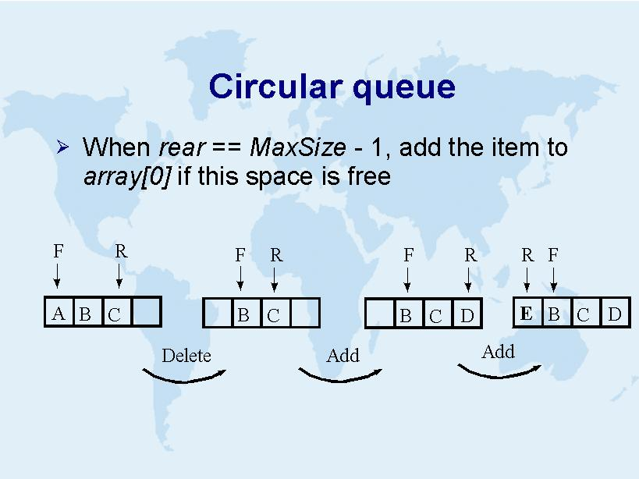

Slide 17
Queue: Implementation: Ctor
public class Queue { int []items; int iFront; int iBack; int counter; public Queue() { [] items = new int[10]; iFront = 0; iBack = 0; counter = 0; }
Note: We should also provide at least one other constructor, so that a person could choose a different size for the queue.

Slide 18
Implementing Circular Queues: Counter Method
public void Enqueue(int newItem) { if(counter>=items.Length) throw new OverflowException("No space in Q"); counter++; back = ((back+1)== items.Length) ? 0 : (back+1); items[back] = newItem; }

Slide 19
Summary
Simple to use, pretty simple to implement
Some more bookkeeping is required
Used in cases wherein items need to be serviced in the order in which they arrive
GUI event systems
DB transactions

