Slide 1
Log in to the computer in front of you
Temp account: 231class / Fall@2017
Update your email in Cascadia's system
If I need to email you I'll use this address
Google for "Cascadia Student Toolbox"
You are required to read your email at least once every 24 hours
Set up Canvas notifications for discussions
There’s info in the 'Orientation' page
You are required to read all announcements and discussion board messages at least once every 24 hours.
Introduce yourself to the people around you
Notes:
Note that posting 1 question & 1 answer to the Google Group will be part of Lesson 02's Post Class Exercises!

Slide 2
BIT 142: Intermediate Programming
Instructor: Mike Panitz
(mpanitz@cascadia.edu)
Tuesdays, 11:00 am to 1:05 pm, CC1-231

Slide 3
tl;dr
Get Visual Studio
Visual Studio 2017 Community Edition is great
If not, you can use Cascadia’s computers, on-site or remotely
The lesson 01 exercises (both coding and video-watching) are due at the start of the next class session

Slide 4
New things this quarter
The website
The ‘Expression Evaluation’ video in Lesson 01
The exercise for this has been updated, too
‘POGIL’ exercise for output (today)

Slide 5
Hybrid vs. “Online”
Online students:
No points for in-class work
Attendance is therefore optional
Class is valuable preparation for the week’s work
OL students CAN attend class
Except for the exams – you still need to show up in class for exams
Dates are listed on the course website

Slide 6
Hybrid vs. “Online”
Hybrid students:
10 points for each class meeting
2 point quiz on prior Lesson
8 points for participation
The exams are still given during class
You can switch between them by emailing me during the first or second week of the quarter

Slide 7
Hybrid vs. online
Think of hybrid as “online, plus guided help sessions before each week’s work starts”
Each hybrid class will be a 'real class'.
There will be structure activities for you to do
You will be encouraged to work together in pairs / small groups
Which one should you sign up for?
There's an ungraded quiz in Lesson 01 to help you think about this decision

Slide 8
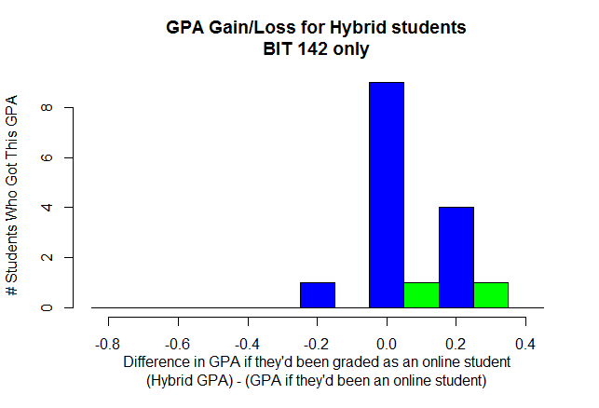

Slide 9
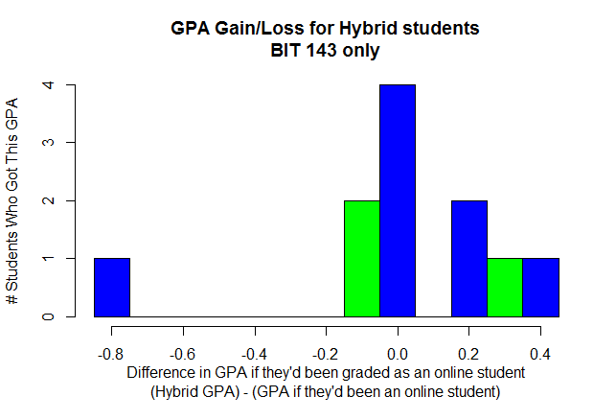

Slide 10
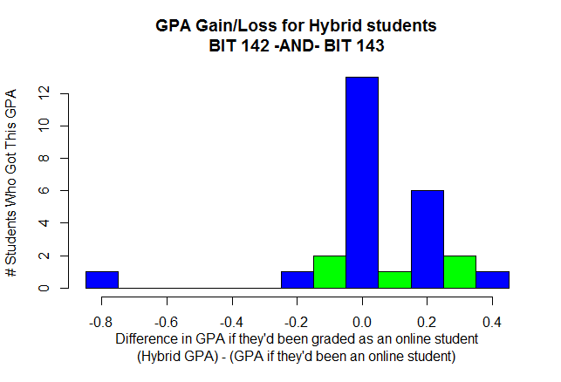

Slide 11
Syllabus
YOU are responsible for knowing the syllabus!
If info isn’t on here, you should ask before it’s an issue.
We won’t be talking about grading, etc, here in class.
Instead, there’s an online quiz (in Canvas) that you’re required to get 100% right (or else lose points)
Notes:
This includes the plagiarism (cheating) policy

Slide 12
Exams happen in-class
There are NO ONLINE EXAMS
If you're an online student start planning for this now!!!!
Exams happen in class
You must bring photo ID, which will be checked!
Exam occurs during class time on the date specified
Exam dates are listed on the course home page

Slide 13
Exams happen in-class
For Lesson 01 you must either:
Confirm that you can make the exams
-OR-
Make alternate arrangements for the exam
If you fail to make alternate arrangements then you must take the exam during the day & time listed on the course web page.

Slide 14
Syllabus : Book info
BIT 142 uses the book fairly extensively
I would recommend getting it
The edition does not matter
"C# How To Program" is the same as "C# For Programmers"
Section numbers may be slightly off. Please first try to locate the material on your own, then email the Discussion Forum if you can't find it.

Slide 15
Website: Orientation Page
Clearly indicated on the front page / main page of the course
Read this first
Follow all the directions on this page

Slide 16
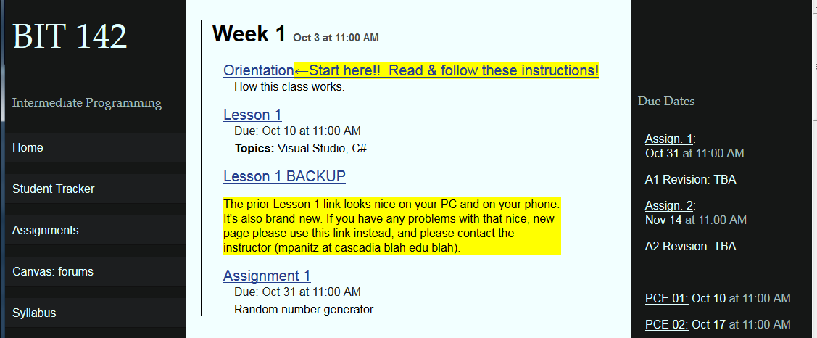
Website: Main Page
Recently redesigned
Let me know ASAP if there’s problems!
Let’s look at each column:

Slide 17
Website: Main Page: Left Column
Left column contains course-wide info

Slide 18
Website: Main Page: Right Column
Right column contains due dates

Slide 19
Website: Main Page: Middle Column
Column column contains the course material
Reading assignments, videos, exercises, etc
Divided up by week
➔ Click on each Lesson for more details ⬅

Slide 20
Website Main Page
Let’s look at a Lesson page in more detail

Slide 21
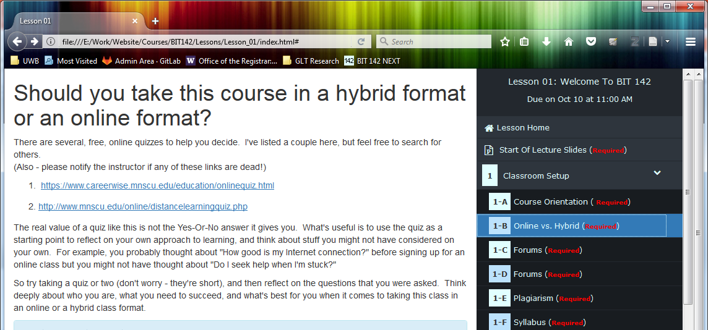
Lesson Page:Overview
There’s a ‘Table of Contents’ in the right column
Click on an item, and it will display
Many will display in the left-hand column
Some will replace the whole page with the new page

Slide 22
Lesson Page: Start of class slides
Each Lesson is about a week of time
EVERYONE is required to read through the ‘start of class’ PowerPoint slides
(In-class or afterwards)

Slide 23
Website: Post Class Exercises (PCEs)
Done INDIVIDUALLY, although you’re welcome to get help from other people, if you need it.
This means that each person must submit their own, unique solution to all the problems.
You are REQUIRED to know all the material, for all the exercises
(i.e., if any of these showed up on an exam, or must be used in a HW assignment, then you need to know it)
You’re only required to HAND IN those items labeled ‘Hand-In’
It’s highly recommended, but not required, that you do all the exercises – do as many as your schedule allows, and as you need to, in order to learn this material!

Slide 24
Do NOT plagiarize other people’s work
Examples of code and exam plagiarism include:
Taking the work of someone else (including other students) and turning it in as your own.
Giving your work to another student to turn in as their own.
Getting information about an exam from another student.
Giving information about an exam to another student.
Copying code off the Internet and turning it in as your own.

Slide 25
Do NOT plagiarize other people’s work
If two or more homeworks or exams are found to be suspiciously similar, the burden of proof rests upon the students who submitted the work.

Slide 26
Late policy for work
Work is due on a day and time
“Work” = PCEs, and homework projects, etc
I will grade the work at or after that time
You’ll get email once the grading is finished
You are encouraged to keep uploading your work until I finish grading it
Once it’s graded then no further uploads will be accepted
EXCEPTION: See next slide

Slide 27
Extension Policy
Goal:
Allow you to hand in something again if you made a mistake packaging up your homework

Slide 28
PCE & Homework Extensions
After instructor finishes grading your work you can use an extension to hand in something late
To use your extension: upload the work to StudentTracker and then email me and say that you want to use an extension
Do this even if you’re not sure how many extensions you’ve got
If you haven’t got any left then it will have no effect
No penalty either – you think you might have an extension, then you may as well try

Slide 29
PCE & Homework Extensions
Each person has two (2) extensions
Each extension must be used within 24 hours of when the instructor grades your work & emails you
Each extension can be used once
You can track these on StudentTracker
You can use an extension if:
You didn’t hand in anything
You forgot to include an entire file or files
You cannot use an extension to revise a file that you’ve already handed in

Slide 30
PCE & Homework Extensions tl;dr:
You can hand in missing work as late as 24 hours after you get my email with your grade
You can use an extension if the whole thing is missing
You can use an extension if one or more file(s) are missing
Extensions are NOT revisions

Slide 31
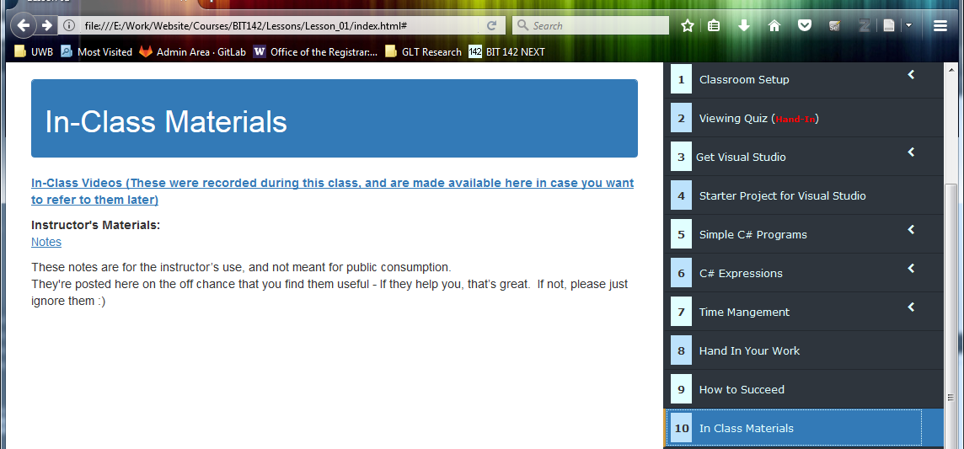
Website: In Class Materials
In class materials may be used in class (or not)
Any videos (of the instructor) recorded during class may be posted for later viewing

Slide 32
Visual Studio here at Cascadia
If nothing else you can use VS here at school.
You will need to sign in (to Microsoft's servers) for this to work!
The account is free.
I think of it as being like the Google account sort of thing

Slide 33
Mac users
Visual Studio is now available for free, for Mac, without needing a virtual machine
Normally, VS for Mac has problems with Console.ReadLine
You can fix it by following the advice here.

Slide 34
BIT 142 Topics for tonight
We’ll go over how to
download a starter project,
work on it using Visual Studio,
hand it in to StudentTracker
Intro to C#
C# generally, main
console I/O
the class thing
Expression evaluation

Slide 35
REMINDER: Lesson 01 work due at the start of the next class session!
BIT 143: Please take special note of this, because it’s a change from the prior quarter
Hybrid Students: Next class will start with a quiz that covers the Lesson 01 material!

