Slide 1
BIT116: Scripting
Decomposing A Program Into Functions

Slide 2
Today
A3 was handed back last night
It was A3, despite some emails claiming that it was A1 ☹
Thanks for catching this, Nathan!
Poster survey
Quiz
Function decomposition
In-Class Homework work time

Slide 3
Program/Function Decomposition

Slide 4
The Golden Rule (For Functions)
Each function should have a single, well-defined purpose
User I/O (Input/Output) counts as a function
Therefore your new functions should EITHER interact with the user OR do something else
The 'main' function's purpose is to sequence all the steps that need to happen
The ‘main’ function is also allowed to do user I/O

Slide 5
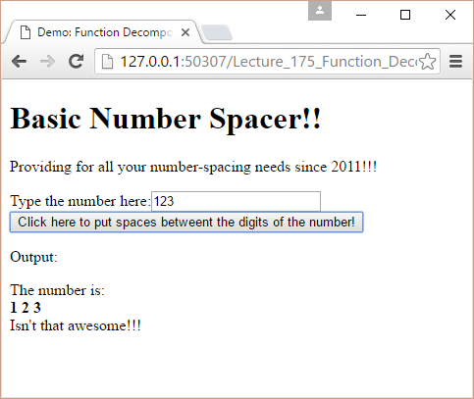
Example: Basic Number Spacer!

Slide 6
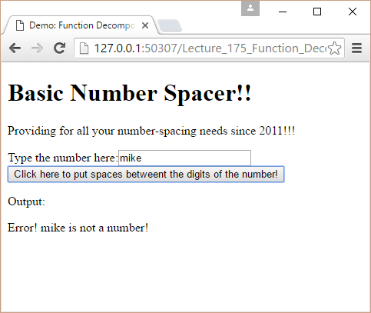
Example: Basic Number Spacer!

Slide 7
Basic Approach
Anonymous 'on click' handler will serve as our 'main' function and organize all the other steps
Three different functions:
Get the user's input
Space out the digits
Display the output on the page

Slide 8
Basic Approach
Three different functions:
Get the user's input
Get the user's input, convert to a number, check if that actually is a number, display an error message if it's not (and stop all further processing), then return that number to 'main'
Space out the digits
Convert the number to a string, and use a loop to accumulate the spaced-out string: for each iteration glue another digit on, then another space
Display the output on the page
Set up the output string (including the text above and below the actual spaced-out number), then put it on the page

Slide 9
Here's what the 'main' / on click handler looks like:
$(document).ready( function() {
$("#functionDemo").click( function() {
var num = GetUserInput();
var spaced = SpaceNumberOut(num);
SetOutput( spaced );
});
});
Notice that each function has a single, well-defined purpose

Slide 10
Here's what the 'main' / on click handler looks like:
function GetUserInput( ) {
var numAsInput = $("#num1").val();
var num = Number( numAsInput );
if( isNaN(num) ) {
$("#output").html( "Error! " + numAsInput + " is not a number!");
throw new Error(numAsInput + “epep is not a number!");
}
return num;
}
$(document).ready( function() {
$("#functionDemo").click( function() {
var num = GetUserInput();
var spaced = SpaceNumberOut(num);
SetOutput( spaced );
});
});
Notice that each function has a single, well-defined purpose

Slide 11
Here's what the 'main' / on click handler looks like:
function SpaceNumberOut( num ) {
var spacedOutNumber = "";
var numAsString = num.toString();
for( var i= 0; i < numAsString.length; i++) {
spacedOutNumber += numAsString.charAt(i) + " ";
}
return spacedOutNumber;
}
$(document).ready( function() {
$("#functionDemo").click( function() {
var num = GetUserInput();
var spaced = SpaceNumberOut(num);
SetOutput( spaced );
});
});
Let's look at .toString(), .charAt(i), .length
Accumulator Table
i | spacedOutNumber
0 | "" + "1" + "□" = "1□"
1 | "1□" + "2" + "□" = "1□2□"
2 | "1□2□" + "3" + "□" = "1□2□3□"
(I'm going to assume that 123 was typed into the text box)

Slide 12
Here's what the 'main' / on click handler looks like:
function SetOutput( szNum ) {
szNum = "The number is:<br/><b>"+szNum+"</b><br/>Isn't that awesome!!!";
$("#output").html( szNum );
}
$(document).ready( function() {
$("#functionDemo").click( function() {
var num = GetUserInput();
var spaced = SpaceNumberOut(num);
SetOutput( spaced );
});
});
Notice that each function has a single, well-defined purpose

Slide 13
Do Exercise #1
Work on Exercise #1 for this part of this lecture

Slide 14
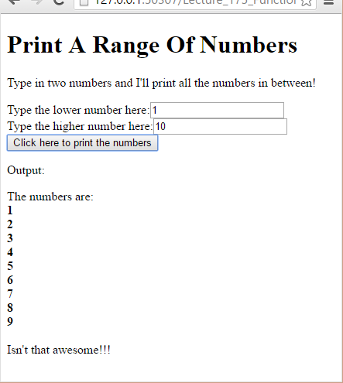
Example #2: Printing A Range Of Numbers

Slide 15
Basic Approach
Anonymous 'on click' handler will serve as our 'main' function and organize all the other steps
Four different functions:
Get the user's first, lower number
Get the user's second, higher number
Accumulate the numbers
Display the numbers on the page

Slide 16
Basic Approach
Four different functions:
Get the user's first, lower number
Get the user's input, convert to a number, that that is a number, display an error message if it's not (and stop all further processing), then return that number to 'main'
Get the user's second, higher number
Get the user's input, convert to a number, that that is a number, display an error message if it's not (and stop all further processing), check if this second, higher number is actually larger than the first, smaller number (display an error message & stop if it's not), then return that number to 'main'
Accumulate the numbers
Use a loop to accumulate the numbers: for each iteration glue another number on, then another HTML line break element
Display the output on the page
Set up the output string (including the text above and below the actual spaced-out number), then put it on the page

Slide 17
Here's what the 'main' / on click handler looks like:
$(document).ready( function() {
$("#functionDemo").click( function() {
var num1 = GetFirstNumber();
var num2 = GetSecondNumber(num1);
var nums = AccumulateNumbers(num1, num2);
SetOutput( nums );
});
});
Notice that each function has a single, well-defined purpose

Slide 18
Here's what the 'main' / on click handler looks like:
function GetSecondNumber( firstNum) {
var numAsInput = $("#num2").val();
var num = Number( numAsInput );
if( isNaN(num) ) {
$("#output").html( "Error! " + numAsInput + " is not a number!");
throw new Error(numAsInput + " is not a number!");
}
if( num < firstNum) {
$("#output").html( "Error! " + num + " should be lower than " + firstNum + " but it's not!");
throw new Error(num + " should be lower than " + firstNum + " but it's not!");
}
return num;
}
$(document).ready( function() {
$("#functionDemo").click( function() {
var num1 = GetFirstNumber();
var num2 = GetSecondNumber(num1);
var nums = AccumulateNumbers(num1, num2);
SetOutput( nums ); });
});
"GetFirstNumber" is pretty much the same as "GetUserInput" from the previous slides

Slide 19
Here's what the 'main' / on click handler looks like:
function AccumulateNumbers( loNum, hiNum ) {
var nums = "";
console.log("lo: " + loNum + " hi: " + hiNum);
for( var i= loNum; i < hiNum; i++) {
nums += i + "<br/>";
console.log("nums is: " + nums);
}
return nums;
}
$(document).ready( function() {
$("#functionDemo").click( function() {
var num1 = GetFirstNumber();
var num2 = GetSecondNumber(num1);
var nums = AccumulateNumbers(num1, num2);
SetOutput( nums );
});
});
"SetOutput " is pretty much the same as "GetUserInput" from the previous slides so we're not going to talk about that, either
Accumulator Table
i | nums
Before loop | “”
1 | "" + "1" + "<br/>" ➔ "1<br/>"
2 | "1<br/>" + "2" + "<br/>" ➔ "1<br/>2<br/>"
3 | "1<br/>2<br/>" + "3" + "<br/>" ➔ "1<br/>2<br/>3<br/>"
(I'm going to assume that 1 and 3 were typed into the text boxes)

Slide 20
The Golden Rule (For Functions)
Exercise #2: Given more complicated code and some starting functions finish the decomp
Exercise #3: Given more complicated code sketch out the functions (without actually filling them in)

