Slide 1
Making Art With Technology
Chris Gildow
Mike Panitz
Notes:
Hi, I'm Mike Panitz

Slide 2
Finished Example
Let’s look an example of what you’ll be able to do by the end of today’s class
Notes:
Show the Arduino here, with the BlinkByMike sketch and a single LED on a wire

Slide 3
Overall Goal
We're going to use a small, cheap computer to make lights flash when you push a button
Then you're going to incorporate this into a 2D design project
Notes:
NOTE: There will be no equations, and only intuitive numbers

Slide 4
Today’s Goal
Learn how to use the technology…
…by creating a ‘throwaway’ art project…
…so you can start planning your real project.

Slide 5
Next Steps
At the end of today you’ll have enough knowledge to decide what you want to do for your real project
You can shop for any extra supplies that you want over the weekend
You don’t have to get extra stuff. But if you do, get it soon so you can make progress next week.

Slide 6
Setting Up The Arduino
Notes:
We’ll start by setting up the hardware
We’ll use pre-fab software for right now
And then replace it with our own later

Slide 7
Disclaimer
We're going to be using very low-power electrical devices that are designed to be safe
Do NOT attempt to rewire your home electrical system unless you have the proper training!!
This class NOT provide the proper training!
Do NOT mess with the electrical plugs in the walls of your home!!!!
Notes:
This might be a good place to show them that you can pinch two wires together with your fingers.
Make sure to emphasize that there’s so little electricity that you don’t even feel a tingle
UNLIKE THE ELECTRICAL WIRES IN YOUR HOME, WHICH WILL KILL YOU IF YOU TOUCH THEM!!!!

Slide 8
Get the laptop online
Login
Make sure to type .\student exactly, including the .\
Make sure that the hardware switch on the side shows you green
Log into the wireless network
Windows will auto-install driver software only if it’s online!!

Slide 9
Get the software for your own computer
Go to: http://arduino.cc/en/main/software
Download the right software for your computer (Windows, Mac, etc)
The software is free (open source)

Slide 10
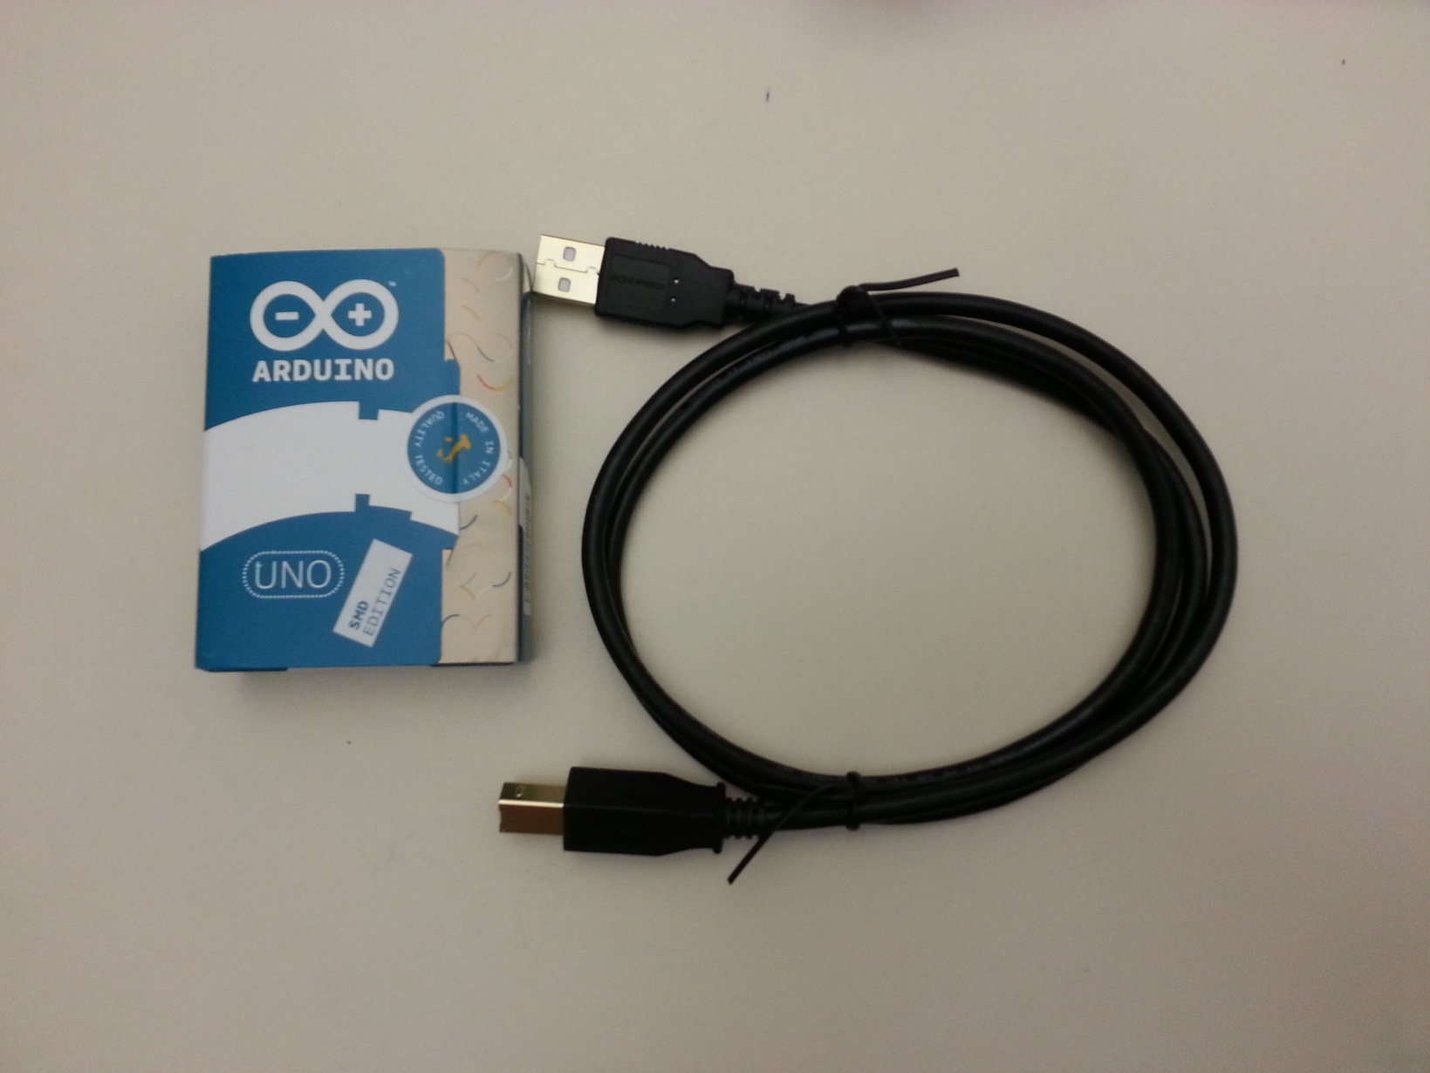
Get the Arduino & USB cable out of the bag

Slide 11
Plug Arduino into computer

Slide 12
Plug the Arduino into the computer
Windows should auto-detect
But only if the computer is online!!

Slide 13
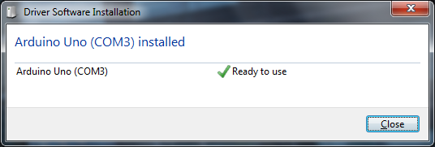
Install the device driver
Eventually it'll finish
Notice the number after COM!!
In this case, COM3.
If you forget that number it's ok, just remember that there's a number there ☺

Slide 14
Start the Arduino Editor Program
Either Start →All Programs →Arduino:
Or else Start, type "Arduino"

Slide 15
Open the ‘Blink’ example:

Slide 16
(Now you’ll see TWO windows)
(Feel free to close the first, empty window)

Slide 17
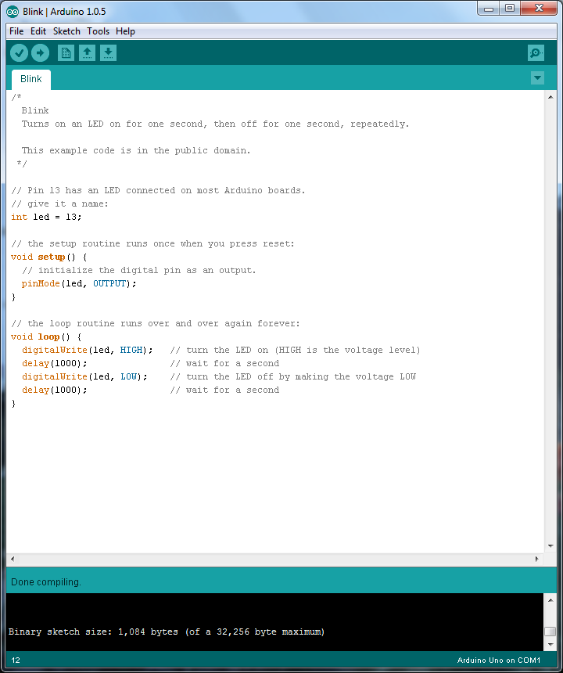
Verify
Click on the check mark:
Then see if there are any errors at the bottom
White text that only lists the size means it went ok!

Slide 18
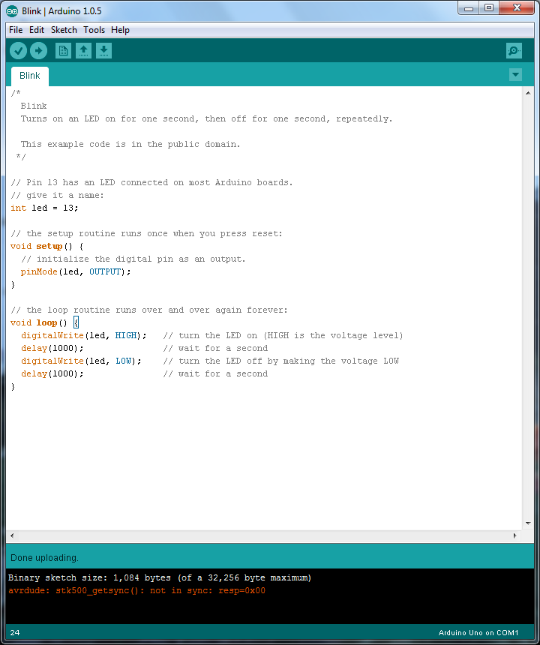
Upload
Click on the arrow
Then see if there are any errors at the bottom
Orange text means something went wrong!!

Slide 19
Use COM3, not COM1
Arduino defaults to COM1, not COM3
Tell it to use COM3 (or whatever it suggests)

Slide 20
Success!
And now the Arduino now blinks ☺
(It’s the little orange light next to pin 13)

Slide 21
Adding LED lights

Slide 22
Wiring up a single LED circuit
Electricity 'flows' like water
A wire needs to go from a 'pin', out to the LED, then back to 'ground'

Slide 23
Instructions (pictures on next slides)
What to attach
Pin 13 → resistor (using wire)
Tie the resistor to the LONG LEG of the LED
If you get this backwards the LED will not light up
You won’t damage it either, though
Short leg of the LED → GND (ground) (using wire)
The bare metal wires can’t touch each other
The LED should now blink, too

Slide 24
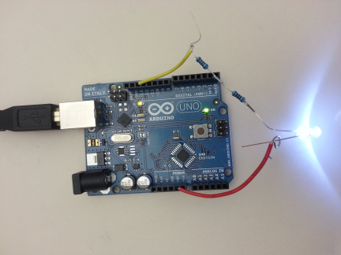
Attach LED WITH RESISTOR
The longer leg (with the resistor(s)) goes to pin 13
Shorter leg goes to (any) GND
Note: if you get it backwards it will not break...
...but it won't light up, either

Slide 25
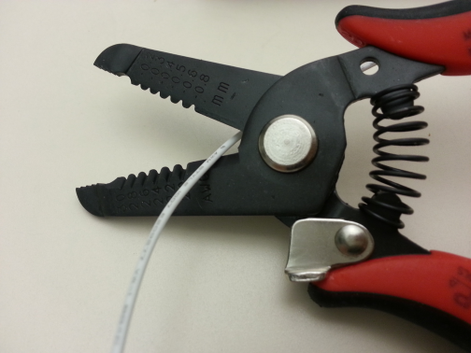
Base of strippers = scissors
Place wire here to cut it
NOTE: The wire spools need to last us for the entire project

Slide 26
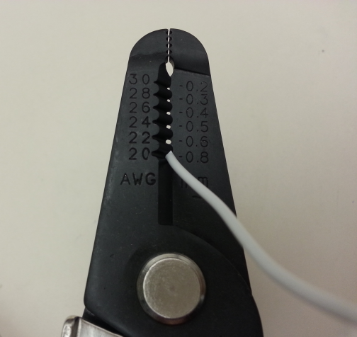
Use 20 gauge to strip plastic insulation

Slide 27
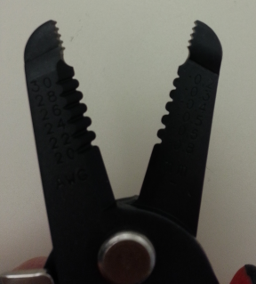
How To Bend Wires
The end of your wire strippers are actually pliers

Slide 28
Make just two of these
Straight at one end
(This will be stuck into the Arduino)
Curled over at the other end (This will be wound around the LED’s wire)

Slide 29
Plug a wire into pin 13

Slide 30
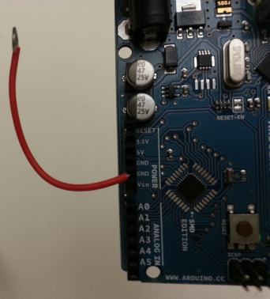
Plug a wire into GND

Slide 31
Do Not Connect Wires To Each Other
DO NOT LET THE BARE METAL WIRES TOUCH!!!!!
If you do you'll destroy your Arduino
We don't have extras, so be careful!!!
It's totally ok for the insulated parts of the wire to touch
Insulated = rubber/plastic coated parts

Slide 32
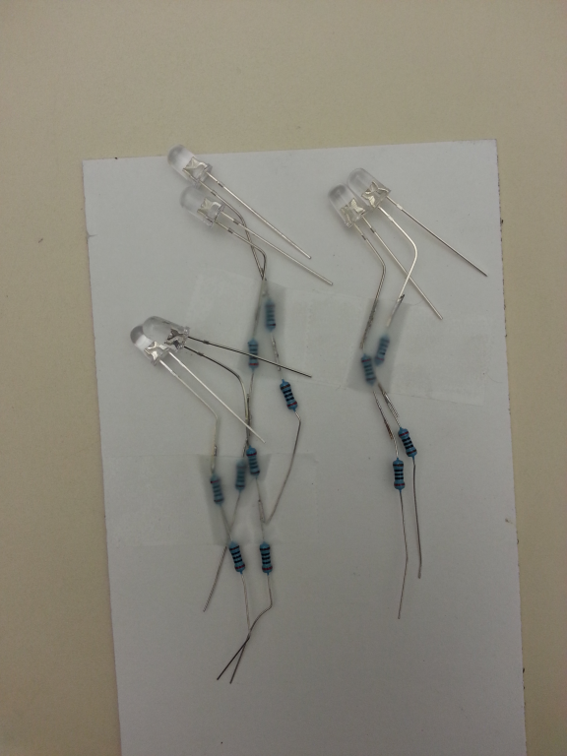
Pick an LED to use
Then attach one resistor to the LONGER leg of the LED
(2 resistors is fine, but not needed)
Use the pliers part of your wire strippers to bend the LED’s LONGER leg around the resistor
And also bend the resistor’s wire around the LED’s leg
Clamp them tightly to ensure a good connection

Slide 33
Attach LED WITH RESISTOR
The longer leg (with the resistor(s)) goes to pin 13
Shorter leg goes to (any) GND
Note: if you get it backwards it will not break...
...but it won't light up, either

Slide 34
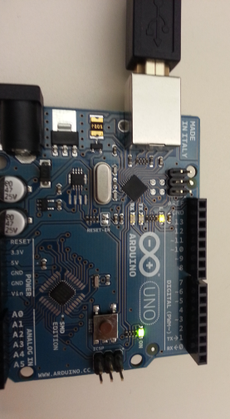
Troubleshooting Tips
USB cable plugged in?
Computer→USB→Arduino
Is the Arduino green 'on' light on?
Is the Arduino orange 'pin 13' light blinking?
Are the wires securely stuffed into the pins?
Are wires tied onto the button well?
If this doesn't work, ask the teacher
You could try another, but if you accidentally blew out the button’s light you don't want to destroy another ☺

Slide 35
WARNING: Complexity Ahead!
For your initial version of your design you will be limited to 6 lights, each of which must have it’s own wire from pin XX out to the resistor&LED, and a separate wire from the LED back to GND.
This will help limit the complexity of the wiring, and help you bring your design into better focus
If and when this is working just fine then you can ask the teacher if you can add more wires/LEDs

Slide 36
You can ‘split’ a wire out to 2 LEDs

Slide 37
Changing the LED’s blink pattern

Slide 38
Let’s look at the software
The ‘Arduino software’ on your laptop lets you look at the program
The program is a bunch of commands, written out textually
We tell the Arduino software on your laptop to Verify (compile) the commands into a language that the Arduino hardware can understand
Then we tell our laptop to upload that program into the Arduino hardware
Let’s look at the program in more detail now

Slide 39
Comments Contain Hints For You
Comments are ignored by the program
You can ignore these, too ☺
Or - write yourself notes inside of comments!
/* ⬅ Multi-line comment starts here Blink Turns on an LED on for one second, then off for one second, repeatedly. This example code is in the public domain. */ ⬅ Multi-line comment ends here
// Pin 13 has an LED connected on most Arduino boards. ↑ Single-line comments starts with //, goes to end of line

Slide 40
Setup function
// the setup routine runs once at the start: void setup() { // initialize the digital pin as an output. // pinMode(led, OUTPUT); // change led to 13 pinMode( 13, OUTPUT); }
Replace led with 13
pinMode tells Arduino how you want a pin to behave
In this case, we want to send electricity OUT along the wire plugged into pin 13 – use OUTPUT
Notes:
This function runs once, and only once, when the program first starts running on your Arduino

Slide 41
loop function
Replace led with 13 here, too
// the loop routine runs over and over again forever: void loop() { digitalWrite( 13, HIGH); // turn the LED on (HIGH is the voltage level) delay(1000); // wait for a second digitalWrite(13, LOW); // turn the LED off by making the voltage LOW delay(1000); // wait for a second } // when the program gets here it goes back to the // top of the loop function
1000 milliseconds = 1 second

Slide 42
Details Must Be Exactly Right
Capitalization matters – write out names EXACTLY
digitalWrite, delay, led, HIGH are good
DigitialWrite, digitalwrite, Delay, high are bad!
No comma in numbers ( 1000 instead of 1,000)
DO separate 13 and HIGH using a comma ,
Match the open and close parentheses ()
Don't forget the semi-colon ( ; )
void loop() {
digitalWrite( 13, HIGH); delay(1000);
...

Slide 43
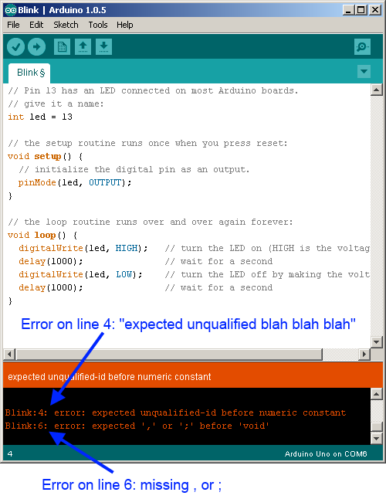
Debugging
If the program has verification errors, then start by getting the line number
Go to that line
Start at the top and count as you move down
Can anyone find a better way?

Slide 44
Error Messages
Line # is where the Arduino got confused
May or MAY NOT be the actual cause of the error
You'll need to figure out what the correct thing to do is
Your job: Get the 'gist' of the error message
Don't worry about the fact that it doesn't make a lot of sense
It may not make any sense

Slide 45
Strategies for debugging
Compare your program to working program
File→Examples→Basics→Blink, etc
Neighbors' programs
Get multiple people to look at it
Everyone in your group
People in neighboring groups
Instructors

Slide 46
Let’s change the pattern (by copy and paste)
Copy the lines you're interested in
Make sure to paste INSIDE the loop function
Inside means:
after the opening {
before the closing }
void loop() {
digitalWrite(led, HIGH); delay(1000);
digitalWrite(led, LOW); delay(1000); digitalWrite(led, HIGH); delay(200); // shorter blink
digitalWrite(led, LOW); delay(200);
}

Slide 47
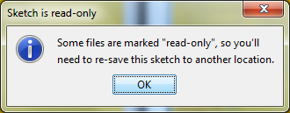
Save Your Work
THE EXAMPLE IS READ-ONLY, so you’ll need to save a copy of your work into a new file
The normal Control+S, or the menu item:
Then say 'Ok':
Pick a name like ‘MyBlink’. Put it wherever you want (a folder on the desktop would be great)

Slide 48
SAVE YOUR WORK!!!
MAKE SURE TO SAVE THESE FILES BEFORE YOU LEAVE TODAY!!!!!
EMAIL YOURSELF A COPY!!!!
PUT IN YOUR GOOGLE DRIVE / MICROSOFT ONEDRIVE / DROPBOX /ETC!!!!
I think that the files will be auto-deleted when you log out

Slide 49
Useful Pattern: Turn a light on and leave it on
Replace led with 13 here, too
// the loop routine runs over and over again forever: void loop() { digitalWrite( 13, HIGH); // Notice how everything else has been removed }

Slide 50
Exercise: Add a second LED
Pick a pin (say, 7)
Put it away from 13, to give yourself some space
Setup function:
Don’t forget to add pinMode(7, OUTPUT);
Loop function:
Turn both on, then wait 1 second, then turn off ONLY pin 13 (pin 7 stays on), wait 1 second, turn pin 7 off, wait 1 second, then repeat
void loop() { digitalWrite( 13, HIGH); digitalWrite( 7, HIGH); delay( 1000 ); digitalWrite( 13, LOW); delay( 1000 ); digitalWrite( 7, LOW); delay( 1000 ); }

Slide 51
Adding a light-up pushbutton
Part 1: Making the button light up

Slide 52
Light & button are separate
The light is basically just an LED inside the button
We’ll look at how to wire that up
Software control of the light is exactly the same as for the LED
Responding to the button is a bit different
So we’ll handle that separately

Slide 53
Wiring LED
What to attach
Pin 13 → resistor (using a wire)
resistor →+ side of middle pair
- side of middle pair → GND (using a wire)
How to attach the wire to the pin without breaking it
Twist the wire into a curly-Q
The end of your wire-stripper is actually pliers – twist the wire with those pliers
Thread it through the hole in the pin
Then use the pliers to clamp it down
WARNING: It’s very easy to accidentally twist the button’s pin
The bare metal wires can’t touch each other
Pushbutton should now blink
(Using the Example→Blink program)

Slide 55
Adding a light-up pushbutton
Part 2: Responding to the button being pushed

Slide 56
Adding A Button
Button will trigger a sequence of lights
While the sequence is running Arduino will ignore the button
When the sequence ends the Arduino will do nothing until the button is pushed again

Slide 57
Wiring Button
What to attach
Pin 7 → + side of outer pair
- side of outer pair → GND
Do NOT use pin 13
It doesn’t work because the built-in LED causes problems
Other pins should work (Pin 7 seems good)
The bare metal wires can’t touch each other
This is getting tricky – there’s 4 wires all right next to each other
Notes:
Pin 13 doesn’t work as INPUT_PULLUP because it’s got that built-in LED attached to it (http://arduino.cc/en/Tutorial/DigitalPins - “NOTE: Digital pin 13 is harder to use…”). The LED causes a voltage drop (from the hoped-for 5V down to 1.7V) which causes the Arduino to always read it as LOW

Slide 58
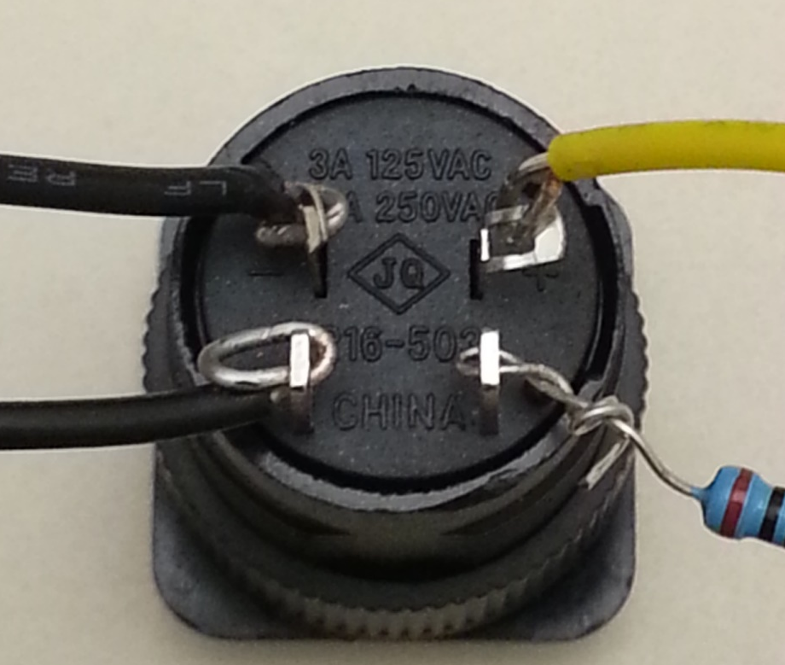
This shows both the LED and the button connected

Slide 59
void setup() { // pin 13 is still the LED inside the button pinMode(13, OUTPUT); // pin 7 is connected to the button // part of the button // tell the Arduino that we want to get // information in from the button pinMode(7, INPUT_PULLUP); }

Slide 60
void loop() { // check if the pushbutton is pressed. // if it is pushed, then the electricity // is LOW: if (digitalRead(7) == LOW) { // the sequence starts here: digitalWrite(13, HIGH); // turn 13 on delay(1000); digitalWrite(13, LOW); // turn 13 off delay(1000); digitalWrite(13, HIGH); // turn 13 on delay(1000); digitalWrite(13, LOW); // turn 13 off // remember that we ignore the button // until the sequence ends } }

Slide 61
Next techno-steps

Slide 62
Where to get the hardware?
Arduino is "open source hardware"
Plans for making them are freely available
➔ several different vendors all make Arduinos/Arduino-compatible stuff
I'm not recommending anything specific
These are just examples
AdaFruit.com
SparkFun.com
others I'm sure

Slide 63
Where to get the hardware?
Arduino category on AdaFruit: http://www.adafruit.com/category/17
I *think* this is close to what you're working with:
http://www.adafruit.com/product/50
This is ONLY the Arduino – not the LEDs, resistors, tools, USB cable, power cable, etc, etc
You can get kits (these are a good place to start)
SparkFun Inventor's Kit for Arduino - V3.1 https://www.sparkfun.com/products/12001

Slide 64
If you liked the programming
BIT 115:
Introduction to programmers...
for nonmajors...
...who have never programmed before.
Good orientation to programming even if you never do this professionally
Good to understand how this works
Good in case you work with software engineers later
DOES transfer to UW as UW 1xx
It's NOT "grey area" / restricted elective
Offered every quarter, including summer

