Slide 1
Making Art With Technology
Mike Panitz and Chris Gildow
Notes:
Hi, I'm Mike Panitz

Slide 2
Goal
We're going to use a small, cheap computer to make lights flash!
Then you're going to add this into your art, somehow!
Learn just enough about
electricity,
electronics,
and programming
to do something interesting
Notes:
NOTE: There will be no equations, and only intuitive numbers

Slide 3
Disclaimer
We're going to be using very low-power electrical devices that are designed to be safe
Do NOT attempt to rewire your home electrical system unless you have the proper training!!
This class NOT provide the proper training!
Do NOT mess with the electrical plugs in the walls of your home!!!!

Slide 4
Credits
Much thanks to Andy Davidson, who provided some of the slides

Slide 5
Divide up into pairs
Teams of 2 people, please

Slide 6
Setting Things Up

Slide 7
Get the laptop online
Login
Make sure to type .\student exactly, including the .\
Make sure that the hardware switch on the side shows you green
Log into the wireless network

Slide 8
Get the software for your own computer
Go to: http://arduino.cc/en/main/software
Download the right software for your computer (Windows, Mac, etc)
The software is free (open source)

Slide 9
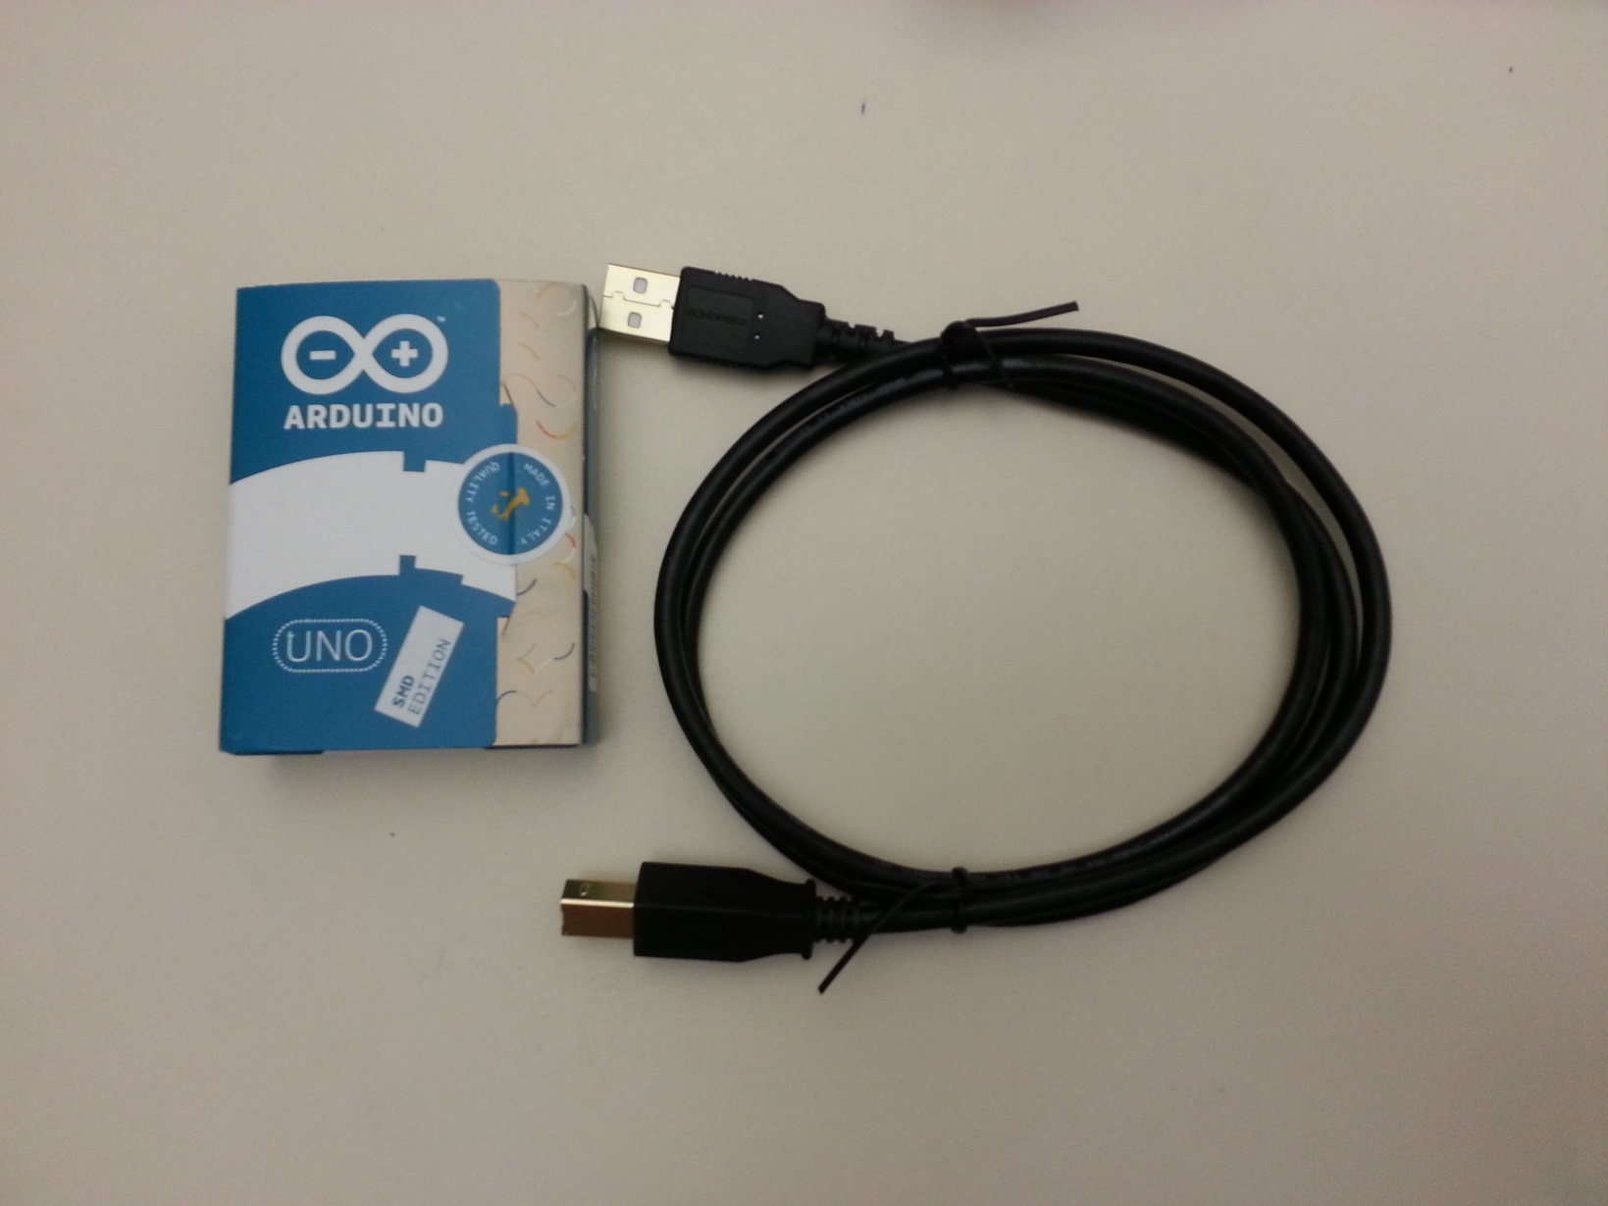
Get the Arduino & USB cable out of the bag

Slide 10
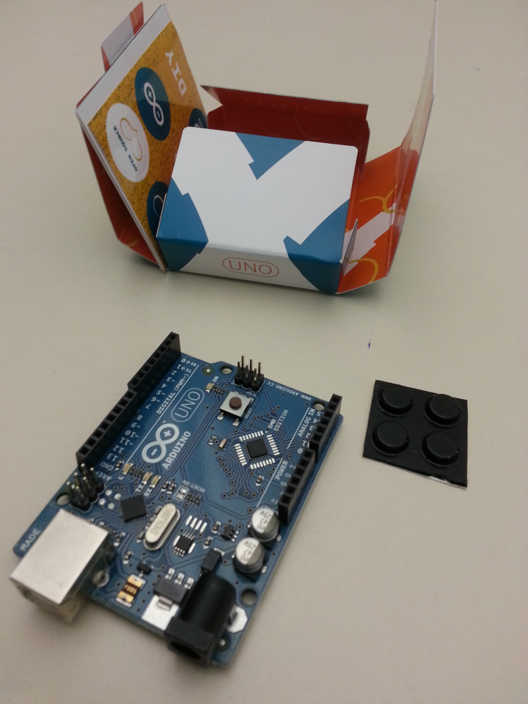
Get Arduino out of box
You can peel off those rubber 'feet' and put them on the bottom of the Arduino
(The picture shows the top of the Arduino – put the feet on the side you can't see)

Slide 11
Plug Arduino into computer

Slide 12
Plug the Arduino into the computer
Windows should auto-detect

Slide 13
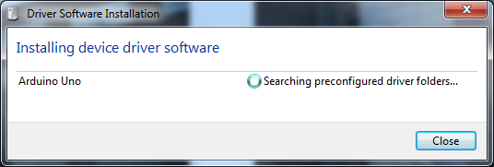
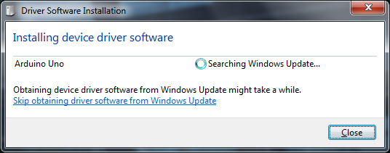
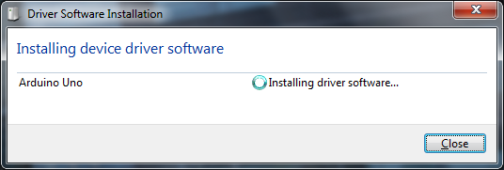
Install the device driver
This will take ≤ 5 minutes

Slide 14
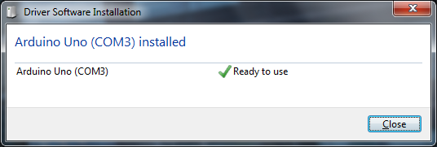
Install the device driver
Eventually it'll finish
Notice the number after COM!!
In this case, COM3.
It's ok if you forget that number just remember that there's a number there ☺

Slide 15
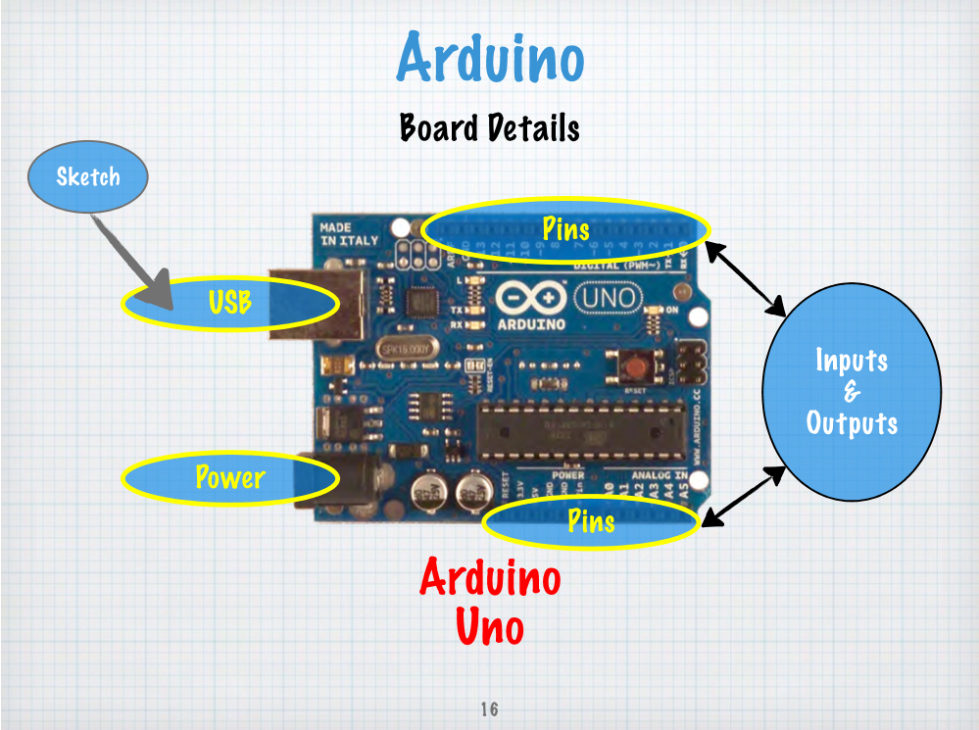
Computer's Brain
Notes:
Important: There's a lot of stuff on the board, but you can ignore everything except what's listed above

Slide 18
Your First Arduino Sketch (Program)

Slide 19
Start the Arduino Editor Program
Either Start →All Programs →Arduino:
Or else Start, type "Arduino"

Slide 20
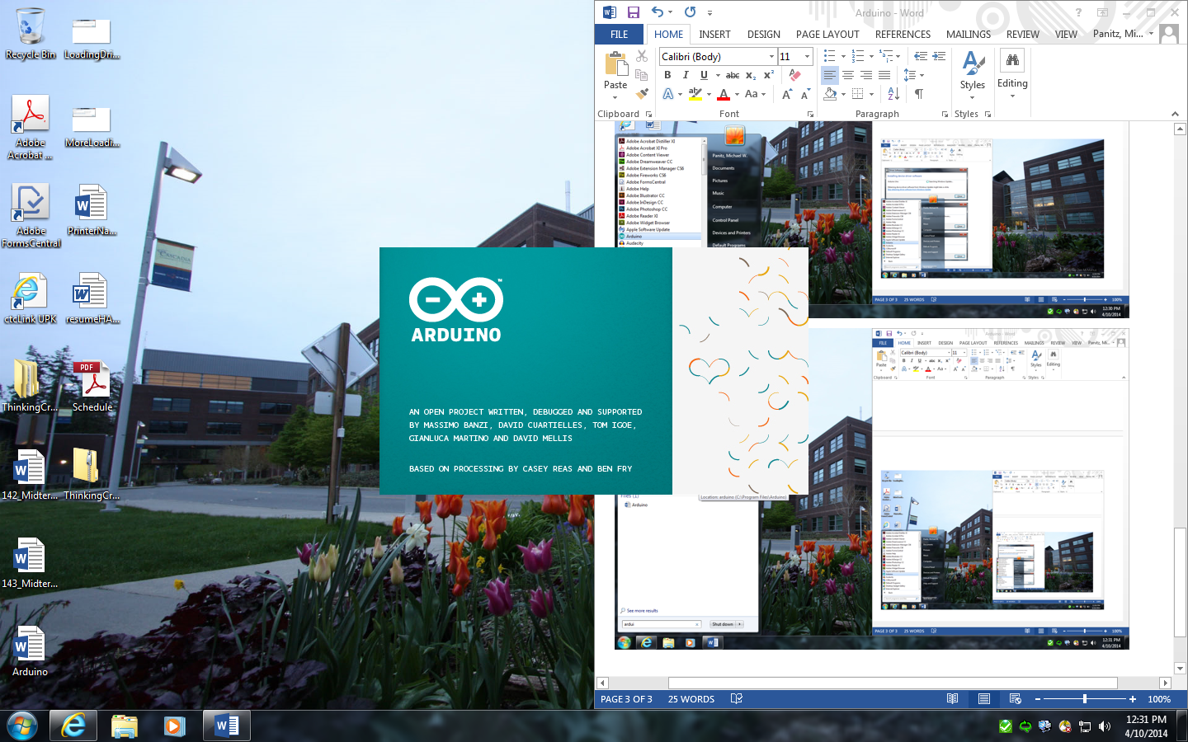
You'll see the splash screen...

Slide 21
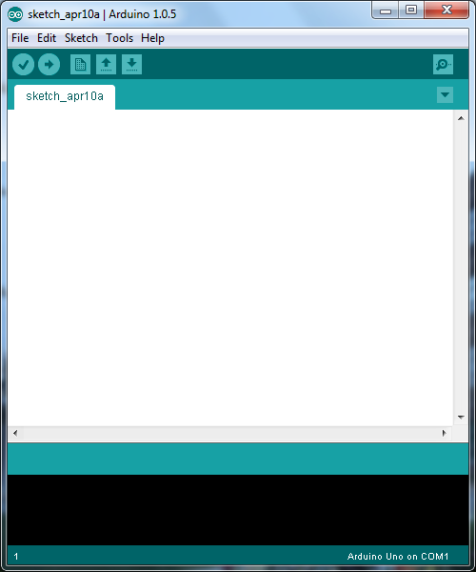
...then the editor

Slide 22
Open the ‘Blink’ example:

Slide 23
(Now you’ll see TWO windows)

Slide 24
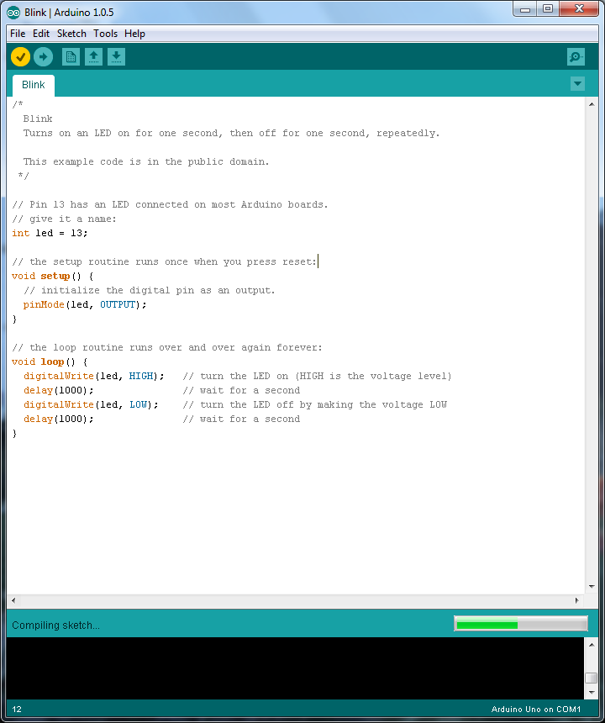
Super Quick Program Overview

Slide 25
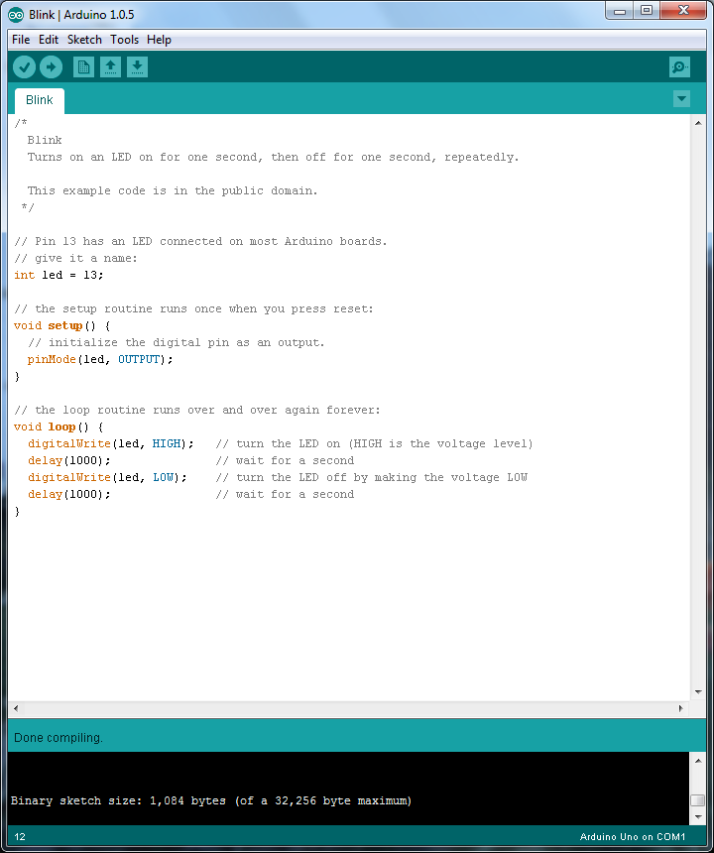
Verify
Click on the check mark:
Then see if there are any errors at the bottom
This means it went ok!

Slide 26
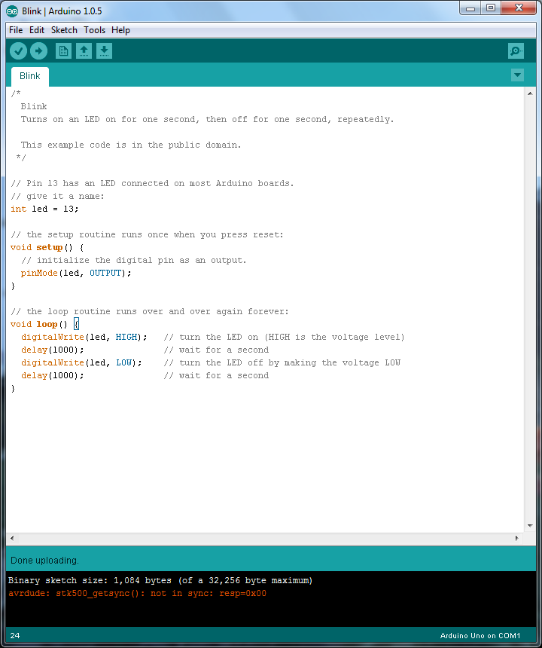
Upload
Click on the arrow
Then see if there are any errors at the bottom
Orange text means something went wrong!!

Slide 27
Use COM3, not COM1
Arduino defaults to COM1, not COM3
Tell it to use COM3

Slide 28
Success!
And now the Arduino now blinks ☺

Slide 29
Tweak the program
void loop() { digitalWrite(led, HIGH); delay(1000); digitalWrite(led, LOW); delay(100); digitalWrite(led, HIGH); delay(100); digitalWrite(led, LOW); delay(100); digitalWrite(led, HIGH); delay(100); }
/* Blink Turns on an LED on for one second, then off for one second, repeatedly. This example code is in the public domain. */ // Pin 13 has an LED connected on most Arduino boards. // give it a name: int led = 13; // the setup routine runs once when you press reset: void setup() { // initialize the digital pin as an output. pinMode(led, OUTPUT); } // the loop routine runs over and over again forever: //void loop() { // digitalWrite(led, HIGH); // turn the LED on (HIGH is the voltage level) // delay(1000); // wait for a second // digitalWrite(led, LOW); // turn the LED off by making the voltage LOW // delay(1000); // wait for a second //} // the loop routine runs over and over again forever: void loop() { digitalWrite(led, HIGH); // turn the LED on (HIGH is the voltage level) delay(1000); // wait for a second digitalWrite(led, LOW); // turn the LED off by making the voltage LOW delay(100); // wait for a tenth of a second digitalWrite(led, HIGH); delay(100); digitalWrite(led, LOW); delay(100); digitalWrite(led, HIGH); delay(100); }
Replace the 'loop' function with this one
Arduino should now have a long blink, then two short blinks
Notes:
Let’s change the program a bit just to make sure that we can get this to work (i.e., it’s not a default program that the Arduino already has on it)

Slide 30
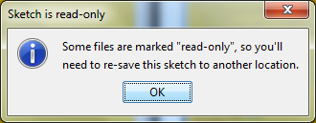
Save Your Work
THE EXAMPLE IS READ-ONLY, so you’ll need to save a copy of your work into a new file
The normal Control+S, or the menu item:
Then say 'Ok':
Pick a name like ‘MyBlink’. Put it wherever you want (a folder on the desktop would be great)

Slide 31
SAVE YOUR WORK!!!
MAKE SURE TO SAVE THESE FILES BEFORE YOU LEAVE TODAY!!!!!
EMAIL YOURSELF A COPY!!!!
PUT IN YOUR GOOGLE DRIVE / MICROSOFT ONEDRIVE / DROPBOX /ETC!!!!
I think that the files will be auto-deleted when you log out

Slide 32
Exercise: Change duration
Change the duration of time that the light is on
Change the duration of time that the light is off

Slide 33
Wiring up a single LED circuit

Slide 34
Wiring up a single LED circuit
Electricity 'flows' like water
A wire needs to go from a 'pin', out to the LED, then back to 'ground'

Slide 35
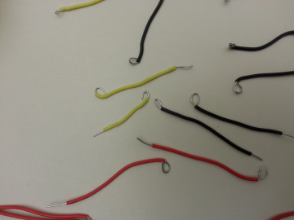
Grab 2 'pigtail' wires
Color doesn't matter – choose whichever you like

Slide 36
Plug a wire into pin 13

Slide 37
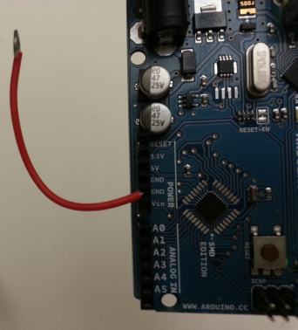
Plug a wire into GND

Slide 38
Do Not Connect Wires To Each Other
DO NOT LET THE BARE METAL WIRES TOUCH!!!!!
If you do you'll destroy your Arduino
We don't have extras, so be careful!!!
It's ok for the insulated parts of the wire to touch
Insulated = rubber/plastic coated parts

Slide 39
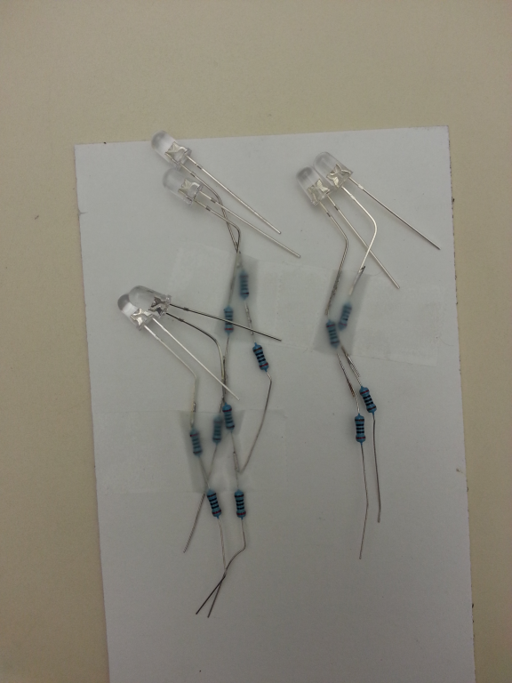
Pick an LED to use
Bags of LEDs:
white
green
blue
others
Try them out and see which one is which ☺

Slide 40
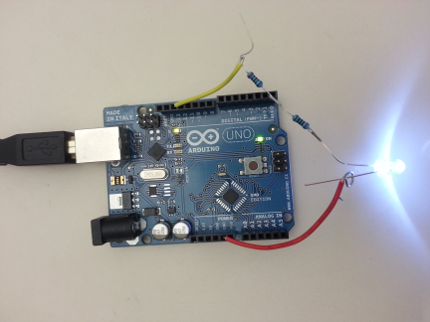
Attach LED WITH RESISTOR
The leg with the resistors goes to pin 13
Note: if you get it backwards it will not break...
...but it won't light up, either

Slide 41
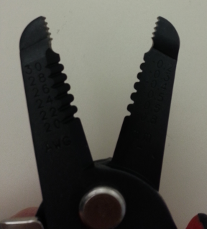
Attach LED WITH RESISTOR
You can bend the wires from the resistors / LED...
... but they will break if you bend them too much!
Try bending the very end
(So if/when it breaks off you've still got the rest)
The end of your wire strippers are actually pliers

Slide 42
Attach LED with long wires
There are two boxes of wire, and each group has a pair of wire strippers

Slide 43
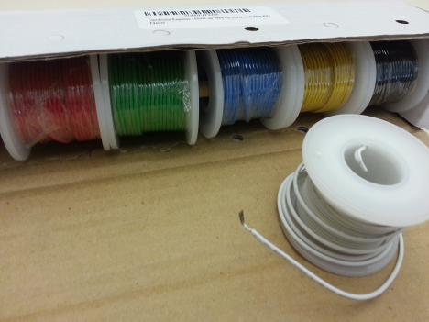
Attach LED with long wires
Each box contains several spools of wire
You can (and should!) remove the spools from the box

Slide 44
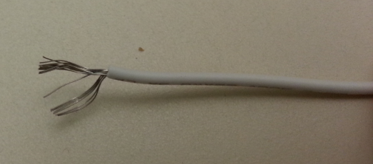
Why two types of wire?
Wires in the box are braided (see below)
Pigtail wires are solid-core
Braided are easier to twisty-tie with your fingers, but very hard to plug into the Arduino pins

Slide 45
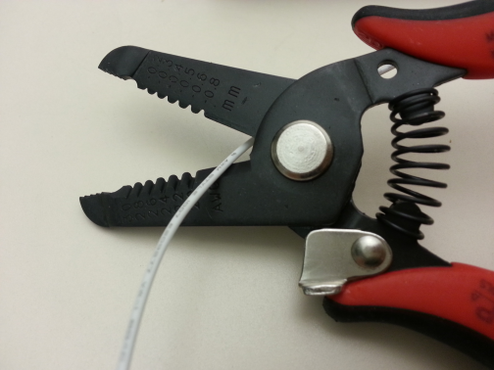
Base of strippers = scissors
Place wire here to cut it
NOTE: The wire spools need to last us for four (4) class sessions!!

Slide 46
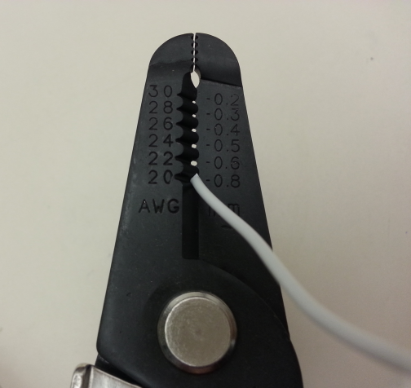
Use 20 gauge to strip plastic insulation

Slide 47
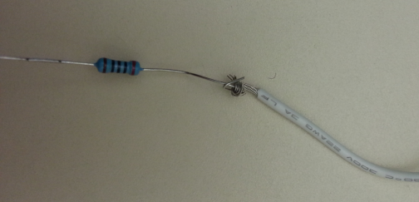
Tie braided wires to pigtail,LED

Slide 48
Another wire for other side
Success!

Slide 49
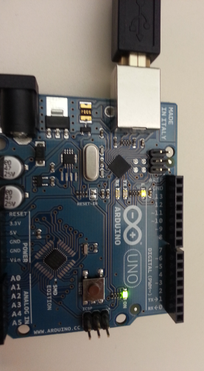
Troubleshooting Tips
USB cable plugged in?
Computer→USB→Arduino
Is the Arduino green 'on' light on?
Is the Arduino orange 'pin 13' light blinking?
Are the pigtails securely stuffed into the pins?
Are the braided wires tied onto pigtails well?
Are braided wires tied onto LED well?
LED: Resistors connect to pin 13 wire, NOT to GND wire
Try turning the LED around – doesn't hurt if it's wrong ☺
If this LED doesn't work, ask the teacher
You could try another, but if you accidentally blew out an LED you don't want to destroy another ☺

Slide 50
Exercise: Change the pin
Let's use pin 8
It's physically far away from pin 13
Thus, it's easy to see that the wire has moved
Remember to change the program, too!
int led =13; should be changed to int led = 8;
The orange light on the Arduino itself only blinks when pin 13 blinks...
...so changing to pin 8 will mean that the Arduino's orange light stops blinking

Slide 51
Multiple LEDs in a line ("in series") on a single circuit

Slide 52
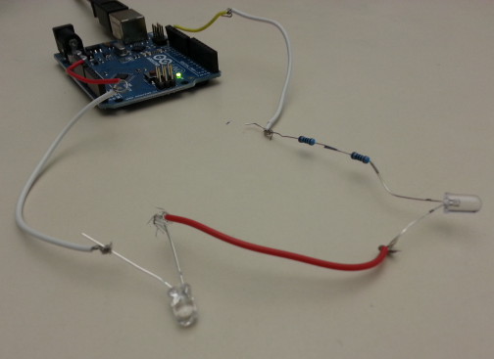
Add a second LED to the wire
Add a wire that goes from LED to second LED
You'll need a 'bare' LED (no resistor)

Slide 53
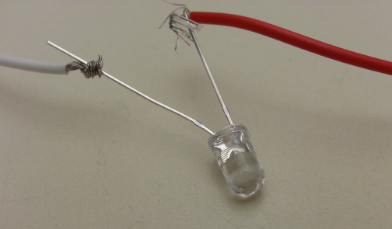
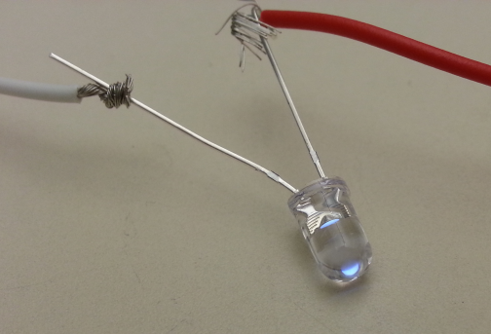
BUT – 2 white LEDs don't light ☹
Off
"On"

Slide 54
Problem: 5 volt circuit
Each white LED needs 3.5 volts
3.5 + 3.5 > 5 ☹
Full list: http://en.wikipedia.org/wiki/Light-emitting_diode#Colors_and_materials
Red 1.63 < ΔV < 2.03
Orange 2.03 < ΔV < 2.10
Green 1.9 < ΔV < 4.0
Blue 2.48 < ΔV < 3.7
Violet 2.76 < ΔV < 4.0

Slide 55
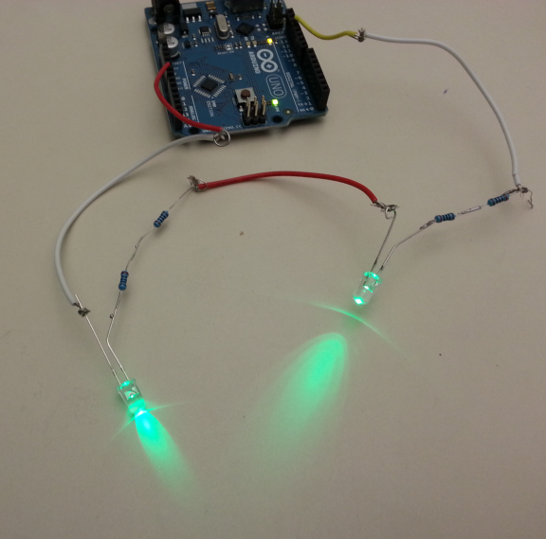
Try again with green
Success!

Slide 56
Multiple LEDs in Series Summary
Multiple LEDs may or may not work
Too many won't damage them
You'll probably only get 2 on a circuit, at most
All LEDs will turn on / off at the same time
Try this out and see what you get
Remember to use the bare LEDs!

Slide 57
Multiple LEDs in parallel on a single circuit

Slide 58
CAN light up in parallel

Slide 59
Rules are different in parallel
Voltage is the same for each LED
voltage = "how much electricity wants to move"
water analogy: kinda like water pressure
Current is added together
current = "how much electricity"
water analogy: volume of water per second
ONLY PUT TWO LEDs TOGETHER ON A CIRCUIT!!
More than this will overload / burn out the Arduino

Slide 60
Multiple circuits
(Each can have 2 LEDs in series or in parallel)

Slide 61
ONLY PUT <= 18 LEDs ON AN ARDUINO
More than this will overload / burn out the Arduino
Remember that you're still only allowed 2 LEDs per circuit, in addition to the overall 18 LED limit
Ran out of time for detailed slides, sorry! ☹

Slide 62
Programming

Slide 63
Programming (by copy and paste)
Copy the lines you're interested in
Make sure to paste INSIDE the loop function
Inside means:
after the opening {
before the closing }
Adjust the number in the delay function
number = milliseconds to delay
1000 milliseconds = 1 second
void loop() {
digitalWrite(led, HIGH); delay(1000);
digitalWrite(led, LOW); delay(100);
}

Slide 64
Details Must Be Exactly Right
Capitalization matters – write out names EXACTLY
digitalWrite, delay, led, HIGH are good
DigitialWrite, digitalwrite, Delay, high are bad!
No comma in numbers ( 1000 instead of 1,000)
DO separate led and HIGH using a comma ,
Match the open and close parentheses ()
Don't forget the semi-colon ( ; )
void loop() {
digitalWrite(led, HIGH); delay(1000);
...

Slide 65
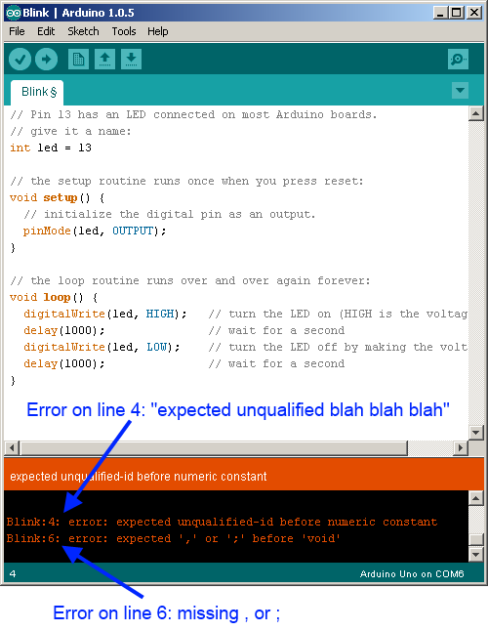
Debugging
If the program has verification errors, then start by getting the line number
Go to that line
Start at the top and count as you move down
Can anyone find a better way?

Slide 66
Error Messages
Line # is where the Arduino got confused
May or MAY NOT be the actual cause of the error
You'll need to figure out what the correct thing to do is
Your job: Get the 'gist' of the error message
Don't worry about the fact that it doesn't make a lot of sense
It may not make any sense

Slide 67
Strategies for debugging
Compare your program to working program
File→Examples→Basics→Blink, etc
Neighbors' programs
Get multiple people to look at it
Everyone in your group
People in neighboring groups
Instructors

Slide 68
Strategies for debugging
Remove problem lines by commenting, not deleting: // Comments start with //, everything on // that line after the // is ignored by // the Arduino
Examples:
int led; // this variable stores the PIN #
// int led // why doesn't this work?

Slide 69
Next steps

Slide 70
Info for future activities
You can Google around for tutorials on how to do many of the things you'll want to do
If you're interested in doing electronics stuff (blinken lights, sounds, sensors, etc) you'll probably need to learn some electronics (at some point)
"Make: Electronics" is a great, hands-on book to teach you the basics

Slide 71
Where to get the hardware?
Arduino is "open source hardware"
Plans for making them are freely available
➔ several different vendors all make Arduinos/Arduino-compatible stuff
I'm not recommending anything specific
These are just examples
AdaFruit.com
SparkFun.com
others I'm sure

Slide 72
Where to get the hardware?
Arduino category on AdaFruit: http://www.adafruit.com/category/17
I *think* this is close to what you're working with:
http://www.adafruit.com/product/50
This is ONLY the Arduino – not the LEDs, resistors, tools, USB cable, power cable, etc, etc
You can get kits (these are a good place to start)
SparkFun Inventor's Kit for Arduino - V3.1 https://www.sparkfun.com/products/12001

Slide 73
If you liked the programming
BIT 115:
Introduction to programmers...
for nonmajors...
...who have never programmed before.
Good orientation to programming even if you never do this professionally
Good to understand how this works
Good in case you work with coders later
DOES transfer to UW as UW 1xx
It's NOT "grey area" / restricted elective
Offered every quarter, including summer

Slide 74
TODO
Probably about 2 LEDs in series
Use 'bare' LEDs for the second+ ones
Could use more in parallel (voltage will be the same) but Adruino is limited to 40 mA (and each LED requires 20 mA to work)
So tell them to connect no more than 2 LEDs per circuit (all circuits can go to the same Ground)

