Slide 1
BIT 286: (Web) Application Programming
Lecture 07: Tuesday, January 27, 2015
Git

Slide 2
Adminis-trivia
Looks like all 3 groups have finished the ‘Team Formation’ activity
I haven’t gotten the ‘Statement Of Needs’ yet
I’ll write that tomorrow
Please create accounts in StudentTracker and sign up for BIT 286
(this is how I’ll show you your grades)

Slide 3
Coding In A Group: Best Practices
What’s in the repository always works
Modulo bugs, of course
Do test while developing
So you’ll check in a completed feature and the tests for it
This might mean checking in a document with a checklist to manually verify
Do NOT develop the code and then go back for a 'QA' phase!!
These are required for this class!

Slide 4
What is version control? (and what's up with git?)
Version control: Persistent, global undo
Shared amongst people
(Once you’ve got the ‘undo history’ saved on the disk, you can share it with others)
Helps to coordinate work
Automatically flags conflicts for you to resolve

Slide 5
What is version control? (and what's up with git?)
Git was created by Linus Torvalds (of Linux fame)
Git was made to be decentralized
Each person has their own, individual copy of the entire project
Each person can work independently and then merge their work back together, easily
Let's look at pictures!
http://git-scm.com/book/en/v2/Getting-Started-About-Version-Control
http://git-scm.com/book/en/v2/Getting-Started-Git-Basics#The-Three-States
Notes:
create rep
add stuff
commit
change, commit
push back to BitHub

Slide 6
Starting Out
Getting set up with GitHub.com
Getting set up with Elegit
Creating a repo locally
Adding a file to the local repo
Push the changes back to GitHub.com

Slide 7
Starting out
Today let’s use Elegit - http://elegit.org/
If you need a 32 bit version (to run on the school computers, go to http://faculty.cascadia.edu/mpanitz/Downloads/Elegit.zip
Download, extract/install, and then run it
Elegit has built-in code to interact with GitHub, BitBucket, etc, so you don’t need to install Git separately.
We’re going to look at GitHub.com, but you can go to BitBucket.com, or Microsoft’s git servers, etc
Each website has it's own directions (they should all be pretty similar)
From Intro To Git For Web Designers

Slide 8
Starting out
Each person should create a GitHub account
(If you’ve already got one then just log into that)
Then create a new repo on GitHub
The ‘plus on the top-right corner:
(For right now just make it public)
Copy the URL for the repo

Slide 9
Starting out
GOAL: Add a simple text file
Clone the repo in Elegit
You’ll need the URL from GitHub
(and your GitHub username/password)
Open the folder
Add a simple text file, with a distinctive first message
Example: This is my distinctive first message!

Slide 10
Starting out
Notice that the new file is ‘untracked’
Add the file
Commit the change
Push to the server
Confirm that that changes are in GitHub

Slide 11
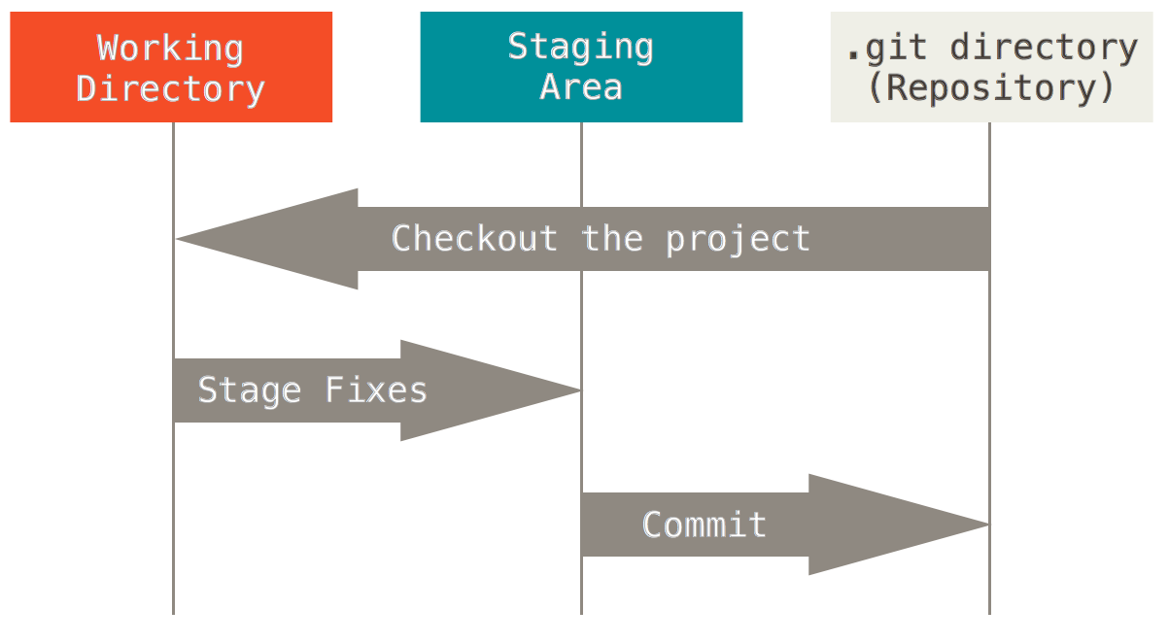
Thinking about your files
The basic Git workflow:
Modify files in the directory.
Stage the files (adds snapshots of files to git's "staging area")
Commit (take staged snapshots & store permanently)
From http://git-scm.com/book/en/v2/Getting-Started-Git-Basics#The-Three-States

Slide 12
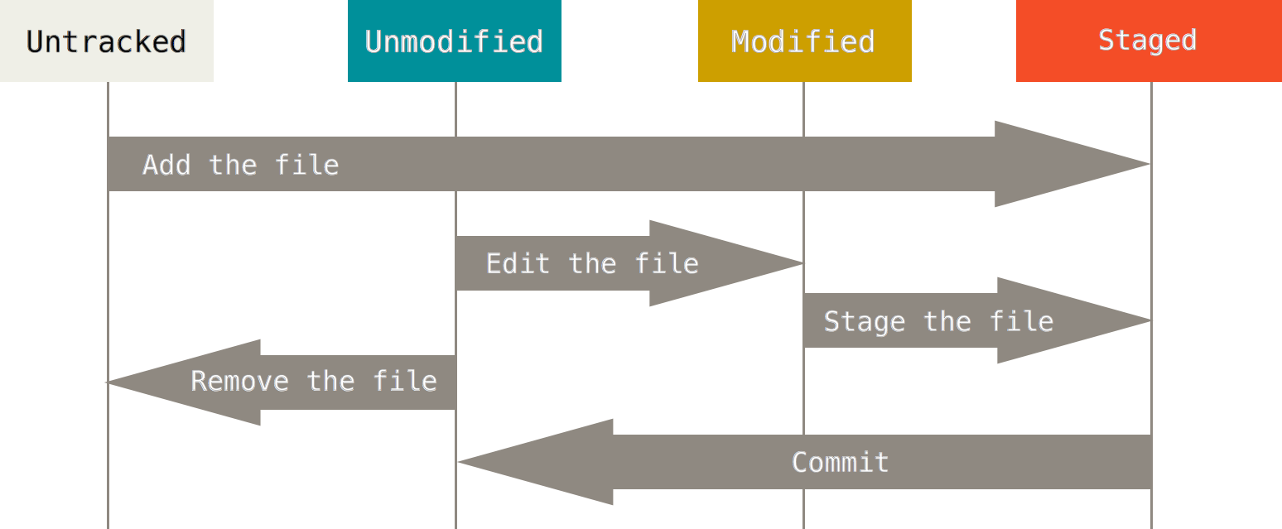
git is ok with files that aren't part of your project
It's worth noting that you can tell git to ignore files
"Project\Views\Something\Index.cshtml"
All .exe files
Etc
These will be left 'untracked', and the GUI won't show them

Slide 13
Typical Individual Workflow
Work on the files
It's easy to discard you changes and roll back to the last thing that you committed
Stage the files (and add any new files)
Commit your changes
This will permanently save your changes into your local copy (and ONLY your local copy).
You need to include a note about what you've done
Git makes it quick & easy to do this, so think about "checking in" as more like "making a quick backup"
The backup has a name & is listed in git's history of your project in case you want to go back to it.
From Intro To Git For Web Designers and http://git-scm.com/book/en/v2/Git-Basics-Recording-Changes-to-the-Repository#Skipping-the-Staging-Area

Slide 14
Typical Individual Workflow
Talk about pull requests (for people outside the group) vs. full commit access (for the “real” members of the group)

Slide 15
Working Jointly On A Shared Repo
Non-conflicting changes

Slide 16
Add collaborators
They’ll get a link to click in an email

Slide 17
Exercise: Independent additions to the repo
Have your collaborator:
download the repo to their computer (using Elegit) – clone it, do NOT fork it
Add a new file
Commit that new change
Push it to the server
(You can do this with their repo while they’re working on yours)
You should then:
Fetch their change
Note that this downloads a copy of the server’s changes but does NOT update your working directory
Then merge the changes into your working directory
“Pull” = fetch then merge
WARNING: If you pull down the most recent copy and it's broken (doesn't compile, or doesn't run correctly) then you'll be stuck until it's fixed (or until you back the changes out – until you undo them).
This is why it's so important that the 'master copy' ALWAYS WORKS

Slide 18
Conflicting Changes
Let’s walk through a merge conflict first
and then you can do this on your own to practice

Slide 19
Exercise: Conflicting additions to the repo
The following will cause a conflict:
You and your collaborator should:
Pull (fetch + merge) the most recent changes
Pick a file and both add a new first line to each copy of that same file
You should add and commit
Collaborator should commit + push to server
You should fetch, then merge
At this point git will warn you that there’s a conflict in that file
You can’t commit until you resolve that conflict
You should select the ‘conflicted’ file and click on ‘Add’
Dialog will appear asking you to fix the conflict
Edit the file in a separate editor (e.g., Visual Studio), then save it. DO NOT OPEN IN NOTEPAD
Click the ‘Add’ button (to close the dialog box), then commit. This will resolve the merge

Slide 20
Exercise: Conflicting additions to the repo
Look at the file that contains the conflict. It’ll look like:
<<<<<<< HEAD MY FIRST LINE ======= CONFLICTING ADDITION! >>>>>>> 672c79e8e9ef582edc24e23ce9619544fd9cface This is my distinctive first message!
MY FIRST LINE
This is my distinctive first message!
CONFLICTING ADDITION! This is my distinctive first message!
My change
Collaborator’s change

Slide 21
Exercise: Conflicting additions to the repo
In order to resolve the conflict:
Look at the changes, and decide what is the right thing to do
This means you need to understand what the code should do
Edit the file to do what you want
Then remove all the <<<,===, >>> stuff
Let’s keep both lines, but put the collaborator’s line first:
CONFLICTING ADDITION! MY FIRST LINE This is my distinctive first message!

Slide 22
More info
http://stackoverflow.com/a/7589612/250610

Slide 23
Owner: Create a repo
Create a team / organization? This will allow them all direct commit access
Git-Flow: Owner: Create branches in the repo – production (main) & dev
Start by reviewing – create your own repo in VS, clone locally, modify & upload?
Create a project
All of the following on one branch:
Collaborator: fork, modify, P.R. Owner: review & accept
Owner: modify, commit (via P.R.?) Collaborator: retrieve changes?
Collaborator & Owner: each make non-conflicting changes to their code Practice having one person commit & PR, then the other
Have several people all make changes & figure out how to resolve the situation
Git-flow will change this – they’ll need to re-get the master branch
Same as #3, except with merge-conflicts
Do 1-4 again, but using different branches
Working independently on unrelated branches
Merging a branch into another branch

Slide 24
Misc.
Commit message must contain the story id that it pertains to
(Update progress doc with link to the commit?)
https://docs.microsoft.com/en-us/vsts/git/tutorial/gitworkflow?view=vsts
How to set up VS? (Esp. the public/private key thing?)
Might useful? https://blogs.msdn.microsoft.com/benjaminperkins/2017/04/04/setting-up-and-using-github-in-visual-studio-2017/

Slide 25
To create from existing solution
First, make sure that the solution file (.SLN file) is in the same folder as all the other files
For my ‘todo’ app the solution file was in the folder ABOVE, and VS committed everything there & below (but VS still only showed me what was in the VS Solution/Project)
https://docs.microsoft.com/en-us/vsts/git/tutorial/creatingrepo?view=vsts&tabs=visual-studio#from-an-existing-solution
In VS 2017, the lower-right button is now called “Add To Source Control” ☺
If you’re using GitHub then you’ll need an empty repo on GitHub.com
Make that using the web UI
Then copy the URL & paste it into the ‘url here’ box that appears
Click ‘publish’
CREDENTIALS?

Slide 26
To clone from GitHub:
View → Team Explorer
Manage Connections panel
Local Git Repos drop-down
Select ‘Clone’

Slide 27
To see / stage changes
‘Home’ panel, then ‘Changes’ option
Within the ‘Changes’ list, click on the ‘+’ to stage all the changes
Under the ‘…’ menu you can switch between Tree View (the default) and List View
To commit (and push/sync):
‘Home’ panel, then ‘Changes’ option
There’s a big yellow box at the top to type your commit message into
Commit message must contain the story id that it pertains to
(Update progress doc with link to the commit?)
Button for ‘Commit Staged’ (local commit), drop-down menu on the button to Commit + Push, or Commit + Sync
NOTE: THIS SHOULD ASK FOR CREDENTIALS, YES?

Slide 28
To retrieve changes from GitHub
‘Home’ panel, then ‘Sync’ option
Under ‘Incoming Commits’ click on ‘Pull’
(Pull = fetch + merge)

Slide 29
Non-conflicting Pull Request
To create pull request
First commit the changes, push them to your fork
On the GitHub, click on ‘new pull request’
OWNER
In the repo (on GitHub), click on ‘Pull Requests’, click on the P.R. that was just submitted
Review changes (comment, approve, or request changes)
Then Commit the merge
Change has now been accepted
OWNER: In V.S. go back and Sync (Pull) the changes

Slide 30
Practice getting non-conflicting changes
Owner: modify, commit (via P.R.?) Collaborator: retrieve changes?
Collaborator & Owner: each make non-conflicting changes to their code Practice having one person commit & PR, then the other
Have several people all make changes & figure out how to resolve the situation
Git-flow will change this – they’ll need to re-get the master branch

Slide 31
Merge w/ merge conflicts
Force a merge conflict
Commit your work locally, then pull the most recent changes from the server(first into your fork on GitHub, then into your PC).
Should notice the merge conflict when you pull the server’s changes
Git will put the conflict markers into your file
Learn to read these
Resolve it by editing your file to remove the markers, then commit
WARNING: VS can mess with random files, sometimes introducing merge conficts
https://docs.microsoft.com/en-us/vsts/git/tutorial/merging?view=vsts&tabs=visual-studio

