Slide 1
Academic Misconduct and Plagiarism

Slide 2
Goals
Make sure you’re clear on what academic misconduct (including plagiarism) is
(NOTE: There may be ways to plagiarize that I don’t list here – you’re still not allowed to do it)
Get ready for a job where you’ll need to do new, novel, work competently on your own

Slide 3
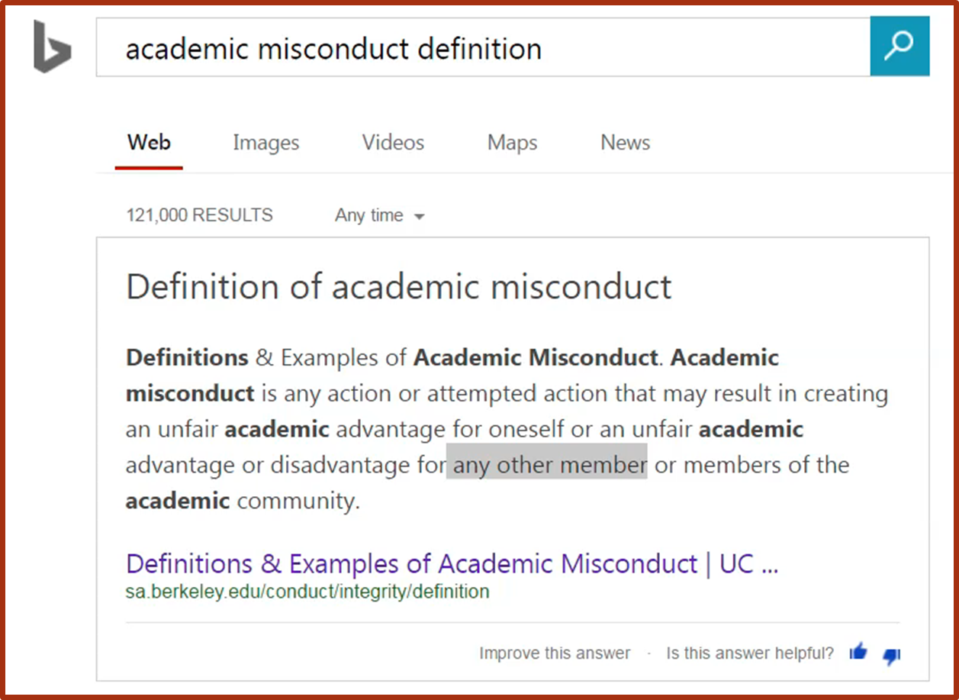
Academic Misconduct

Slide 4
What is plagiarism?
Using someone else’s work as your own…. … in a way that prevents you from learning this as well as you can.

Slide 5
Examples
These are all listed in the syllabus
Search for (Control+F) something like
plagiarism
Academic Dishonesty
Academic Misconduct

Slide 6
Examples
Taking the work of someone else (including other students) and turning it in as your own.
Giving your work to another student to turn in as their own.

Slide 7
Examples
Getting information about an exam from another student.
Giving information about an exam to another student.

Slide 8
Examples
Copying code off the Internet and turning it in as your own.
Getting someone else to write your homework for you. This includes paying someone else to write your homework for you.

Slide 9
Examples
If two or more homeworks or exams are found to be suspiciously similar, the burden of proof rests upon the students who submitted the work.

